Slide 1
SMUD Transportation Electrification
Sacramento Clean Cities Coalition
January 30, 2020

Slide 2
Transportation Electrification
New Integrated Resource Plan
Recently completed fleet EV pilot projects
Site visits for fleet EV charging
Planning for EV Charging As A Service
SMUD Incentives for EVs and Charging

Slide 3
New Integrated Resource Plan
SMUD newly adopted Integrated Resource Plan (IRP) designed to be net carbon neutral by 2040, which will require more:
  PV and wind generation
  Distributed energy resources (no longer central station generation model only)
  Transportation electrification
  Building electrification

Slide 4
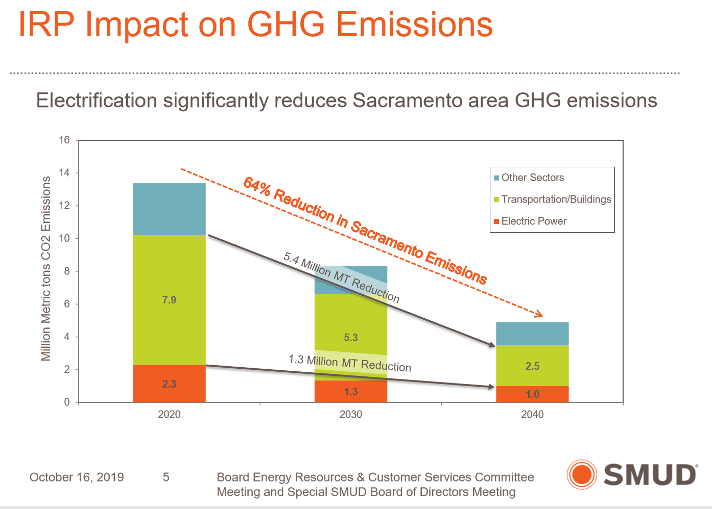

Slide 5
2 Recently Completed EV Pilots
Electric Vehicle Suitability Assessment Pilot
  5 participants,
  104 data loggers provided for free
  Total Cost of Ownership analysis for participants
  Which, if any, EVs would have a lower cost of ownership

Slide 6
2 Recently Completed EV Pilots
EV Charging Strategies Pilot
  Purpose: How to reduce the installed cost of EVSE
  Tested 3 different charge management systems that allow for more EV charging from an existing electrical panel with limited capacity
    Power-sharing EVSE (Clipper Creek)
    Rotational charging for EVSE (Cyber Switching)
    Cloud controlled virtual panel sharing EVSE (eMotorWerks aka EnelX)

Slide 7
EV Charging Site Visits for Fleet Customers
Provide input on how to approach EV charging at your site to accomplish your EV procurement and charging goals
Available on a limited basis
This type of advisory service may be incorporated into future SMUD programs for fleet EV charging
If interested, leave your card and write “site visit”

Slide 8
Planning for EV Charging As A Service
The installation of EV Charging is an often cited barrier to EV adoption
  It can be complicated and expensive
The high upfront capital cost may “appear” prohibitive, even if the life cycle cost of electricity as a fuel is cheaper than gas or diesel fuel
How to amortize this cost over the life of the EV?

Slide 9
SMUD EV Incentives
Commercial EV Charging
  $1,500 per charging station (per handle)
Commercial EV Fleet
  From $750 for light duty EVs up to $15,000 for heavy duty EVs
  Forklifts: $2000 per lift truck for the user
    $1000 per lift truck for vendor

Slide 10
Thank You!!
Dwight MacCurdy
Dwight.Maccurdy@smud.org
916-732-5471
Jillian Rich
Jillian.Rich@smud.org
916-732-6454
Brent Sloan
Brent.Sloan@smud.org
916/732-7373

