Slide 1
TransPower - Peterbilt
CEC Funded P520EV-ASL Overview
Joshua Goldman

Slide 2








Heavy Duty Electric Refuse Trucks
(HDERT)
1
CEC Project Overview:
  Demonstrate up to 3 Electrically Powered Vehicles in Refuse Applications using TransPower’s ElecTruck™ Battery-Electric Drive System In a Peterbilt 520 Truck.

Slide 3

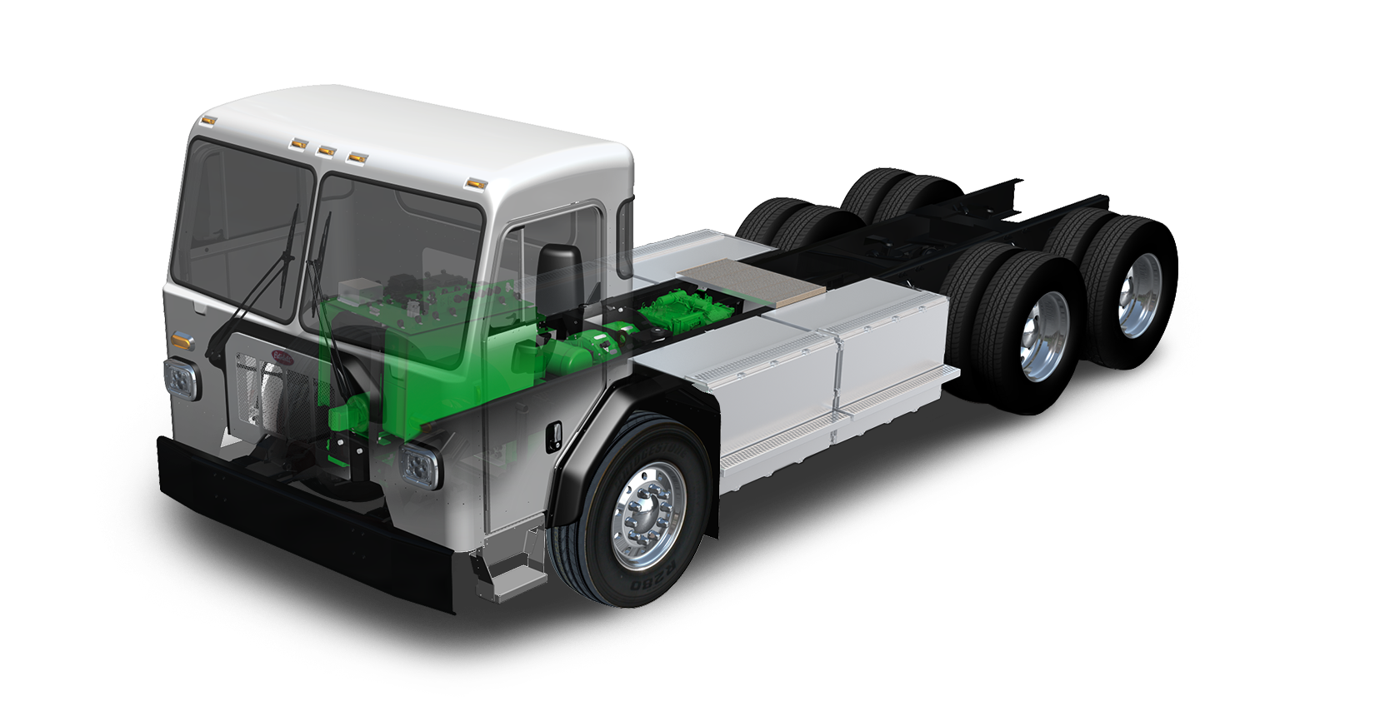
1
HDERT Demonstration Vehicle
520 Features
3
2
Electric Powertrain Specs
Specifications
Touch a Number Button
For More Information

Slide 4
TransPower Electric Powertrain Specs
Zero Emissions
Motor Power Ratings: 370 kW (~495 HP); 60 kW ePTO
Batteries: Lithium Nickel Manganese Cobalt (Nissan)
Battery Storage: 308 kWh NMC,
Estimated Operating Range: 45-65 miles, 6-8 hours
Recharge Time (Onboard Charger): 4 Hours

Slide 5
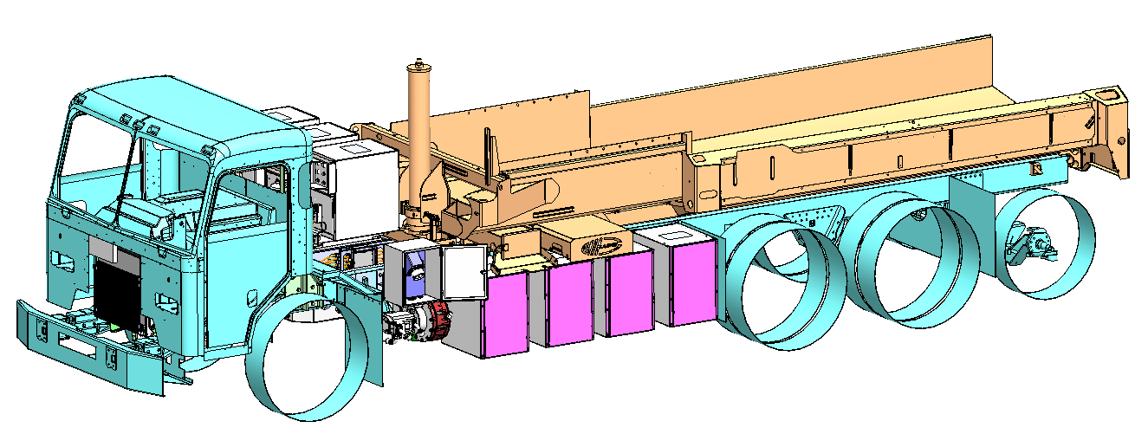
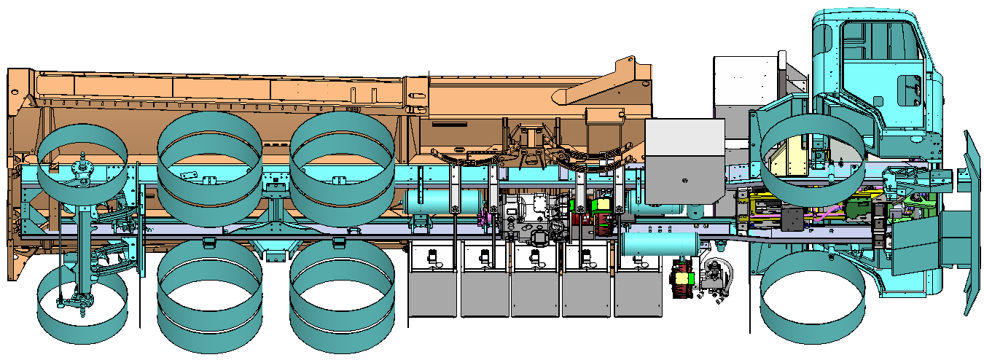
Current Refuse Truck Design
Charge port
Nissan Leaf NMC Battery Storage (308 kWh)
Dual 150 KW electric motor w/10-speed transmission
Integrated controls

Slide 6
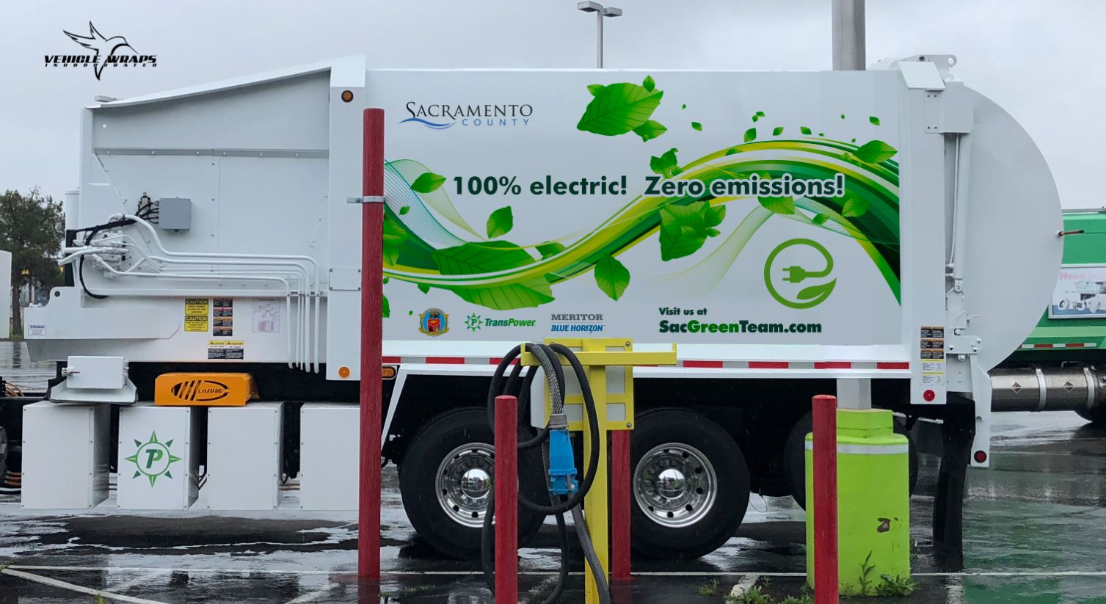
First CEC-Funded Refuse Truck

Slide 7
Planned Upgrades to Current System
Battery Subsystem – replace Nissan Leaf NMC batteries with CATL LFP batteries
  Liquid-cooled
  Longer cycle life
  Lower cost
  Battery manufacturer warranty
Electric architecture
  Increase main bus voltage from 400V to 600-650 V (more efficient)
  Switch from 70 kW onboard AC charging to 150 kW offboard fast DC charging
  Faster charging
  Standardized equipment
  Lower cost drive system
Other potential upgrades
  Higher power drive motors
  All-electric refuse body

Slide 8
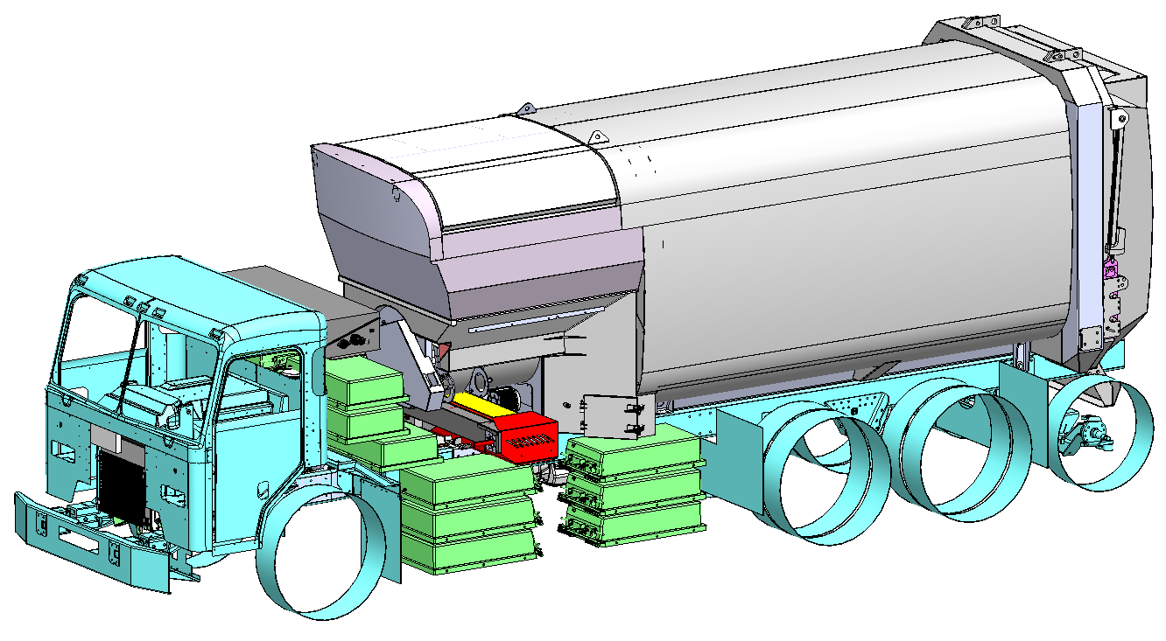
Next-Generation Refuse Truck Design
CATL LFP Battery Storage (424 kWh)
Standardized DC fast charge port

