Slide 1
ZEV Transition Planning Case Study
David Renschler, CPFP
Fleet Division Manager
City of Fairfield, California
DRENSCHLER@Fairfield.ca.gov

Slide 2
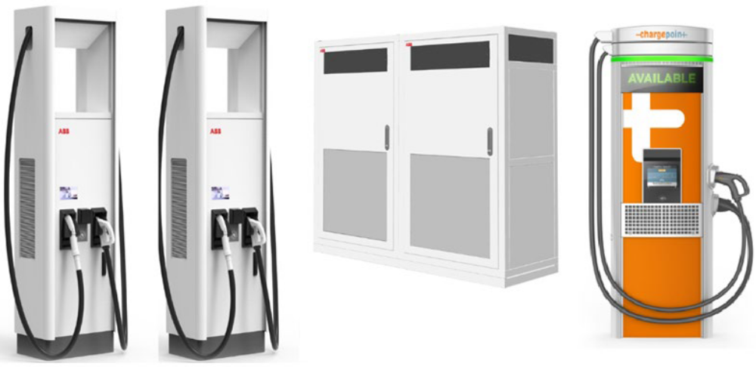
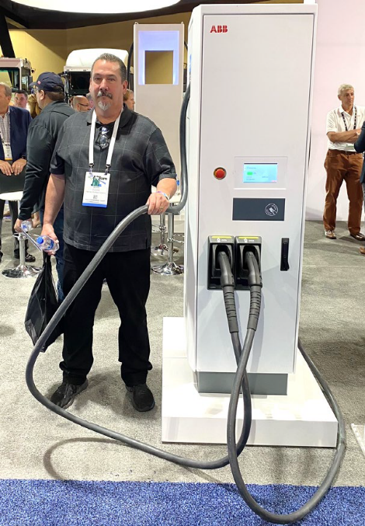
Electric Vehicle Charging Equipment
The higher the required kWh capacity, the larger charging stations overall design. Some charging stations require liquid cooled cords to support high voltage and amperage designs.

Slide 3
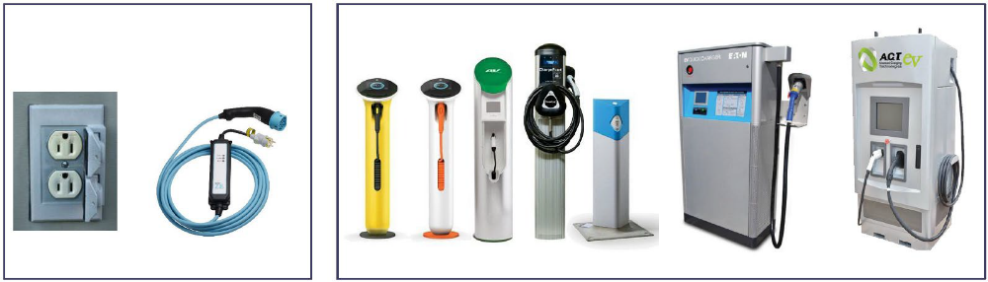
Electric Vehicle Charging Equipment
“Dumb” Equipment “Smart” Equipment
Port Cable Size is Important: Vehicle Voltage x Cable Amperage = Maximum kW

Slide 4
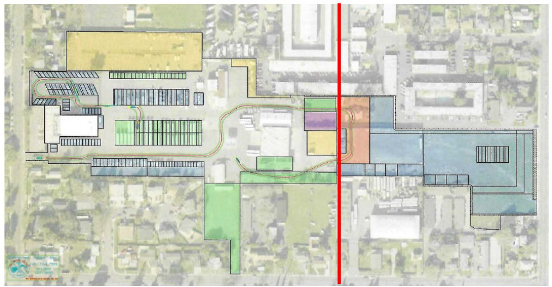
Infrastructure Planning
Current Corporation Yard Necessary Expansion
Once You Know The Type, Voltage, and Amperage Requirements of Needed Charging
Stations, Determine Where The Infrastructure Will Be Best Suited to Be Installed

Slide 5
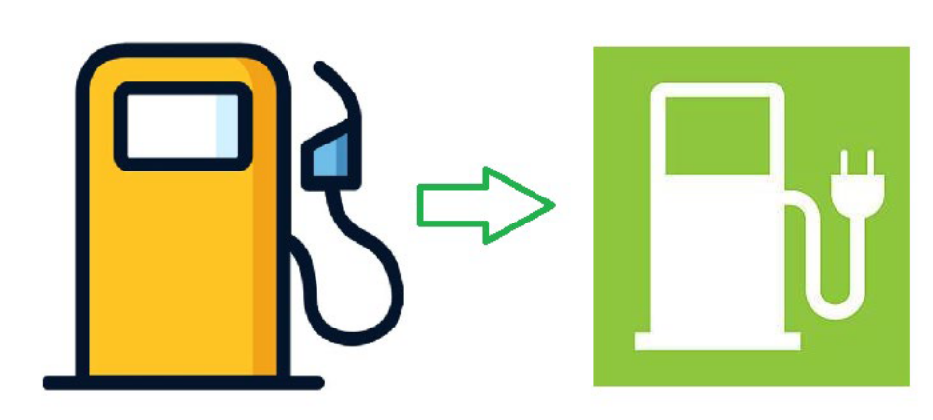
Cost Recovery
Facilities Absorb Cost of Electricity as a Fuel
Billing Customers for Electricity as a Fuel
Connected Smart Electric Vehicle Supply Equipment (EVSE)
FMIS Software Integration or Charging Station Software
CARB Low Carbon Fuel Standard (LCFS) Credit Generation and Sales

Slide 6
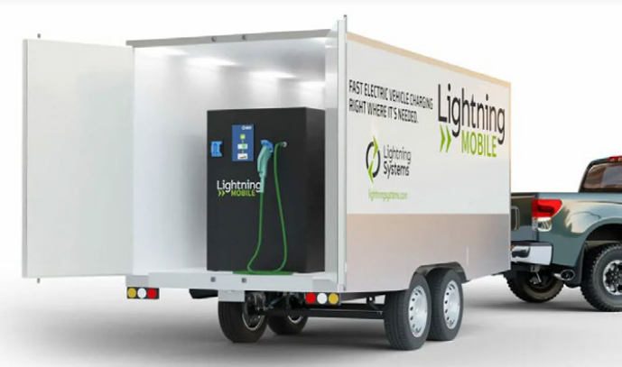
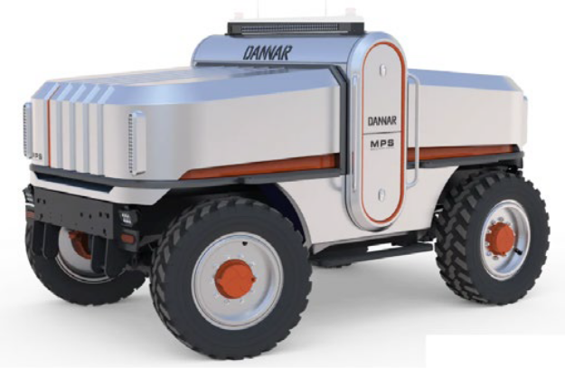
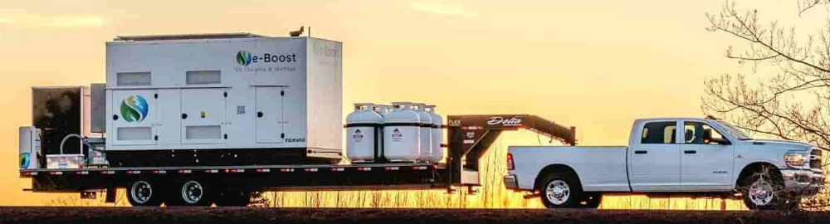
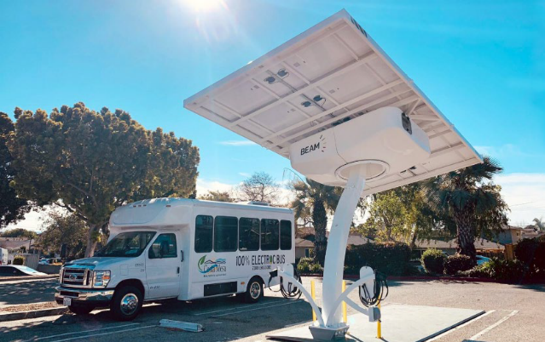
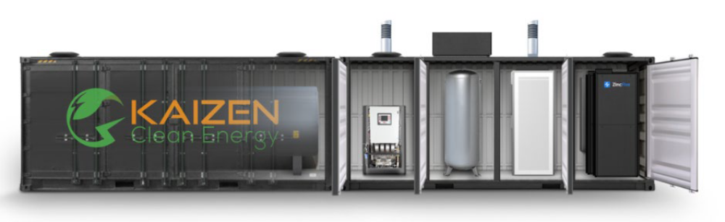
Challenges – Temporary Charging & Back Up Power
Propane Powered Generator Charging Station
Battery Trailer Charging Station
Mobile Onsite charging
Hydrogen Fuel Cell Generator Microgrid Charging Station
Solar Powered Charging Station

Slide 7
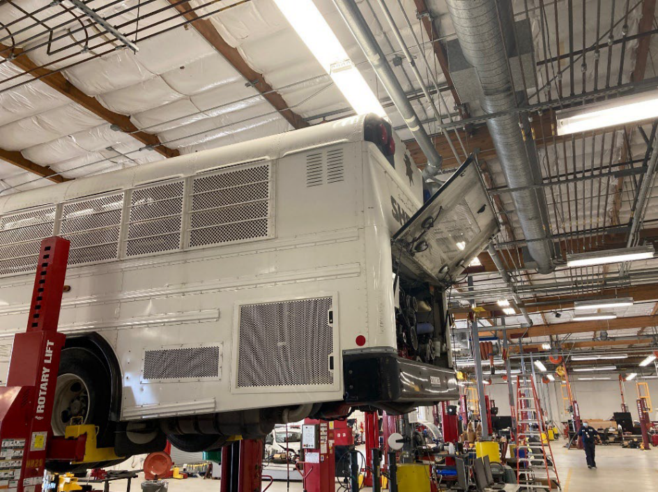
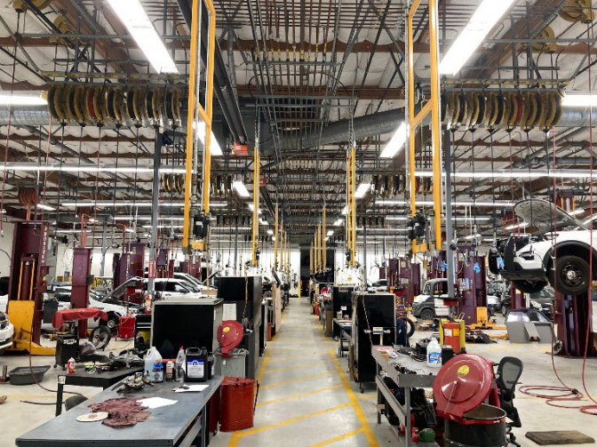
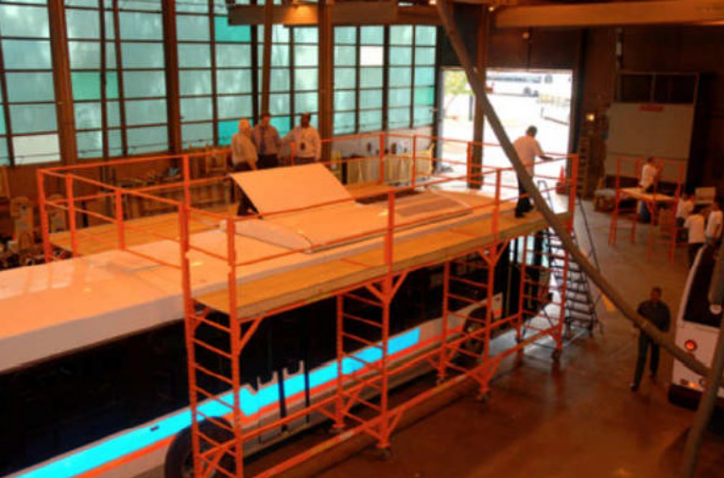
Challenges - Facilities
Employee Safety -
10’ clearance between EV
and closest metal object
Employee Safety -
Fall protection work platforms
Maintenance Facility -
Vehicle to roof clearance sufficient?

Slide 8
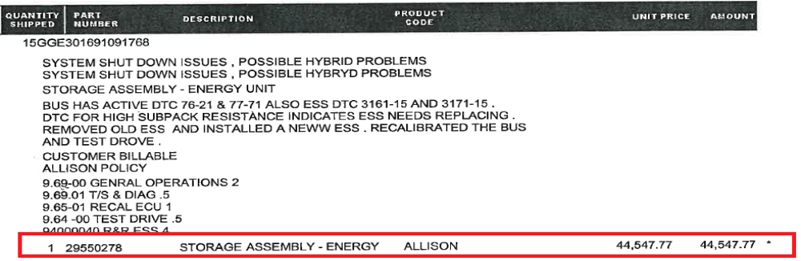
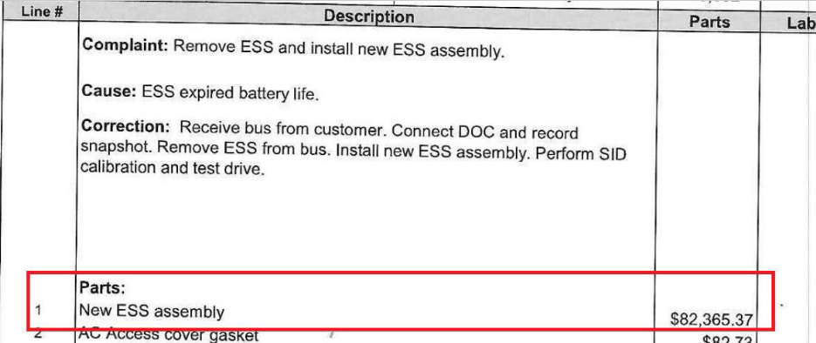
Challenges – Battery Module Replacement
Will Future Replacement Battery Modules be Backwards Compatible?
Will Vehicles Need to be Replaced Because Battery Modules and Control Systems are Not Backwards Compatible or Cannot be Retrofitted?
  Battery Cost per kWh Reduction Advancements May Not Decrease Older Battery Module Replacement Costs

Slide 9
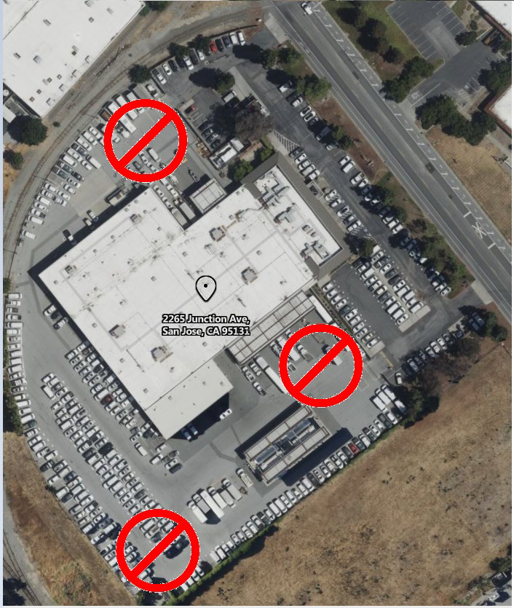
Challenges – Accident Damage
Light Duty EV Trucks Require a 50’ Radius Between the Vehicle and the Next Closest Object In Case of a Fire
Medium/Heavy Duty Truck Radius Requirements May Be Greater
An EV Truck Will Need to Remain in Quarantine for Between 48 Hours and 2 Weeks Depending on the Manufacturer’s Safety Protocols
A Majority of Towing Vendors Do Not Have Space to Meet Manufacturer’s Safety Protocols for Just Tow EV Sedans

Slide 10
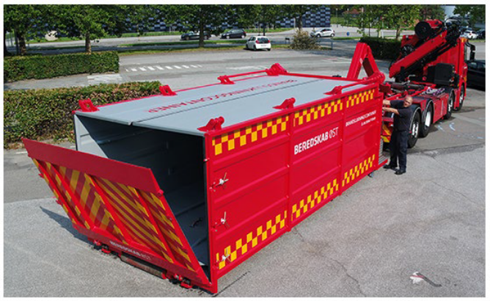
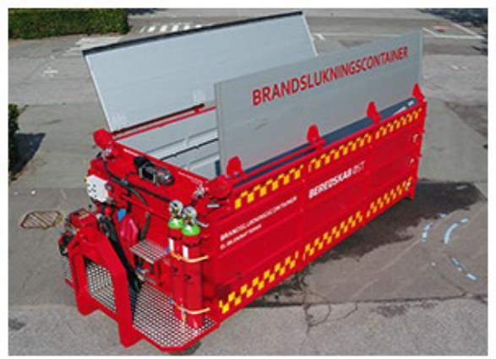
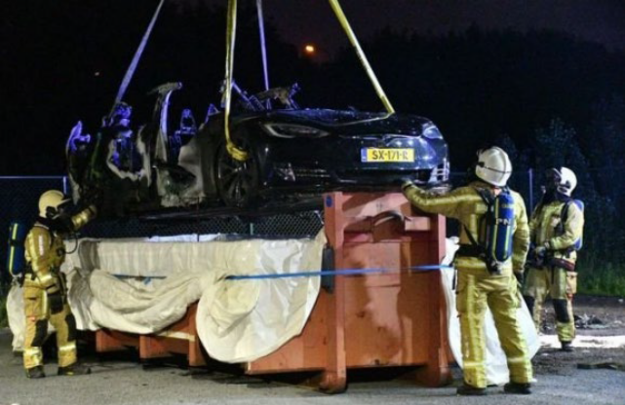
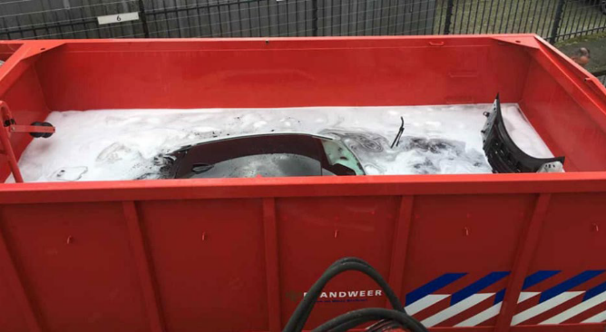
Challenges – EV Fire Containment
It Can Take Between 2,500 to 20,000 Gallons of Water to Contain an EV Battery Fire
Runoff Water May Contain Hazardous Chemicals that Can trigger a HAZMAT Response if the Water threatens to Enter a Storm Drain or Creek

Slide 11
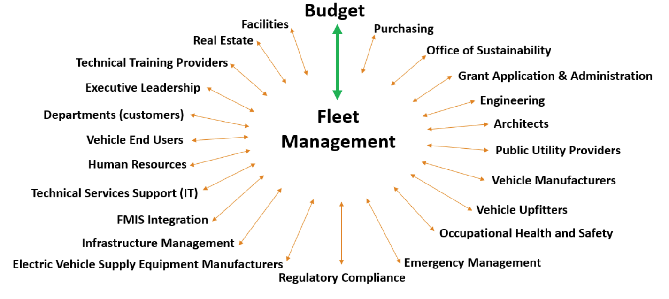
Internal and External Group Collaboration Required

Slide 12
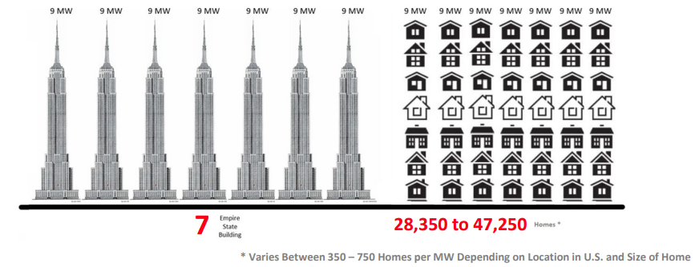
A Parting Thought
454 Trucks – Forecast Daily kWh Consumption

Slide 13
Questions?
David Renschler, CPFP
Fleet Division Manager
City of Fairfield, California
DRENSCHLER@Fairfield.ca.gov

