Slide 1


Planning for the ACF Transition

Slide 2
Transition Planning
Fleet Plan
Inventory
Duty cycle
Infrastructure Plan
Locations
Types
Energy Plan
Capacity
Resiliency
Vehicle preferences
Technologies
Improvements
Efficiency
Scope
Financial Plan
Capital costs
Procurement
Revenue
GHG reduction
Charging strategies
Implementation Plan
Budgeting
Policies
Training
Facility improvements

Slide 3
Near-term compliance
Determine the vehicle replacement schedule
Know the everyday use, equipment, schedule
Identify the available ZEV/NZEV replacements
Do the ACF shuffle—upsize, downsize, extend, pull forward
Calculate the daily energy needed
Determine a near-term charging strategy

Slide 4
Year | Make | Model | Use | Daily Miles | Use Notes
2013 | Ford | F250 | Utility Bed | 7 | Underutilized
2013 | Dodge | Dakota | Utility Bed | 40 | Used daily for maintenance and repairs, powers equipment at site
2012 | Ford | F250 | Crime Scene | 100 | Light-weight cargo
2014 | Ford | F550 | Utility Bed | 5 | Used to tow off-road equipment
2013 | Freightliner | M2 | Cargo | 1 | Not operated most days
2013 | Ford | F350 | Utility Bed | 11 | Used daily for maintenance and repairs

Slide 5
Year | Make | Model | Miles | Use Notes | Option 1 | Option 2 | Option 3
2013 | Ford | F250 | 7 | Underutilized | Retire | Replace with Silverado EV or 1500 REV | Replace with EV
2013 | Dodge | Dakota | 40 | Used daily, powers equipment at site | Replace with gas | Replace with Silverado EV or 1500 REV | Replace with Class 4 step van
2012 | Ford | F250 | 100 | Light-weight cargo | Replace with Lightening 150 or Blazer EV | Replace with Lightening 150 or Blazer EV | Replace with Lightening 150 or Blazer EV
2014 | Ford | F550 | 5 | Used to tow off-road equipment | Retire | Replace with gas | Extend life
2013 | Freightliner | M2 | 1 | Not operated most days | Replace with flatbed BEV that can transport off road equipment | Retire | Extend life
2013 | Ford | F350 | 11 | Used daily for maintenance and repairs | Replace with gas | Replace with Silverado EV, 1500 REV, or Ram Promaster | Replace with Class 4 step van
 |  |  |  |  | 4 vehicles 2 EV 2 gas | 5 vehicles 4 EV 1 gas Bank one credit | 4 vehicles 4 EV Bank two credits

Slide 6
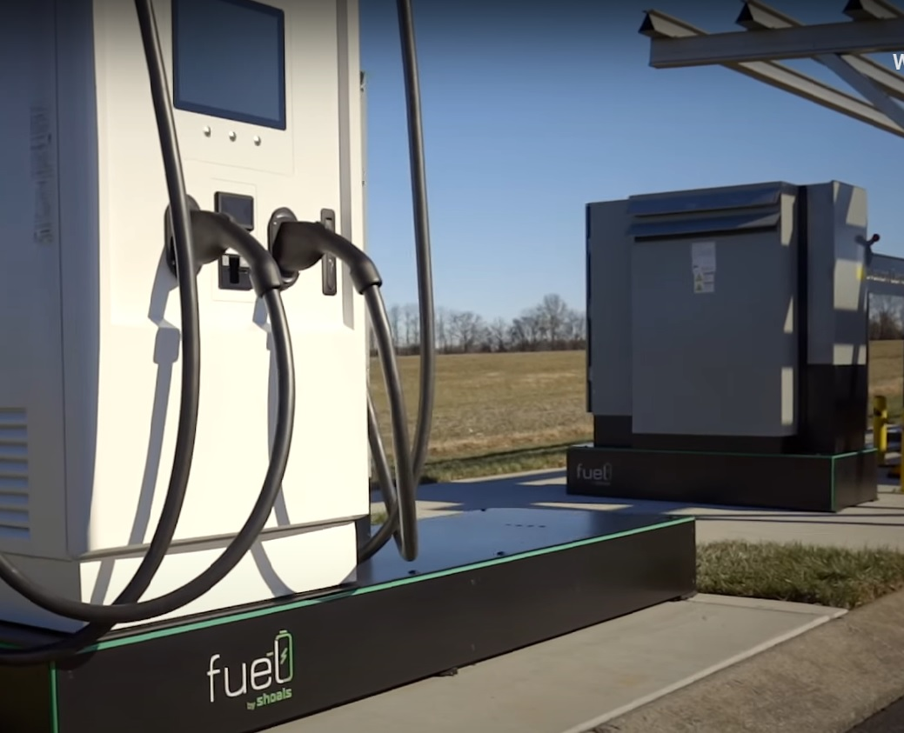
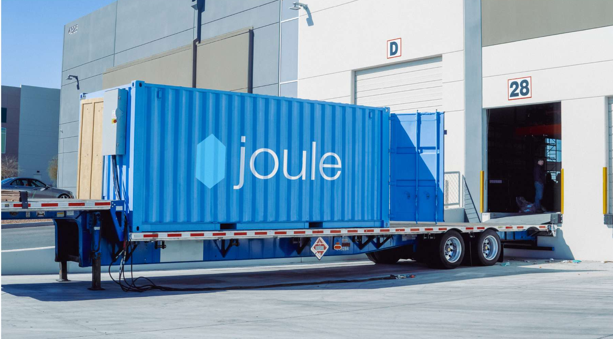
Charging in a Grid Constrained World
Above-ground EV charging
Battery-integrated charging stations
Mobile charging units
Trailer-mounted batteries
Fuel cell power to EVSEs

Slide 7
Strategies to consider
Move early and bank credits
  Incentives will decrease as compliance increases
Think about alternatives
  Plumbers and electricians use step vans and box trucks
Take it in stages
  Specific plan for 2024-2026
  Actions to take now for 2027-2030
  Actions to consider now for post-2030
Notes:
We plan for three stages of deployment: What you need to do now—like comply with ICT and Advanced Clean Fleet. What you need to start doing now—like increase electrical capacity, and what you need to do longer term—like build a microgrid for resiliency.
Finally, we balance enthusiasm and technical innovations with a dose of reality. We identify for the no-regrets actions that avoid the fear of missing out of federal funding or a cool pilot program and that will and reduce the likelihood of charging stations becoming lawn ornaments in the next few years.

Slide 8
Thank you!
Chris White
cwhite@frontierenergy.com
916-371-2899
Director, Transportation
Frontier Energy

