Slide 1


Slide 2

Notes:
Make sure to point out your prospect's challenges, using a source that is not yourself.

Slide 3
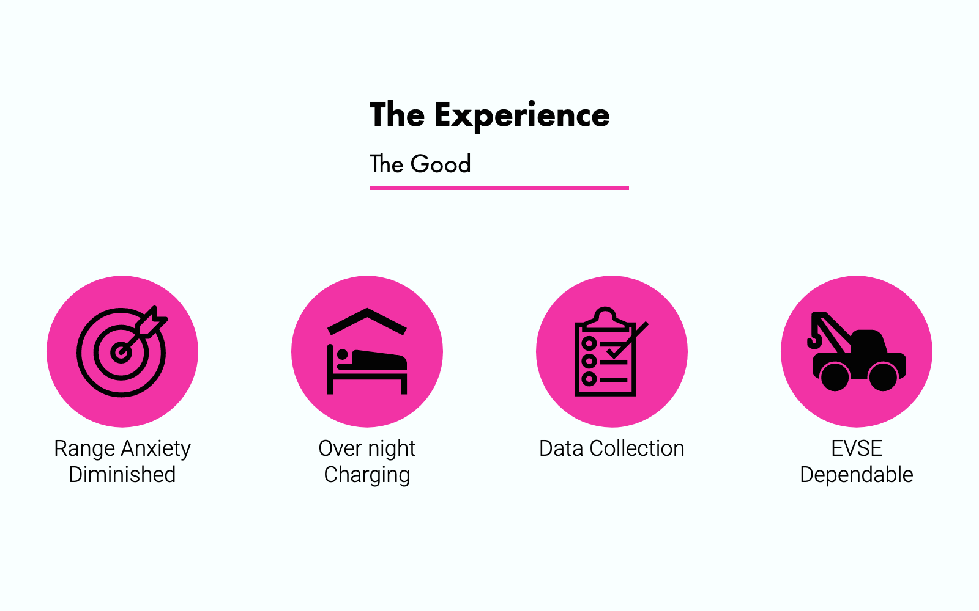

Slide 4
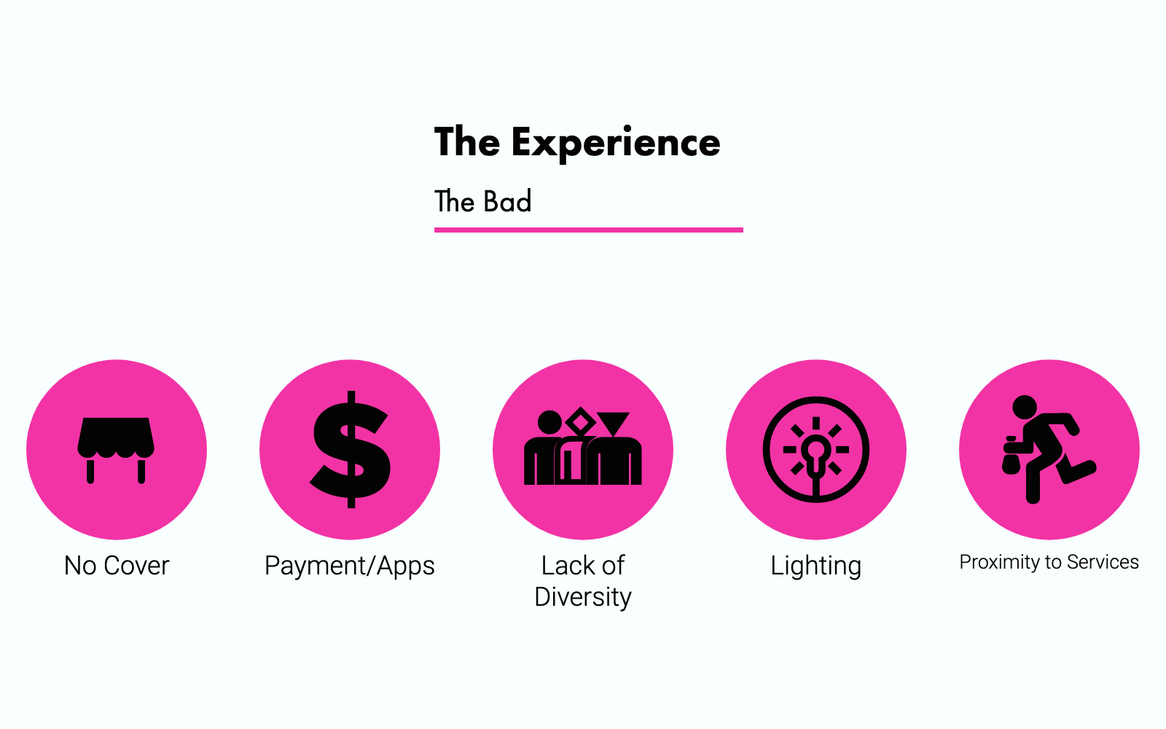

Slide 5
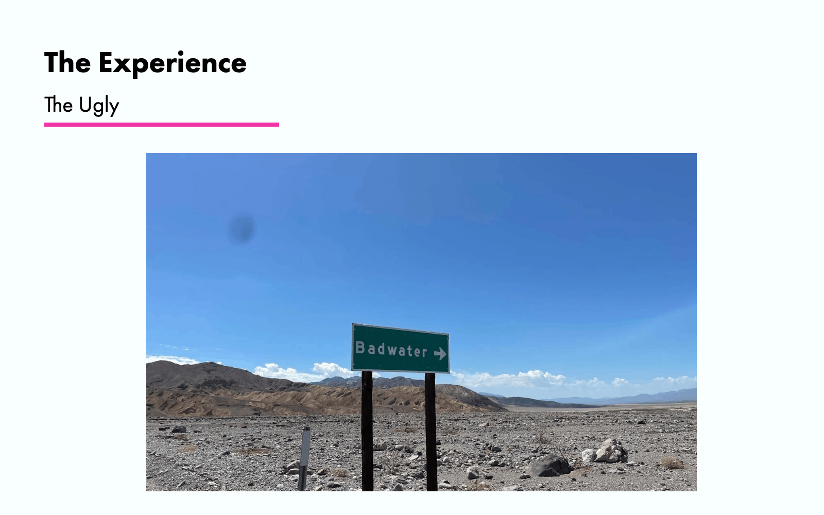

Slide 6
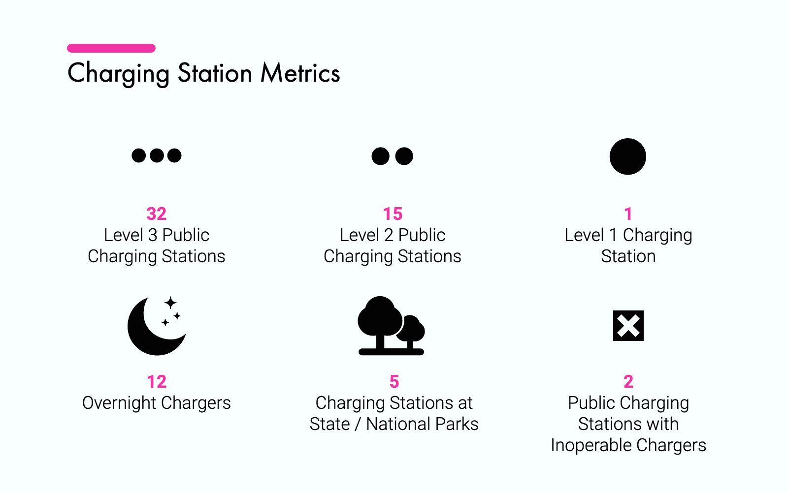

Slide 7
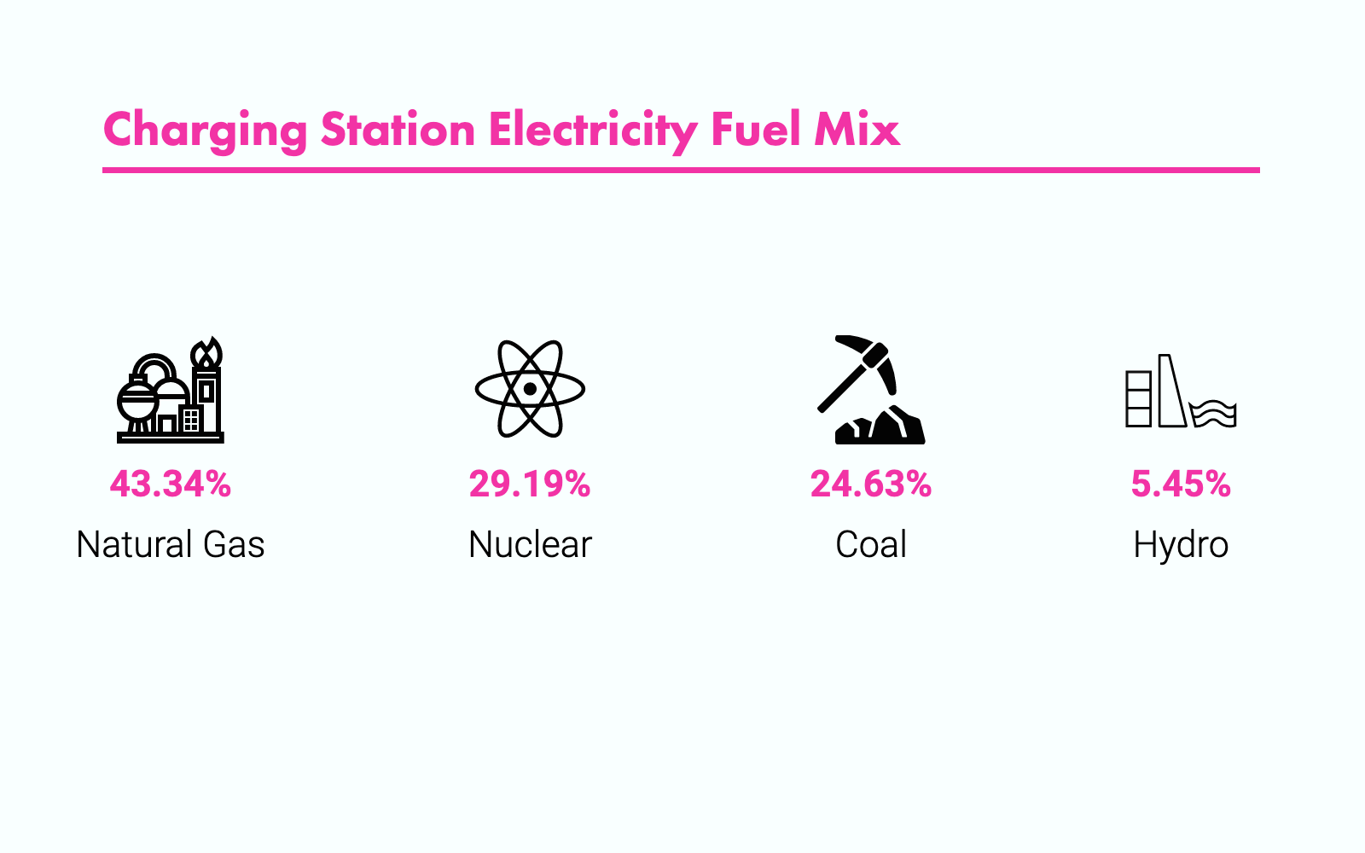

Slide 8


Slide 9


Slide 10
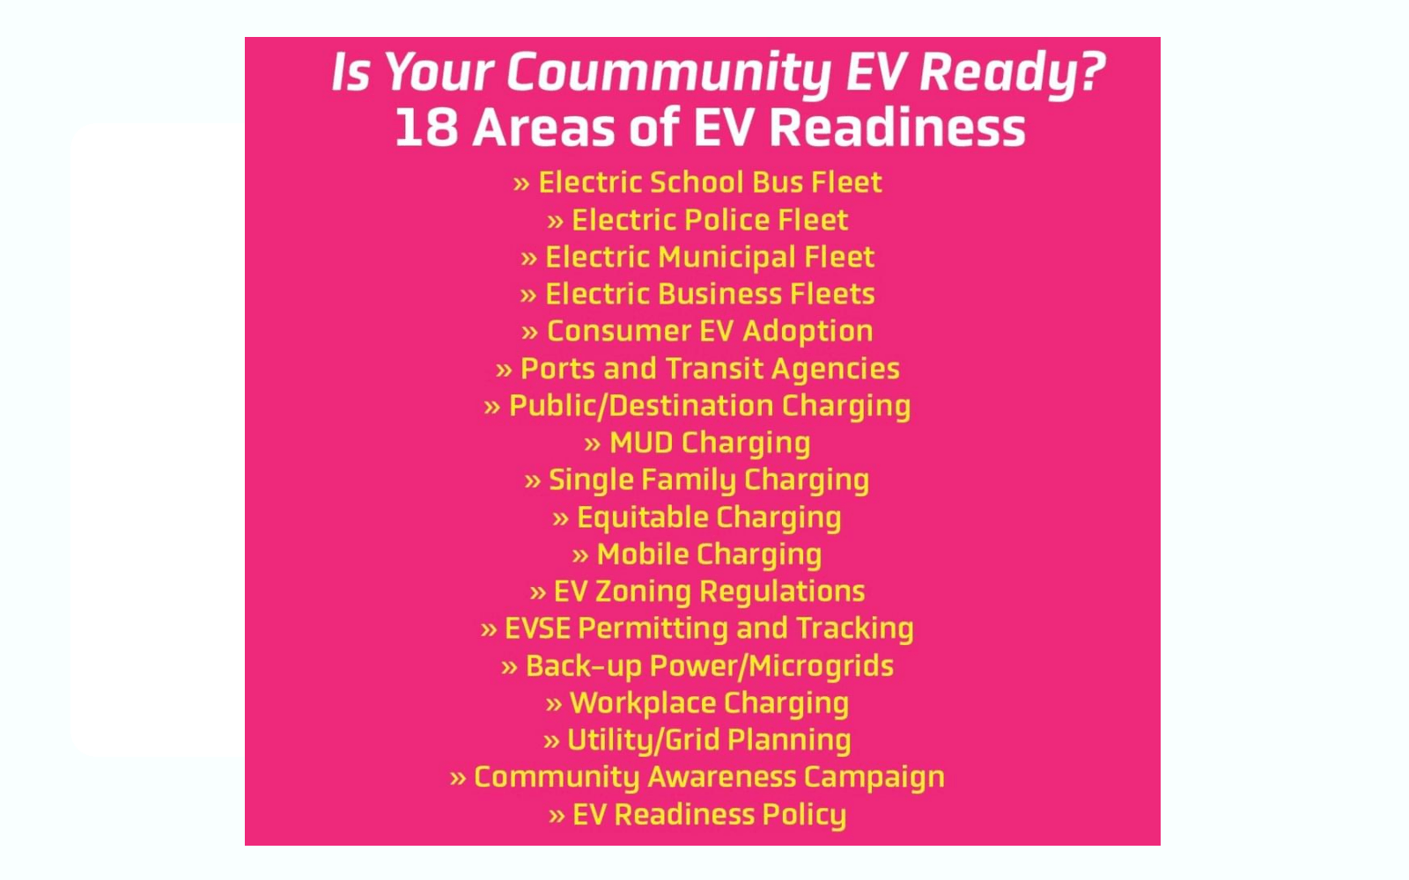

Slide 11
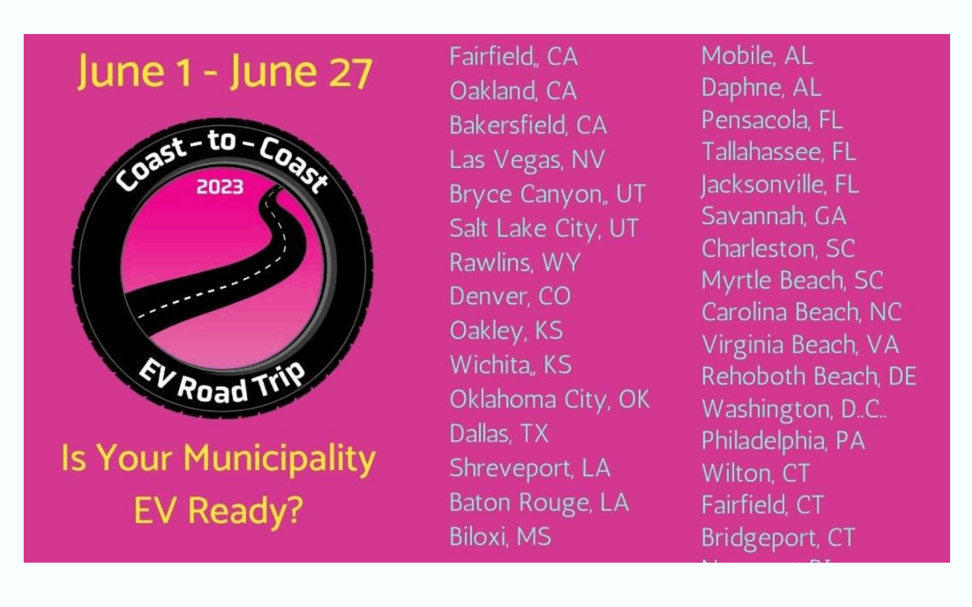

Slide 12


Slide 13
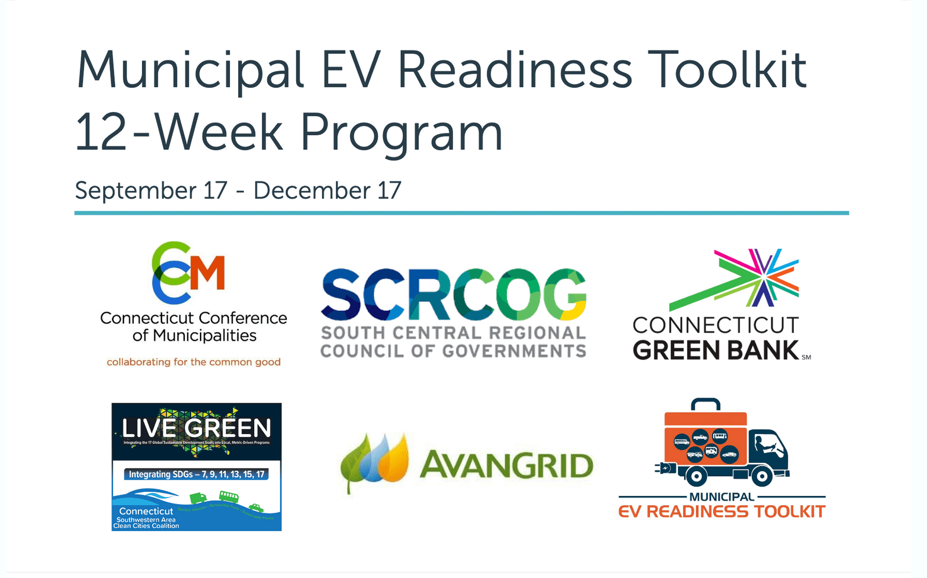

Slide 14


Slide 15


Slide 16


