Slide 1
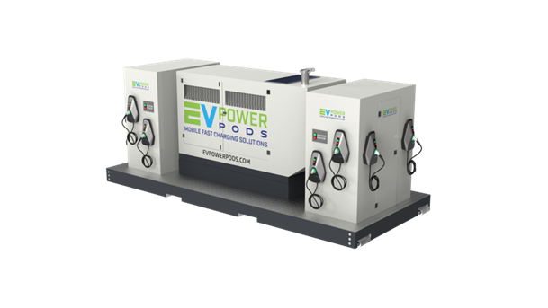
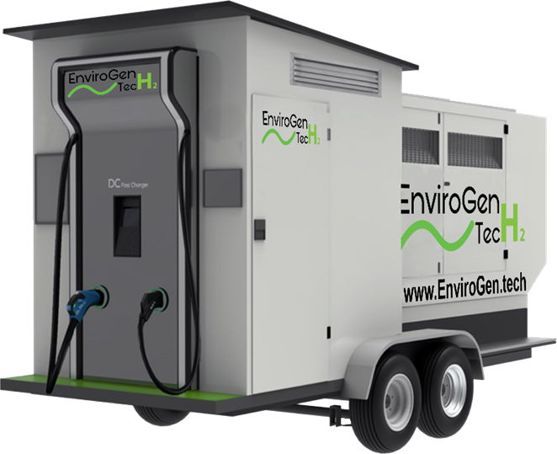

EnviroCharge: EV Power Pod

Slide 2
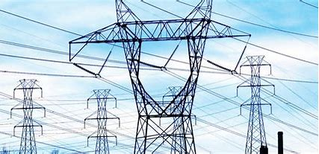
EnviroCharge: The Problem
Fleet Charging #1 Challenge: The Electric Grid
Limited Capacity = Brownouts
Aging Electric Grid Infrastructure
Construction & Permitting Delays
Limited Rural Grid Accessibility

Slide 3
EnviroCharge EV Power Pod: The Bridge Solution
Mobile, completely off-grid, chargers from EnviroCharge provide fast and eco-friendly mobile solutions for fast charging of Electric Vehicles & Fleets. The easily and rapidly deployable units are self-contained, green, powerful, and efficient.
Made in the USA
Provides a true “gap to grid” solution for EV charging
Long-term resiliency in a grid charging infrastructure

Slide 4
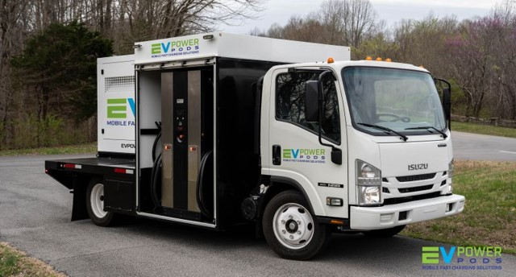

Slide 5


Slide 6
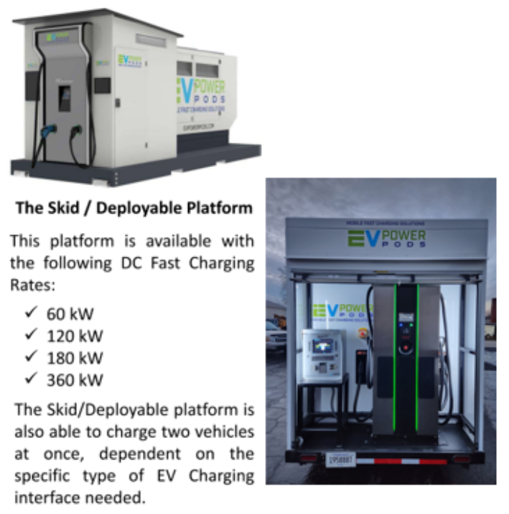
EnviroCharge EV Power Pod Units
The skid EVPP is ready to be installed and hooked to the existing fuel infrastructure system.
  Level III DC Fast Charge capability or Level II options to any facility.
  Sends data from the charging sessions to fleet manager.
Electric supply lead times
  EVPP allows for Electric Fleet deployment and utilization to begin long before grid chargers installed.
Power level:
120-180 kW Dual Charging Leads that split and equalize to charge two vehicles simultaneously

Slide 7
EV Power Pod: Designed for the eRevolution
Advantages Over Electric Grid-Charging
Options: Multiple Clean Fuel Choices
Rapidly Deployable as Skid or Trailer-Mounted
100% Independent from the Electric Power Grid
Completely Self-Contained
Immune from Blackouts, Brownouts and Surges
Provides Energy Resilience & Energy Equity
Remote Access and Monitoring Software
EPA Tier 4 and CARB Compliant
Hydrogen
Propane
Renewable Propane
Renewable Dimethyl Ether (rDME) + Propane
Natural Gas
Renewable Natural Gas (RNG)
Roadmap: Hydrogen On Demand

Slide 8
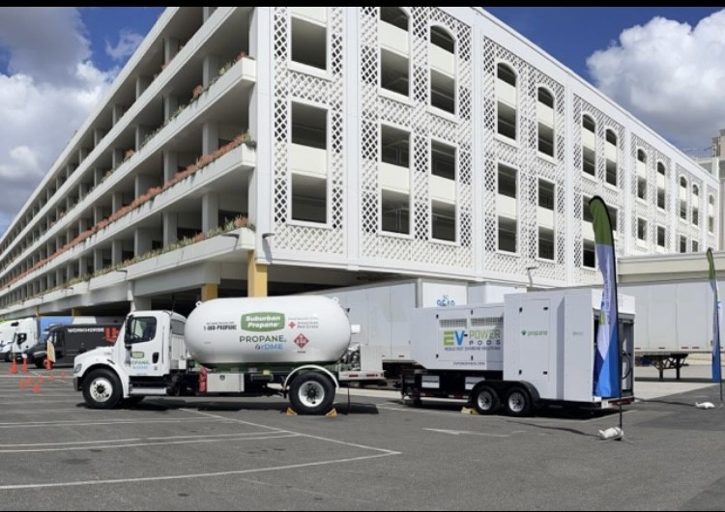
Renewable Propane

Slide 9
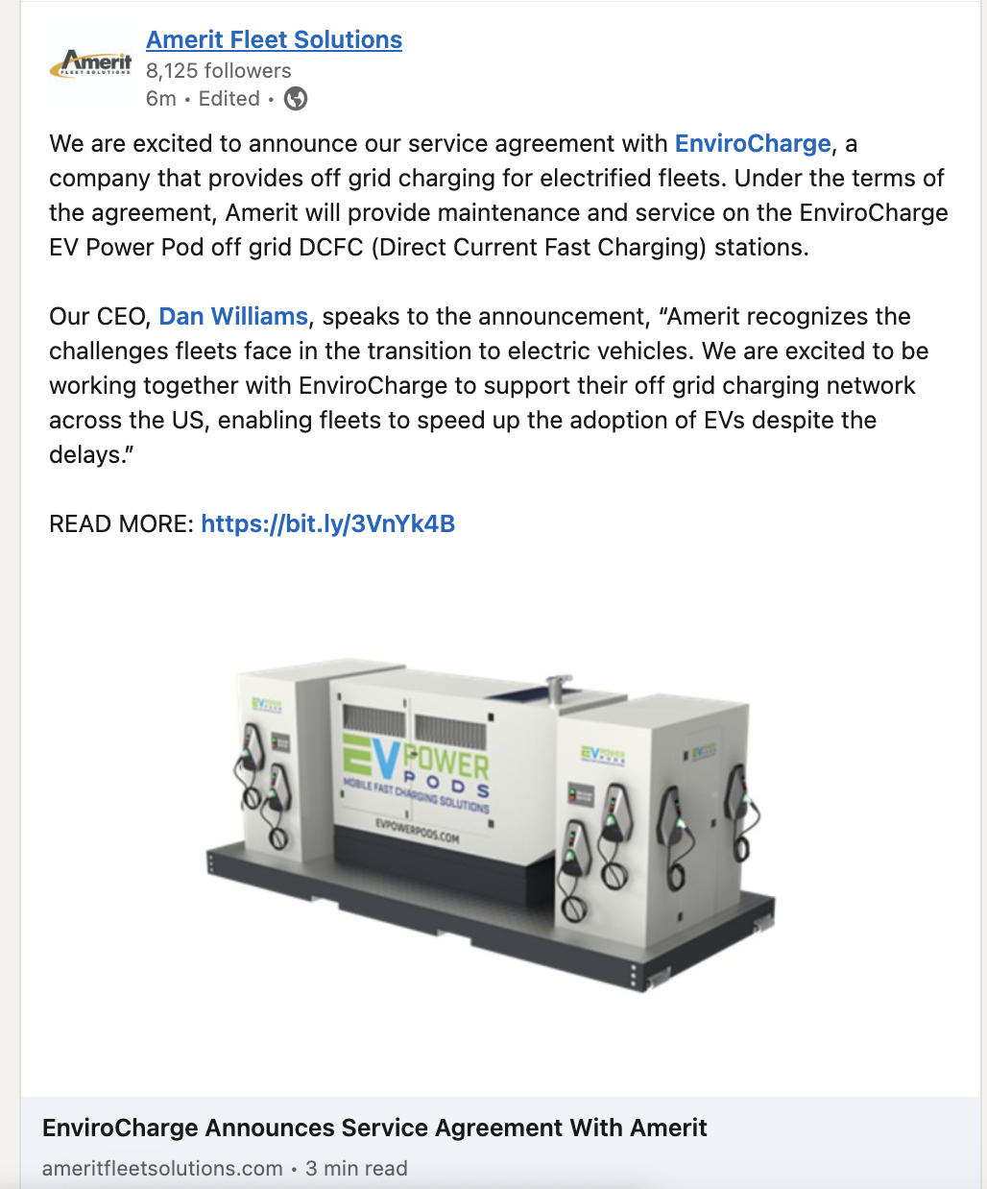
Maintenance & Service
AmeritFleet & EnviroCharge Teaming Together to Maintain and Service Units

