Slide 1
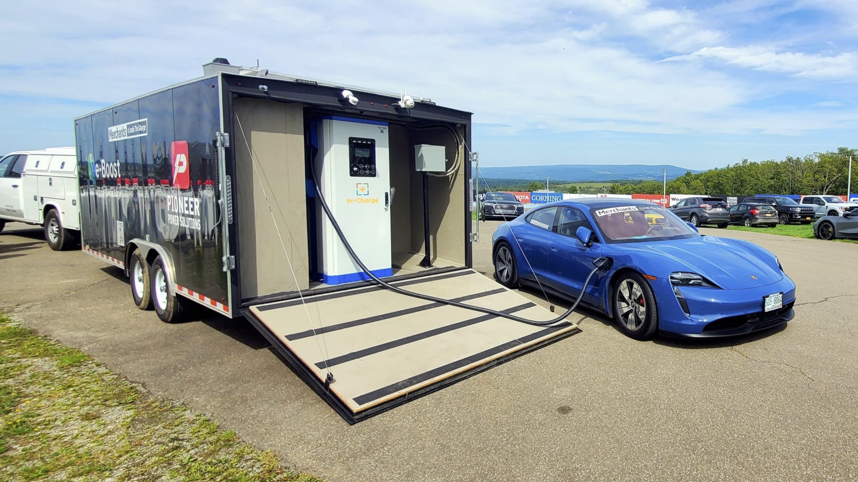
Off-Grid EV Charging
Scott Bradley
Director of Sales
and Strategic Partnerships
scott@pioneer-emobility.com
Pioneer eMobility
Geo Murickan
President and CEO
geo@pioneer-emobility.com

Slide 2
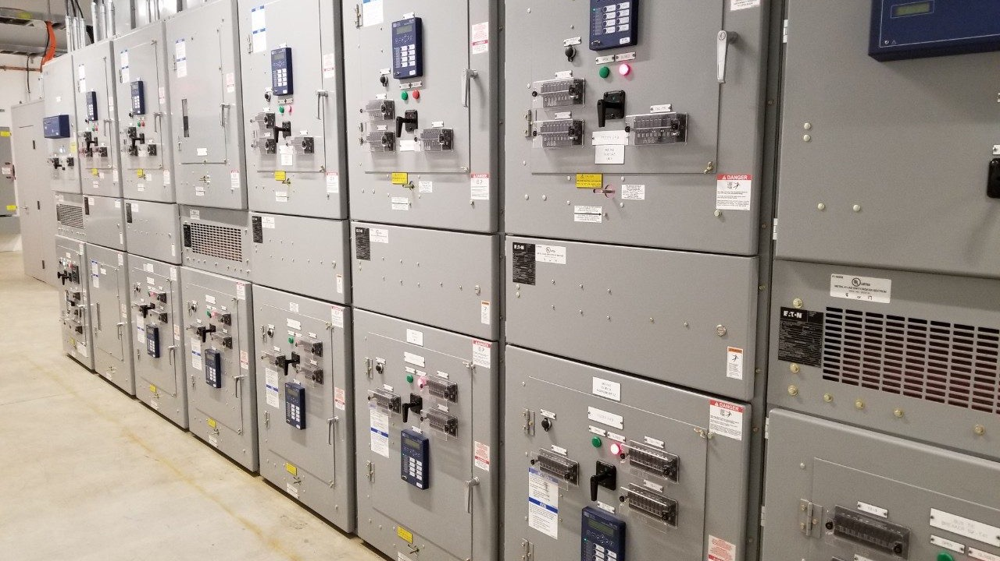



Pre 2020
Since 2020
Circuit Breakers
Transformers
LV Switchboards
MV Switchgear & Powerhouses
Paralleling Switchgear & ATS
Critical Power Genset – Install & Service
E-Bloc
Compact, Integrated Power
Aggregation, Storage & Distribution
e-Boost
EV Charging w/ Mobility
30 Years of Power Distribution Equipment, Controls and Services - USA & CAN
Nationwide service and maintenance team
Nationwide propane delivery partnerships
Notes:
Early in 2021 we introduced E-Bloc, a compact integrated outdoor system that allows end users to add and control multiple sources of electrical energy. E-Bloc is a BESS (Battery Energy Storage System) on steroids

Slide 3
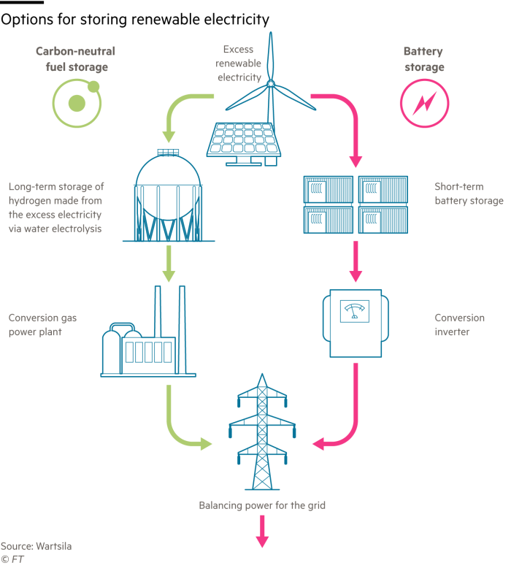

Future Proof
Hydrogen
Battery
Propane
Clean Fuel | Yes | Yes | Yes
Low Cost | No | No | Yes
Easy to Transport | No | Yes | Yes
Readily Available | No | Yes | Yes
Off-Grid | Yes | No | Yes
Short Term | No | No | Yes
Medium Term | No | Yes | Yes
Long Term | Yes | Yes | Yes

Slide 4
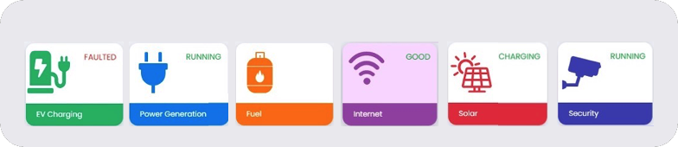
Patent Pending Solution
e-Boost RealM
Data Analytics
Fleet Planning
Nationwide Propane Distribution
Nationwide Service and Maintenance
1) Sophisticated Integration of Hardware and Software
2) 24 / 7 Cloud-based Remote Monitoring
3) LTE-Mesh and/or Satellite Communication Backhaul

Slide 5
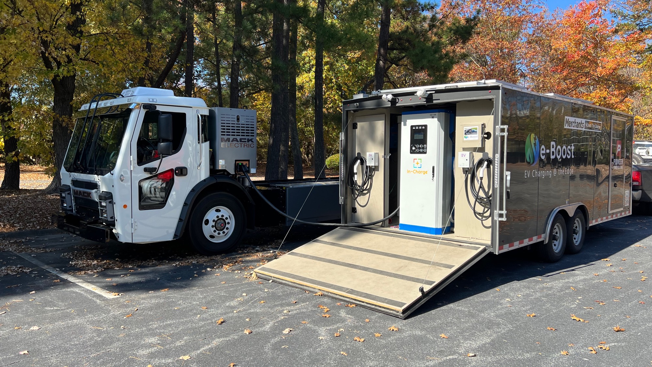
Off-Grid EV Charging

Slide 6
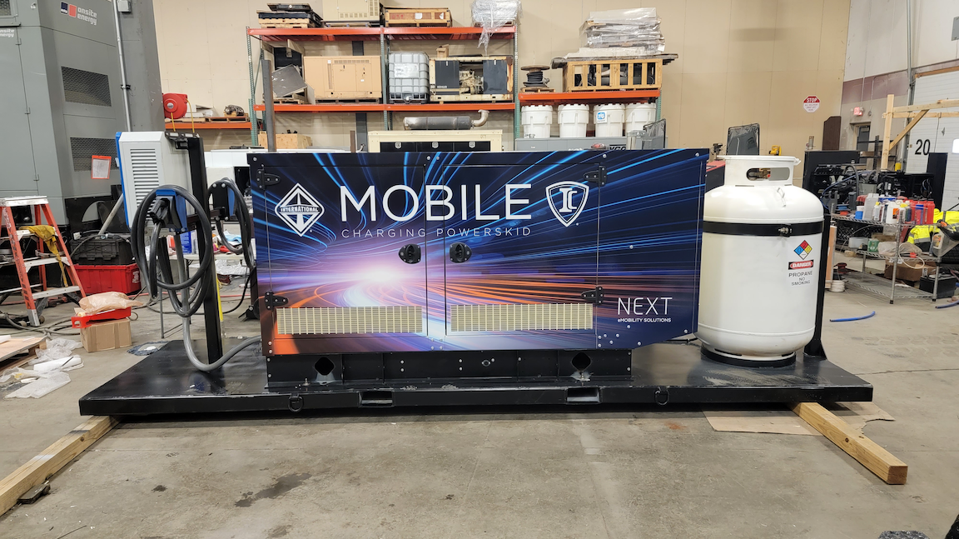
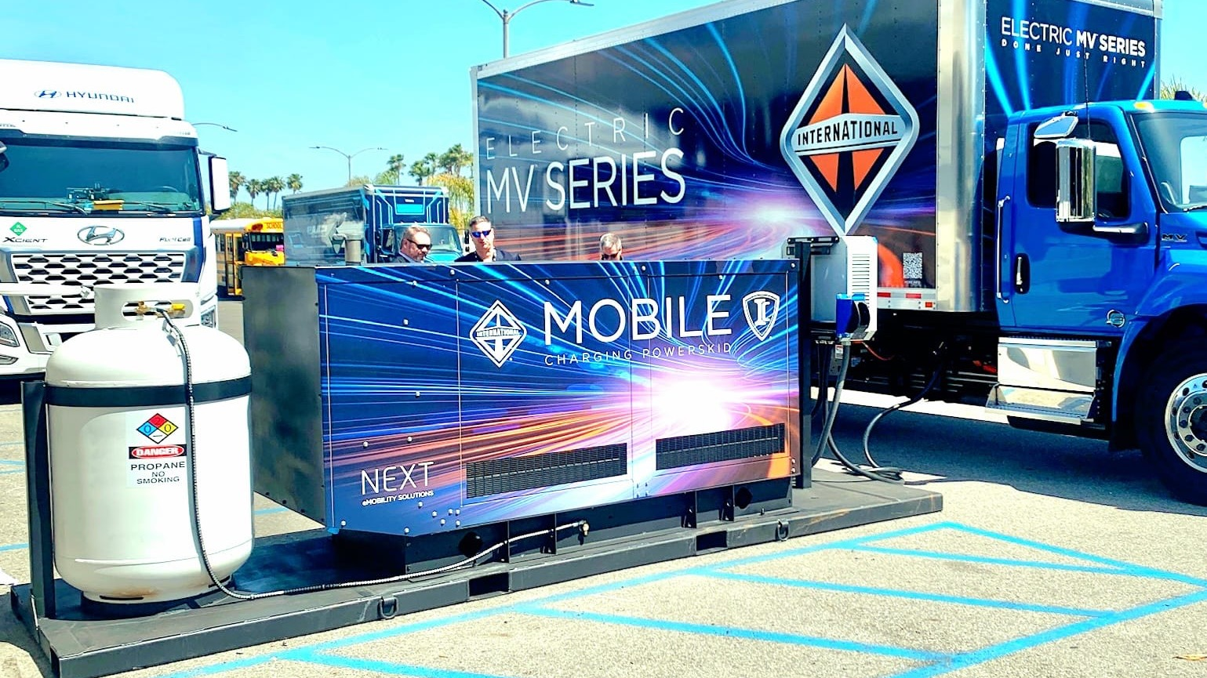

OEM Case Study
Ride & Drives
Dealerships
Customer Pilots

Slide 7
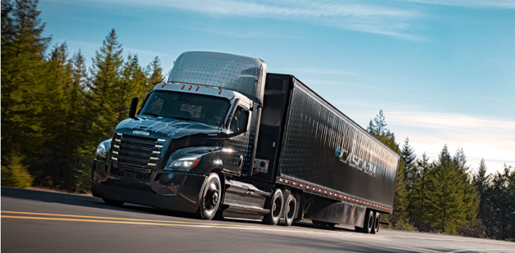
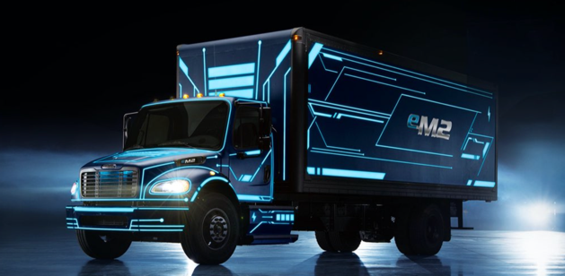
Fleet Planning
Vehicle | eCascadia Class 8 Tandem Drive | eCascadia Class 8 Single Drive | eM2 Class 7 | eM2 Class 6
Range | 220 miles | 155 – 230 miles | 230 miles | 230 miles
Battery Energy | 438 kWh | 291 – 438 kWh | 294 kWh | 194 kWh
Charge Time (80%) | 90 min – 6 hrs | 90 min – 6 hrs | 90 min – 6 hrs | 90 min – 6 hrs
Charger Size | 240 kW – 60 kW | 40 kW – 60 kW | 160 kW – 40 kW | 160 kW – 40 kW

Slide 8
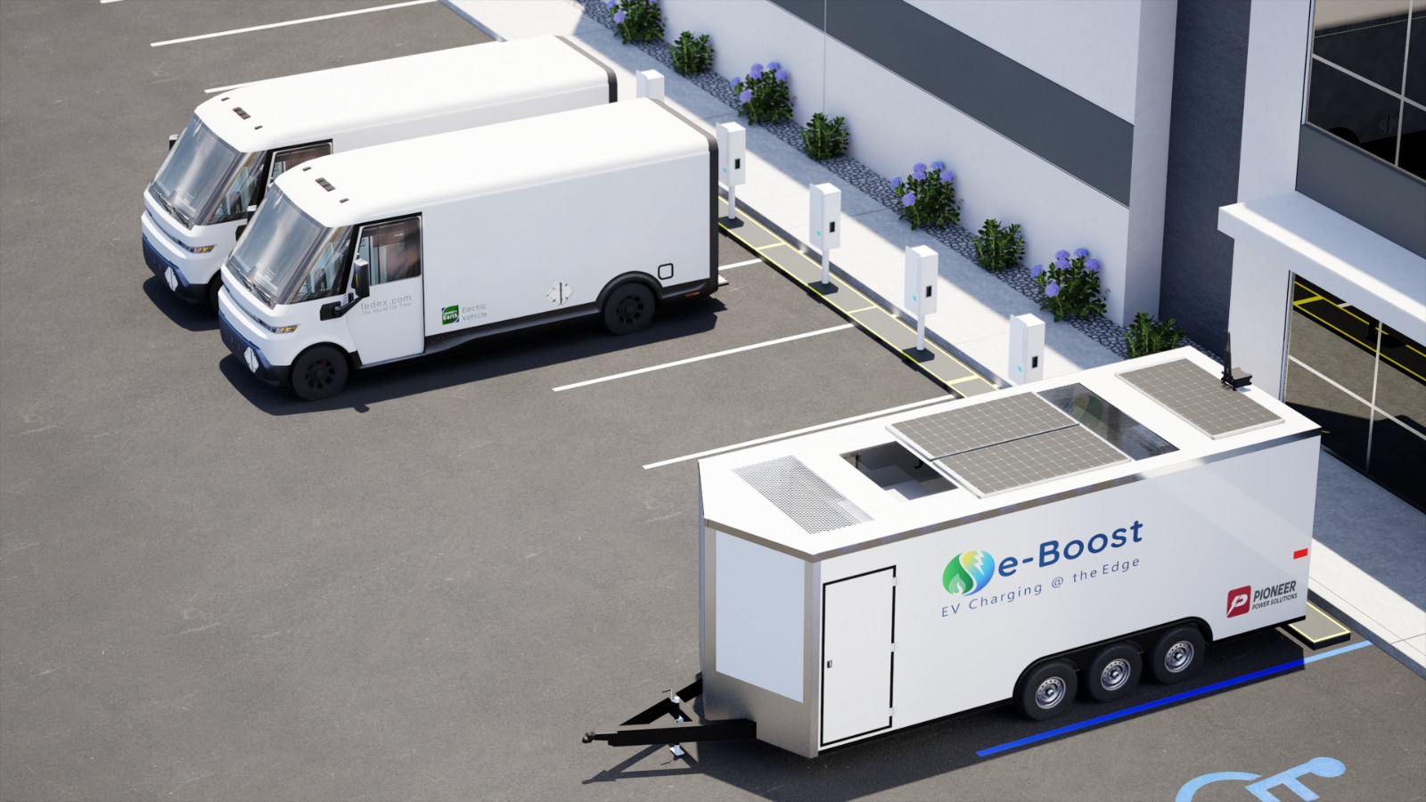
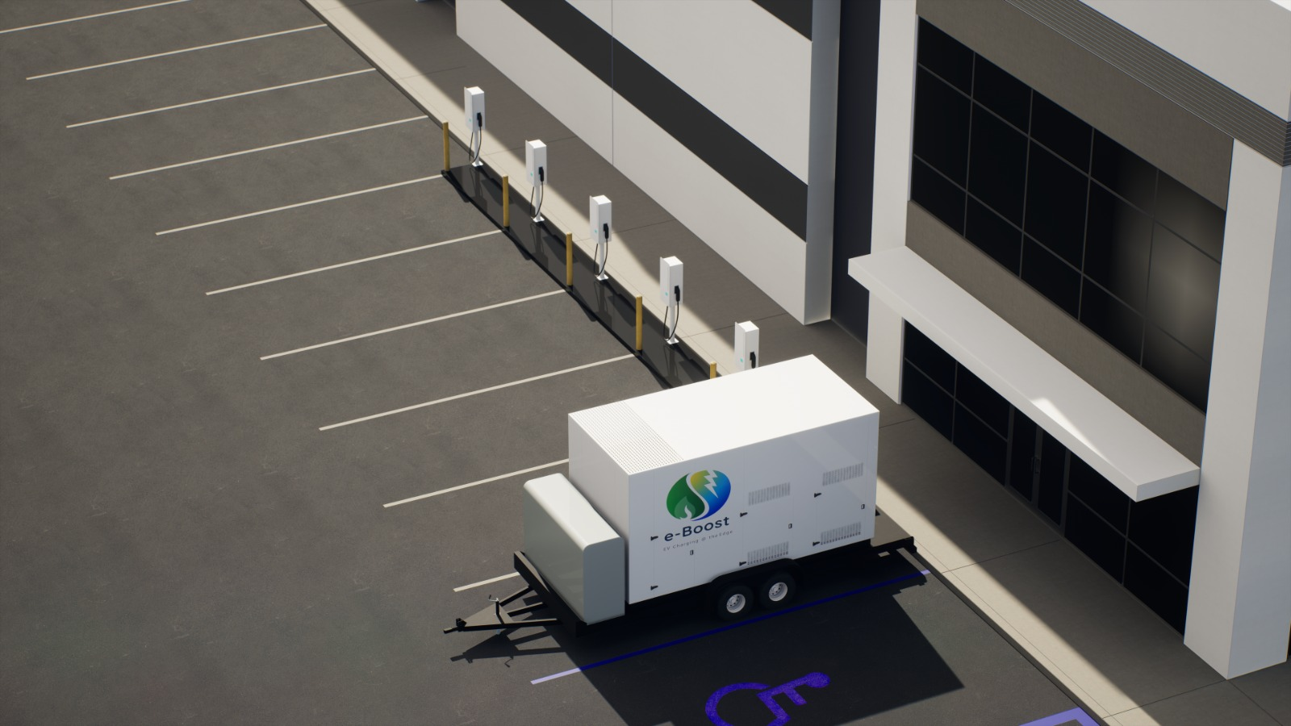
Fleet Case Study
Temporary infrastructure until permanent is available
Infrastructure on leased land
Resiliency after the grid is connected

Slide 9

Rural Case Study
Insufficient power
No power

Slide 10
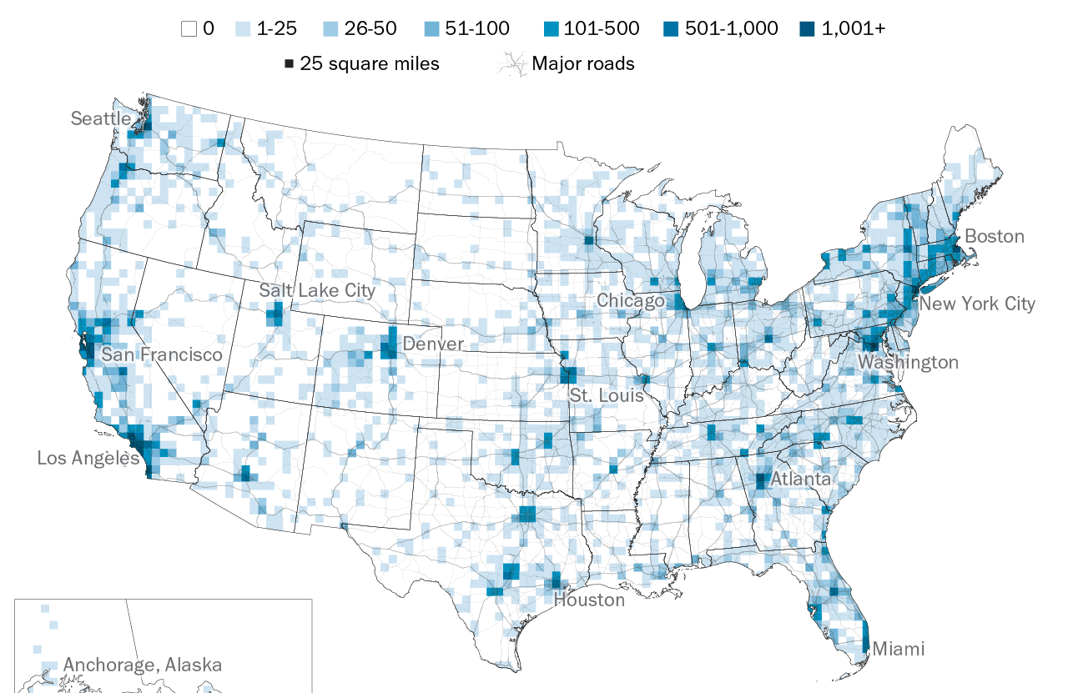
Charger Installations Heavily Align w/ Grid Infrastructure
Notes:
The reality is that, as recently as May 2021, the heat map of charger installations are shown as being heavily weighted towards the Metro cities of USA, aligning with grid infrastructure. PEW Research Center.
Electric vehicle charging outlets are mostly concentrated in large US cities.
Number of public charging outlets, May 2021

Slide 11
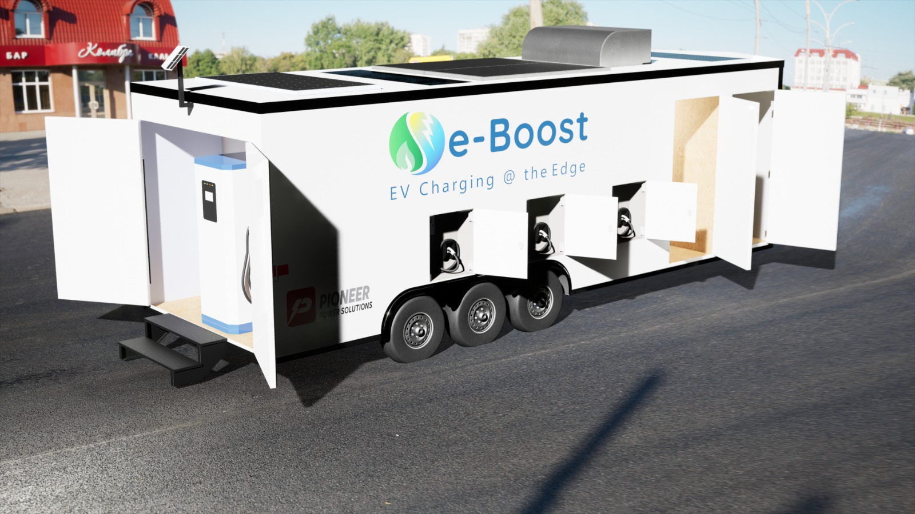

Slide 12
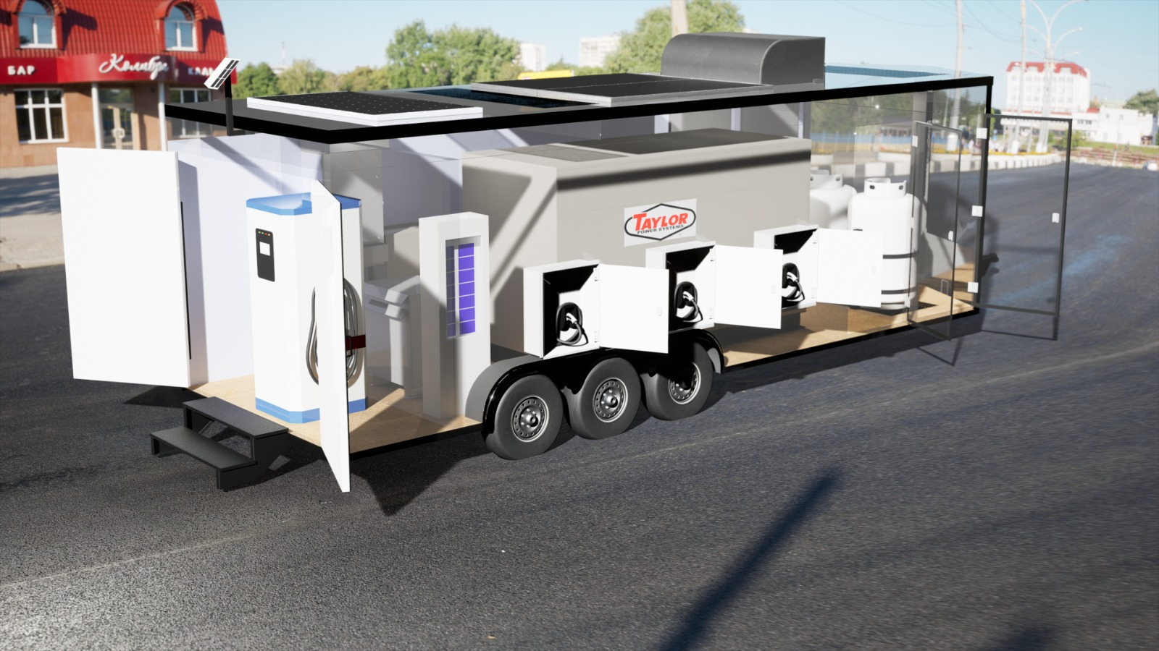

5) E-Boost RealM Monitoring
6) LTE Mesh Backhaul
7) Solar Panels for Parasitic Loads
8) Lighting and Security Cameras
4) Two Propane Tanks
3) 75 kW Propane Generator
2) Six 11.5 kW Level 2 Chargers
1) 60 kW DCFC Charger

Slide 13


Sustainable Fuel
US Grid
1/5 Renewable | 1/5 Nuclear
2/5 Natural Gas | 1/5 Coal
140
130
120
110
100
90
80
70
60
50
40
30
20
10
0
Diesel
Gasoline
Propane LPG (Green Fuel) [Cleaner than the grid in 38 states.]
Carbon Intensity (gCO₂ eq / MJ)
Green Today, Available Everywhere

Slide 14
Sustainable Fuel
US Grid
1/5 Renewable | 1/5 Nuclear
2/5 Natural Gas | 1/5 Coal
140
130
120
110
100
90
80
70
60
50
40
30
20
10
0
Diesel
Gasoline
Propane LPG (Green Fuel) [Cleaner than the grid in 38 states.]
Carbon Intensity (gCO₂ eq / MJ)
CA GRID
rLPG (Renewable Propane) [Cleaner than the grid in 49 states.]
rLPG + rDME
Renewable Propane +
Renewable DiMethyl Ether
Greener Tomorrow, The March to Net Zero

Slide 15

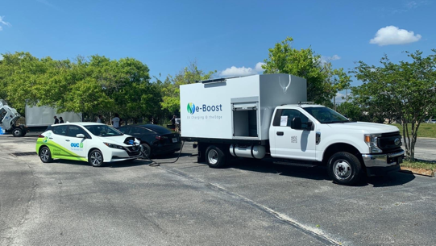


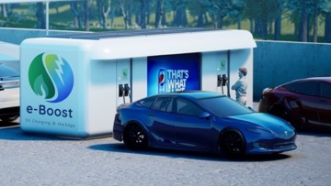

e-Boost
 | e-Boost Mini | e-Boost Mobile | e-Boost Pod | e-Boost GOAT
Chargers | 30kW – 50kW | 30kW – 300kW | 240kW – 600kW | 30kW – 90kW
Levels | DCFC or Level 2 | DCFC or Level 2 | DCFC or Level 2 | DCFC or Level 2
Form Factor | Skid | Trailer | POD | Truck

Slide 16

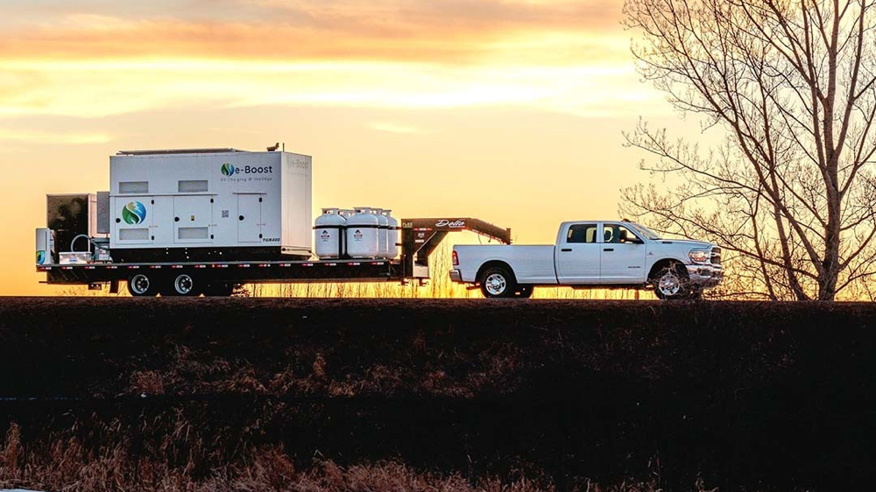


Slide 17
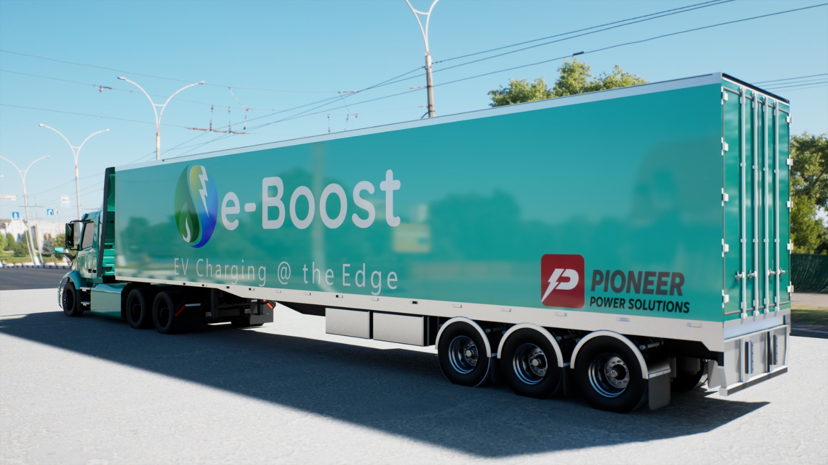

Slide 18


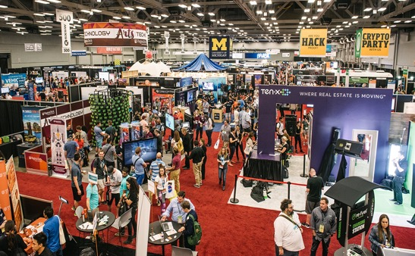

“Humanoid Spike”
Sporting Events
Concerts
Trade Shows
Conventions
Notes:
e-Boost Mobile is able to provide the higher capacity of charging, while still providing mobility through towing. With the higher capacity, it can address many more needs requiring higher demands. We anticipate a larger rental market for e-Boost Mobile to address the many “Humanoid Spike” occurrences in the everyday activities of most cities. These include sporting events, concerts, conventions, trade shows, festivals, fairs etc where a large number of humans congregate for a small periods of time in which there will not be enough available high speed EV chargers available, nor enough power for the utility to provide. These pose a particular paradigm that can only be addressed by rented e-Boost Mobile units that can be deployed for the extent of the event and then moved to the next location. We anticipate that a rental company can easily keep more than a dozen e-Boost Mobile units rented for more than 300 days per year in any urban / suburban market.

Slide 19
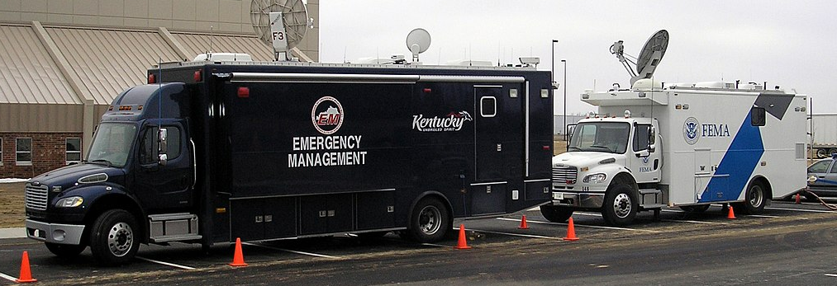
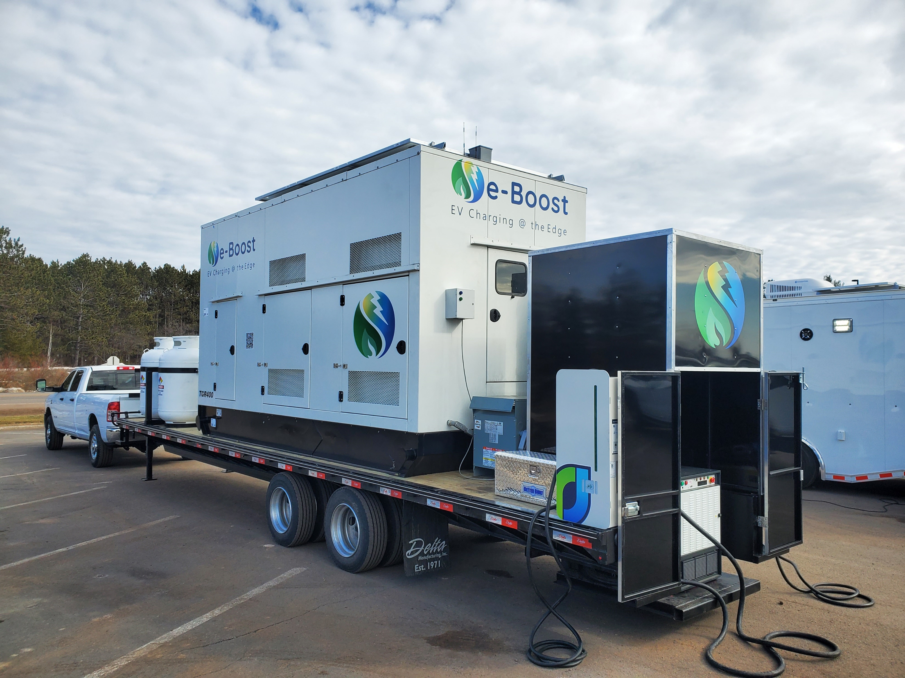
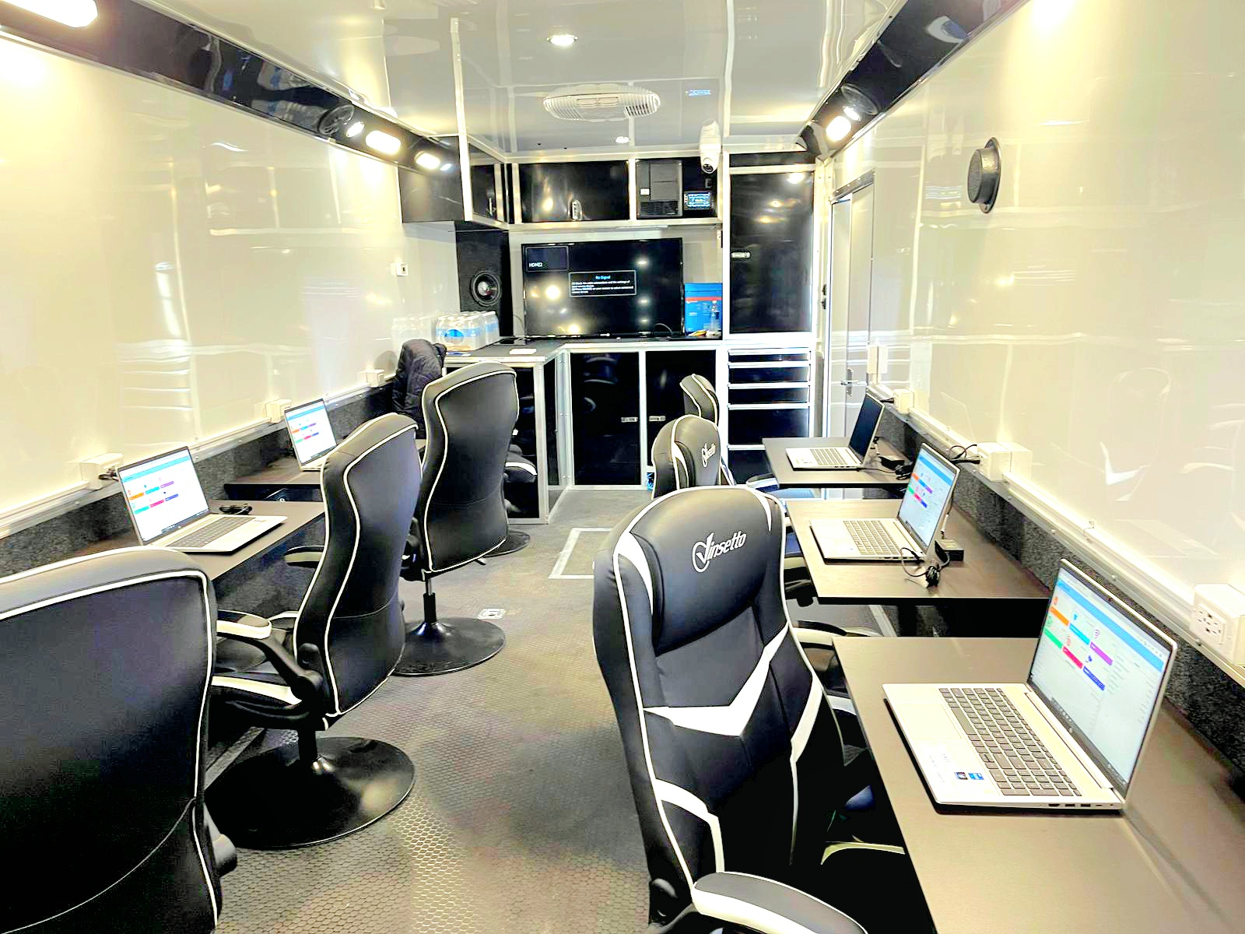
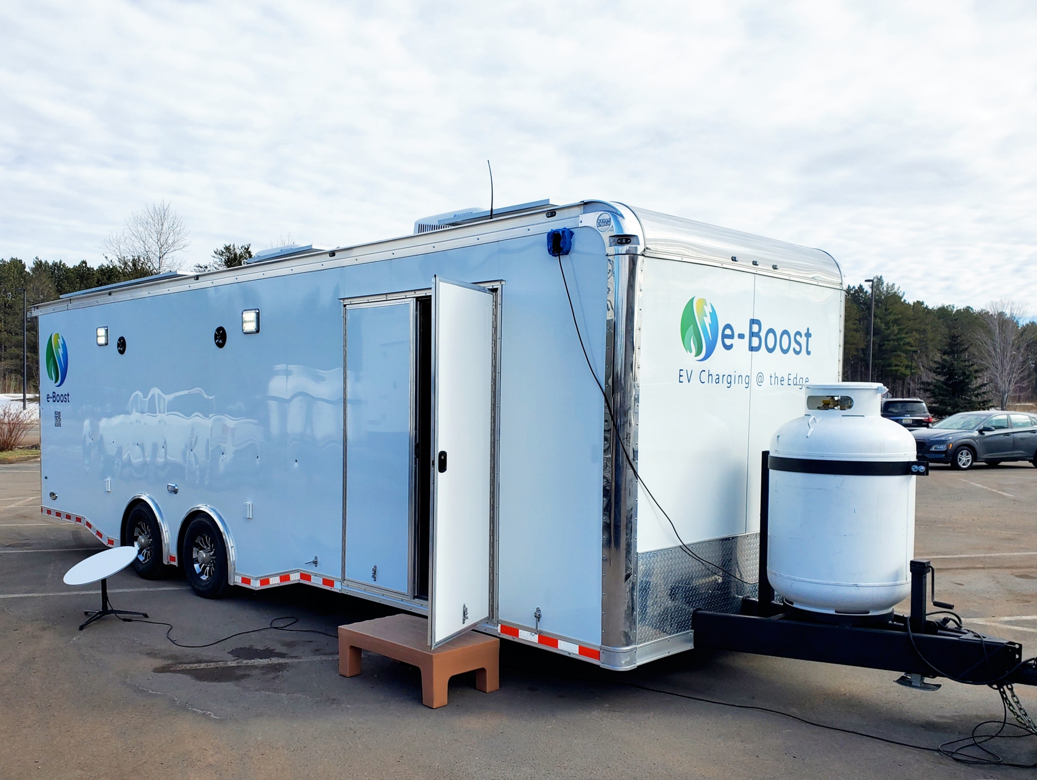
Emergency Management

Slide 20
Thank you!
Scott Bradley
Director of Sales
and Strategic Partnerships
scott@pioneer-emobility.com
Geo Murickan
President and CEO
geo@pioneer-emobility.com

