Slide 1
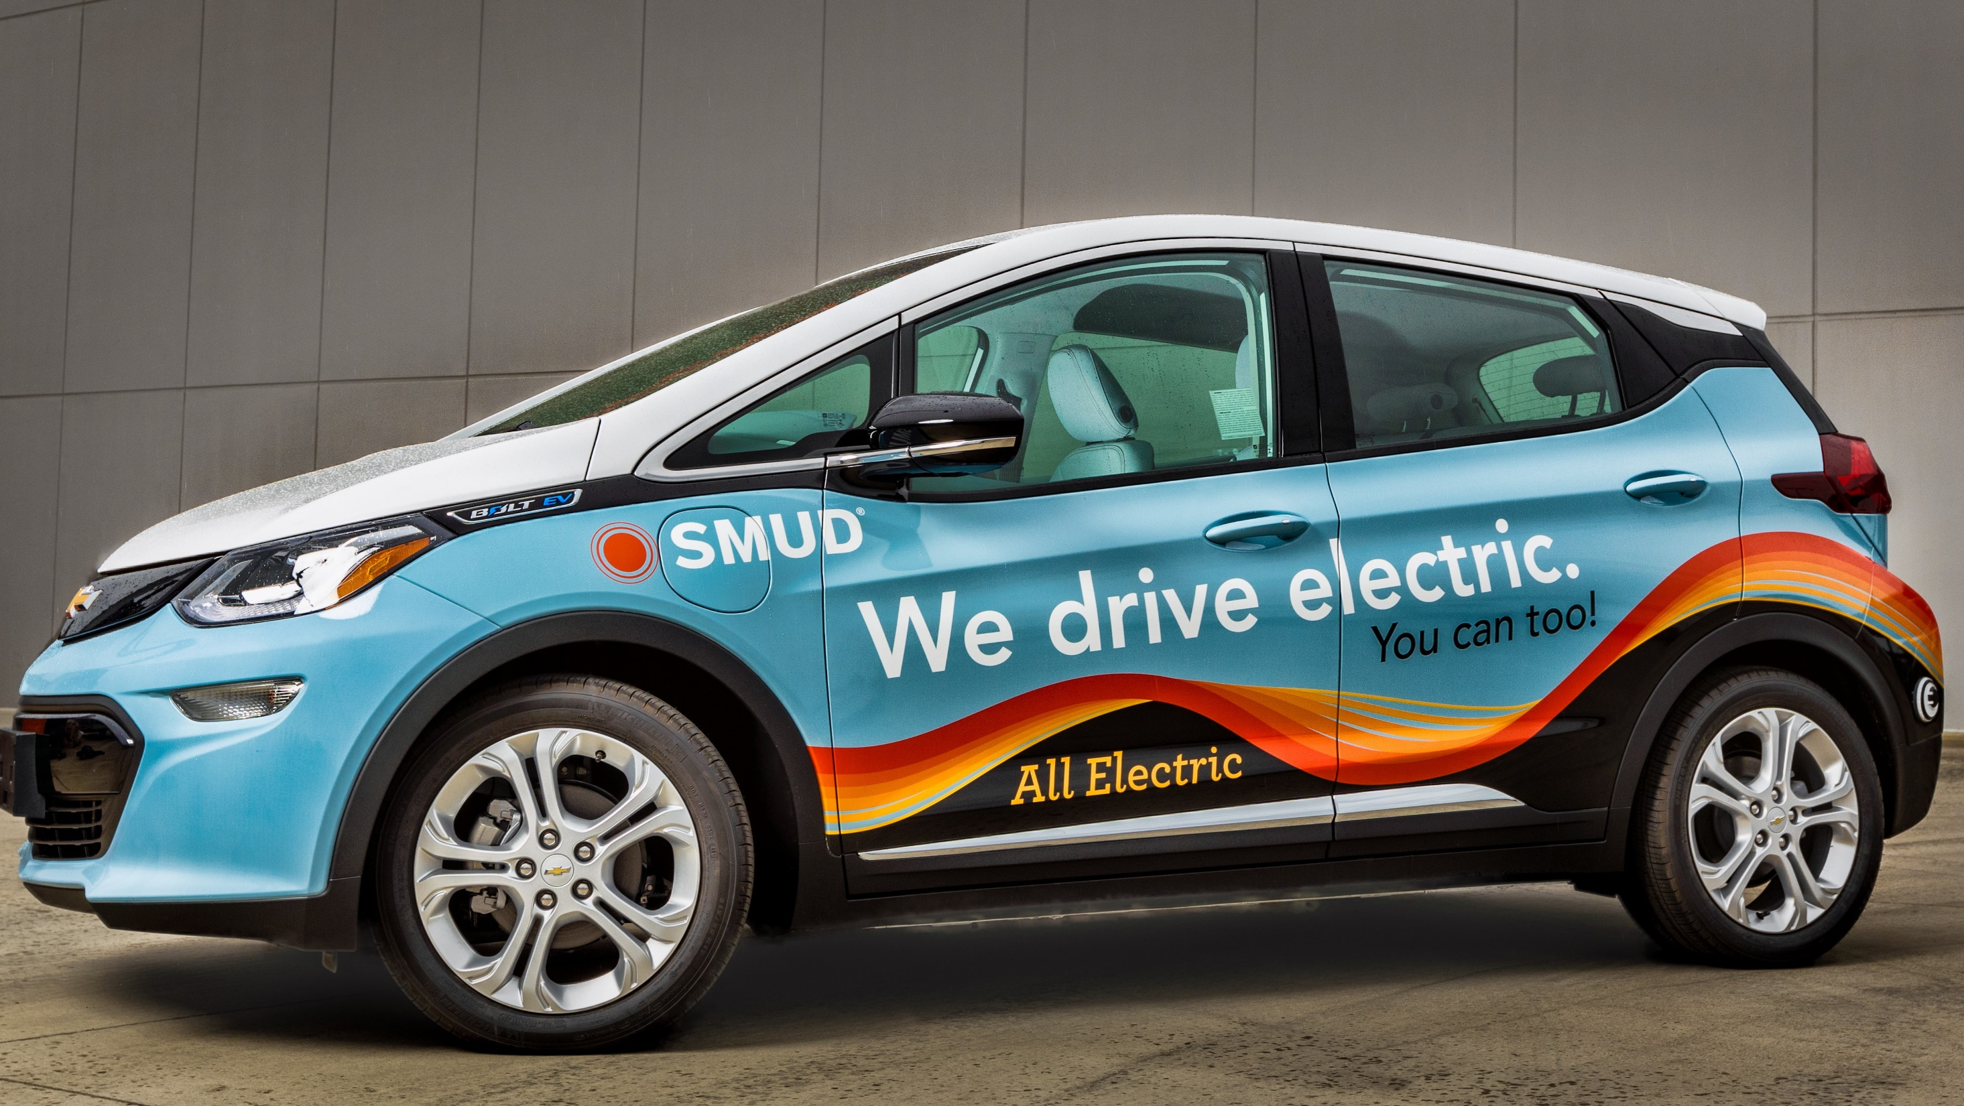

Fleet Zero Emission Vehicle
and Equipment Specification Writing
Case Study
Clean Cities Sacramento
10/19/2023
Casey Fallon
Director, Purchasing, Warehouse & Fleet
Sacramento Municipal Utility District (SMUD)

Slide 2
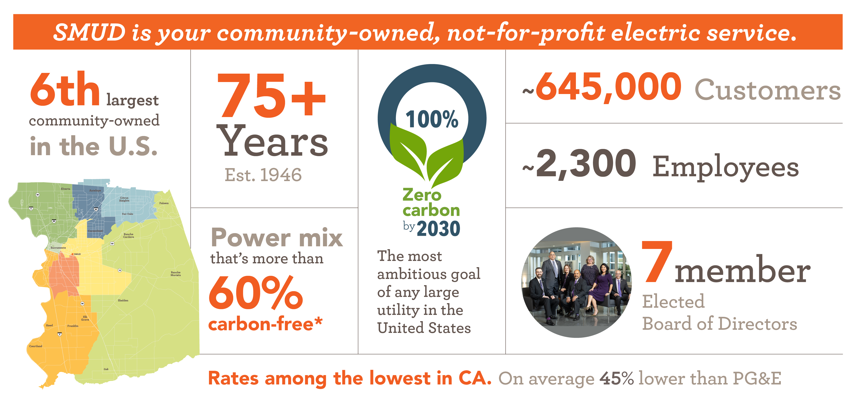
Sacramento Municipal Utility District (SMUD)
CleanPowerCity.org
2
* In 2020, SMUD’s power supply was more than 60% carbon free. SMUD has a goal to reach zero carbon in its electricity production by 2030.

Slide 3
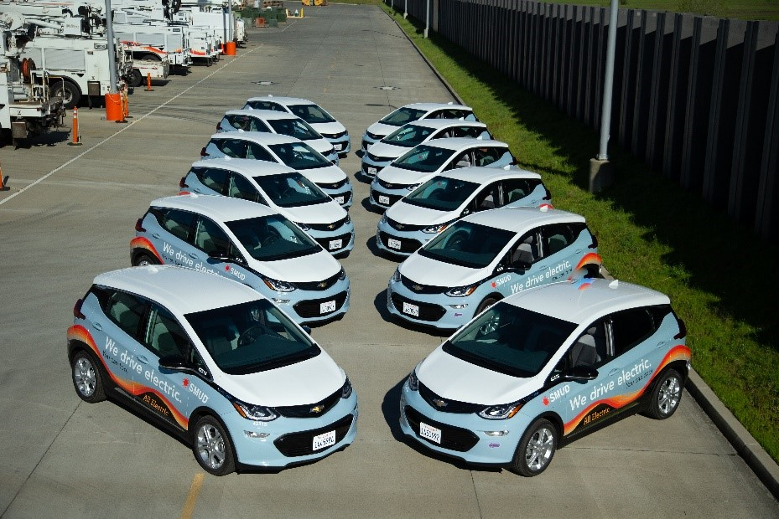
SMUD fleet overview
927
fleet assets
13%
“electrified”
5,413,708
miles annually
$10M
investment
3% zero emission (165,000 miles)
Total annual fleet capital

Slide 4






Breakdown of our fleet
Pickups & vans
Bucket trucks
Light duty
294
0%
electrified
93
30%
hybrid-electric
106
48%
electrified
2,438,750 annual miles driven
993,097 annual miles driven
488,557 annual miles driven
Heavy duty
Service trucks
Construction equipment
68
0%
electrified
141
4%
hybrid-electric
225
14%
electrified
327,711 annual miles driven
1,143,685 annual miles driven
9,907 annual miles driven

Slide 5
Key metrics

Slide 6
Spec writing for ZEVs…
Technical complexity
Demanding customers
Supply chain
Technology advances
Spec Writing
Customize vs. standard
Regulatory compliance
Ambitious fleet goals

Slide 7
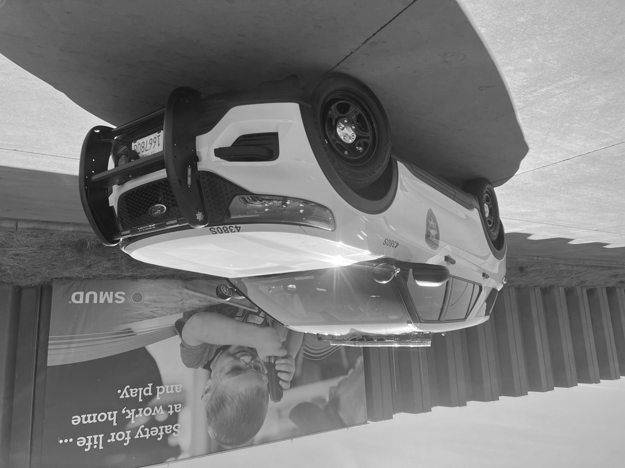
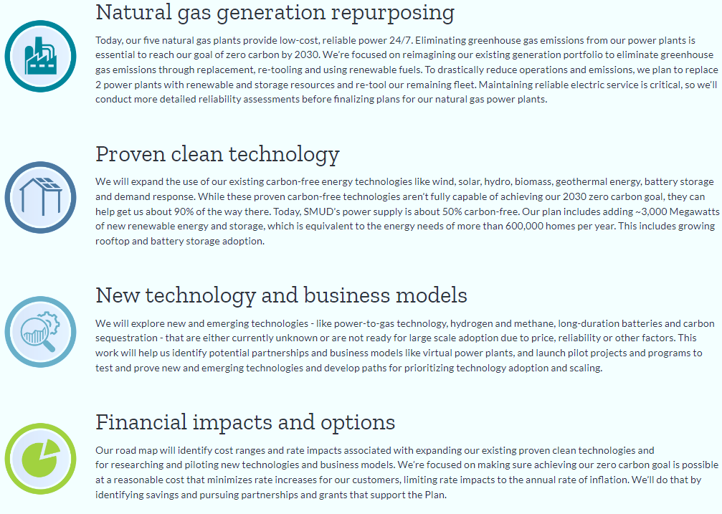


Case Study – SMUD Security
Problem Statement
      Telematics
      Test Data
      Workgroup Meeting
Methodology
Vehicle​ | AVE Total kWh/Day​
1884S​ | 46​
1887S​ | 27​
1947S​ | 16​
2046P​ | 64​
4016S​ | 187​
4017S​ | 104​
4018S​ | 82​
4019S​ | 139​
4020S​ | 124​
4021S​ | 244​
Average​ | 103​
Solution Finding
Vehicle | Battery [kWh]
Lightning SR | 98
Lightning ER | 131
Bolt EUV SSV | 65
Blazer SSV | 102
Silverado EV | 200
      Hybrid Vehicles
Electrify SMUD’s Fleet by 2030
Meet End User Minimum Requirements (Keep The Lights On)
Cost Effective Solutions
Repeatable Process
      Focus on Low Utilization
Final Decision
New Focus
Calculate Energy Usage
  Fuel Consumption
Utilized five months of data
  Idle Time
  Drive Time
Notes:
BOSWORTH
[Problem Statement]
Executive direction to electrify
Director direction to electrify
Keep the Lights On
Meet end user’s requirements to effectively perform their job
[As Fleet and as Fleet’s Engineers, we do not want to tell other departments how to do their job; we want to find solutions to problems]
Identify gross polluters
Idle time is a significant contribution to fleet emissions
Security Highest idle time in SMUD
Repeatable Process
Create a process to aid with evaluating other workgroup’s vehicles.
We don’t want this to be a one time process

Slide 8
Electrify SMUD’s Fleet by 2030
Meet End User Minimum Requirements (Keep The Lights On)
Cost Effective Solutions
Repeatable Process
Case Study – SMUD Security
      Telematics
      Test Data
      Workgroup Meeting
Problem Statement
Methodology
Vehicle​ | AVE Total kWh/Day​
1884S​ | 46​
1887S​ | 27​
1947S​ | 16​
2046P​ | 64​
4016S​ | 187​
4017S​ | 104​
4018S​ | 82​
4019S​ | 139​
4020S​ | 124​
4021S​ | 244​
Average​ | 103​
Solution Finding
Vehicle | Battery [kWh]
Lightning SR | 98
Lightning ER | 131
Bolt EUV SSV | 65
Blazer SSV | 102
Silverado EV | 200
      Hybrid Vehicles
Calculate Energy Usage
  Fuel Consumption
Utilized five months of data
  Idle Time
  Drive Time
      Focus on Low Utilization
Final Decision
New Focus
Test for Idle Consumption
  Standardized set of criteria
Ambient Temp., A/C, Radio, State of Charge
Notes:
BOSWORTH
[Utilize Telematics] - Create a repeatable process
Calculate energy usage based on fuel consumption to determine minimum battery size (Focus on fuel consumption rather than mileage)
Five Months' worth of usable data using telematic [data from July 2023]
Idle time
Drive time

Slide 9
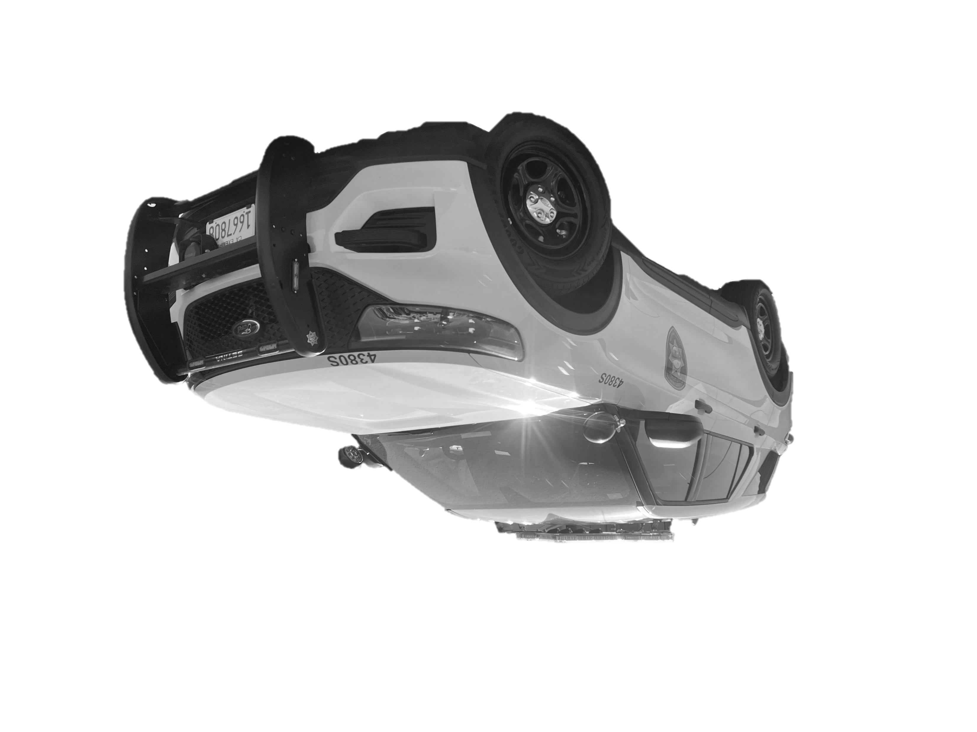
Calculate Energy Usage
  Fuel Consumption
Utilized five months of data
  Idle Time
  Drive Time
Case Study – SMUD Security
Methodology
      Telematics
      Test Data
      Workgroup Meeting
Methodology
Vehicle​ | AVE Total kWh/Day​
1884S​ | 46​
1887S​ | 27​
1947S​ | 16​
2046P​ | 64​
4016S​ | 187​
4017S​ | 104​
4018S​ | 82​
4019S​ | 139​
4020S​ | 124​
4021S​ | 244​
Average​ | 103​
Solution Finding
Vehicle | Battery [kWh]
Lightning SR | 98
Lightning ER | 131
Bolt EUV SSV | 65
Blazer SSV | 102
Silverado EV | 200
      Hybrid Vehicles
Test for Idle Consumption
  Standardized set of criteria
Ambient Temp., A/C, Radio, State of Charge
      Focus on Low Utilization
Final Decision
New Focus
JULY 2023
Vehicle | Idle Time | Drive Time [hr] | Idle Time % | gal/hr | gal/hr Drive | gal/hr Idle | Drive kWh/month | Idle kWh/ month | Drive kWh/ day | Idle kWh/Day | Total kWh/Day
1884S | 104 | 43 | 71% | 0.68 | 0.81 | 0.63 | 1,283 | 94 | 41 | 3 | 44
1887S | 78 | 15 | 84% | 0.76 | 1.72 | 0.57 | 946 | 70 | 31 | 2 | 33
1947S | 56 | 14 | 80% | 0.72 | 1.82 | 0.45 | 937 | 51 | 30 | 2 | 32
2046P | 43 | 59 | 42% | 0.84 | 1.05 | 0.55 | 2,258 | 38 | 73 | 1 | 74
4016S | 256 | 112 | 70% | 0.84 | 1.51 | 0.55 | 6,195 | 231 | 200 | 7 | 207
4017S | 203 | 85 | 70% | 0.74 | 1.39 | 0.47 | 4,324 | 183 | 139 | 6 | 145
4018S | 50 | 18 | 74% | 0.72 | 1.35 | 0.49 | 892 | 45 | 29 | 1 | 30
4019S | 165 | 77 | 68% | 0.82 | 1.43 | 0.53 | 4,037 | 149 | 130 | 5 | 135
4020S | 172 | 91 | 65% | 0.91 | 1.58 | 0.56 | 5,268 | 156 | 170 | 5 | 175
4021S | 365 | 168 | 68% | 0.82 | 1.50 | 0.51 | 9,262 | 329 | 299 | 11 | 309
Notes:
BOSWORTH
[Test Data] with current EVs (to determine idle kW consumption)
Ran a test with current inventory of Bolt EVs, ID.4, Leaf, Mach E, mimicking average idle time
Consistent radio, air conditioner, state of charge, ambient temperature settings

Slide 10
Case Study – SMUD Security
Methodology
      Telematics
      Test Data
      Workgroup Meeting
JULY 2023
Vehicle | Idle Time | Drive Time [hr] | Idle Time % | gal/hr | gal/hr Drive | gal/hr Idle | Drive kWh/month | Idle kWh/ month | Drive kWh/ day | Idle kWh/Day | Total kWh/Day
1884S | 104 | 43 | 71% | 0.68 | 0.81 | 0.63 | 1,283 | 94 | 41 | 3 | 44
1887S | 78 | 15 | 84% | 0.76 | 1.72 | 0.57 | 946 | 70 | 31 | 2 | 33
1947S | 56 | 14 | 80% | 0.72 | 1.82 | 0.45 | 937 | 51 | 30 | 2 | 32
2046P | 43 | 59 | 42% | 0.84 | 1.05 | 0.55 | 2,258 | 38 | 73 | 1 | 74
4016S | 256 | 112 | 70% | 0.84 | 1.51 | 0.55 | 6,195 | 231 | 200 | 7 | 207
4017S | 203 | 85 | 70% | 0.74 | 1.39 | 0.47 | 4,324 | 183 | 139 | 6 | 145
4018S | 50 | 18 | 74% | 0.72 | 1.35 | 0.49 | 892 | 45 | 29 | 1 | 30
4019S | 165 | 77 | 68% | 0.82 | 1.43 | 0.53 | 4,037 | 149 | 130 | 5 | 135
4020S | 172 | 91 | 65% | 0.91 | 1.58 | 0.56 | 5,268 | 156 | 170 | 5 | 175
4021S | 365 | 168 | 68% | 0.82 | 1.50 | 0.51 | 9,262 | 329 | 299 | 11 | 309
Vehicle​ | AVE Total kWh/Day​
1884S​ | 46​
1887S​ | 27​
1947S​ | 16​
2046P​ | 64​
4016S​ | 187​
4017S​ | 104​
4018S​ | 82​
4019S​ | 139​
4020S​ | 124​
4021S​ | 244​
Average​ | 103​
Methodology
      Hybrid Vehicles
Solution Finding
Vehicle | Battery [kWh]
Lightning SR | 98
Lightning ER | 131
Bolt EUV SSV | 65
Blazer SSV | 102
Silverado EV | 200
      Focus on Low Utilization
Final Decision
New Focus
Notes:
BOSWORTH

Slide 11
JULY 2023
Vehicle | Idle Time | Drive Time [hr] | Idle Time % | gal/hr | gal/hr Drive | gal/hr Idle | Drive kWh/month | Idle kWh/ month | Drive kWh/ day | Idle kWh/Day | Total kWh/Day
1884S | 104 | 43 | 71% | 0.68 | 0.81 | 0.63 | 1,283 | 94 | 41 | 3 | 44
1887S | 78 | 15 | 84% | 0.76 | 1.72 | 0.57 | 946 | 70 | 31 | 2 | 33
1947S | 56 | 14 | 80% | 0.72 | 1.82 | 0.45 | 937 | 51 | 30 | 2 | 32
2046P | 43 | 59 | 42% | 0.84 | 1.05 | 0.55 | 2,258 | 38 | 73 | 1 | 74
4016S | 256 | 112 | 70% | 0.84 | 1.51 | 0.55 | 6,195 | 231 | 200 | 7 | 207
4017S | 203 | 85 | 70% | 0.74 | 1.39 | 0.47 | 4,324 | 183 | 139 | 6 | 145
4018S | 50 | 18 | 74% | 0.72 | 1.35 | 0.49 | 892 | 45 | 29 | 1 | 30
4019S | 165 | 77 | 68% | 0.82 | 1.43 | 0.53 | 4,037 | 149 | 130 | 5 | 135
4020S | 172 | 91 | 65% | 0.91 | 1.58 | 0.56 | 5,268 | 156 | 170 | 5 | 175
4021S | 365 | 168 | 68% | 0.82 | 1.50 | 0.51 | 9,262 | 329 | 299 | 11 | 309
Case Study – SMUD Security
Methodology
      Telematics
      Test Data
      Workgroup Meeting
Methodology
Vehicle​ | AVE Total kWh/Day​
1884S​ | 46​
1887S​ | 27​
1947S​ | 16​
2046P​ | 64​
4016S​ | 187​
4017S​ | 104​
4018S​ | 82​
4019S​ | 139​
4020S​ | 124​
4021S​ | 244​
Average​ | 103​
Solution Finding
      Hybrid Vehicles
Vehicle | Battery [kWh]
Lightning SR | 98
Lightning ER | 131
Bolt EUV SSV | 65
Blazer SSV | 102
Silverado EV | 200
Minimum ten vehicles
Two 12 hour shifts
Lighting Package
Body Accessories
      Focus on Low Utilization
Final Decision
New Focus
Change Management Opportunities
Cross Reference Available Vehicles With Data
Notes:
FREEMAN
We held multiple Workgroup Meetings
Understand work practice and duty cycle
Determine Minimum Specifications
Substantial Lighting Package
Radios
Laptop Mobile Data Terminal
Push Bumper
Storage for safety equipment
Ballistic Panels

Slide 12
Minimum ten vehicles
Two 12 hour shifts
Lighting Package
Body Accessories
Case Study – SMUD Security
      Telematics
      Test Data
      Workgroup Meeting
Vehicle​ | AVE Total kWh/Day​
1884S​ | 46​
1887S​ | 27​
1947S​ | 16​
2046P​ | 64​
4016S​ | 187​
4017S​ | 104​
4018S​ | 82​
4019S​ | 139​
4020S​ | 124​
4021S​ | 244​
Average​ | 103​
Methodology
Solution Finding
Vehicle | Battery [kWh]
Lightning SR | 98
Lightning ER | 131
Bolt EUV SSV | 65
Blazer SSV | 102
Silverado EV | 200
      Hybrid Vehicles
Change Management Opportunities
Cross Reference Available Vehicles With Data
      Focus on Low Utilization
Final Decision
New Focus
Wait for More Viable EV solution
Current State: 75% to 80% solution
Higher Risk to Operations
Notes:
FREEMAN
[Solution Finding]
Cross reference available vehicle battery size (usable battery) with required energy per day
Utilize data to determine vehicle quantity – are more vehicles needed to meet equipment needs
(2) 12 hours shifts
Minimum 10 vehicles
Look at service locations and charging feasibility (Worked in parallel with utilization data)
Security operates throughout SMUD’s service territory and power generation facilities – Sacramento County, Solano County, and Eldorado County
Use data to look at possible change management opportunities
Underutilized vehicles – 1947S was not utilized because it “is a piece of junk”

Slide 13
Change Management Opportunities
Cross Reference Available Vehicles With Data
Case Study – SMUD Security
Vehicle​ | AVE Total kWh/Day​
1884S​ | 46​
1887S​ | 27​
1947S​ | 16​
2046P​ | 64​
4016S​ | 187​
4017S​ | 104​
4018S​ | 82​
4019S​ | 139​
4020S​ | 124​
4021S​ | 244​
Average​ | 103​
Solution Finding
Vehicle | Battery [kWh]
Lightning SR | 98
Lightning ER | 131
Bolt EUV SSV | 65
Blazer SSV | 102
Silverado EV | 200
      Hybrid Vehicles
Wait for More Viable EV solution
Current State: 75% to 80% solution
Higher Risk to Operations
      Focus on Low Utilization
Final Decision
New Focus
Lower Mile per Year
Daily Utilization
Duty Cycle
  Supervisor Vehicles
  Pool Vehicles
Notes:
FREEMAN
[Final Decision]
EV was not a valid solution
75% Solution: Upfit requirements, daily utilization, EV availability, charging infrastructure (remote locations provide level 1 charging, if at all)
Determination to proceed with Hybrid vehicles
Reduce emissions while maintaining operational efficiency
Additional Example: Meter/Elec tech Van
Duty Cycle, average milage, upfit requirements (Aux A/C, export power)

Slide 14


Wait for More Viable EV solution
Current State: 75% to 80% solution
Higher Risk to Operations
Case Study – SMUD Security
      Hybrid Vehicles
Lower Mile per Year
Daily Utilization
Duty Cycle
  Supervisor Vehicles
  Pool Vehicles
Additional Testing
      Focus on Low Utilization
Final Decision
New Focus
EV FLEETS
      Telematics
      Test Data
      Workgroup Meeting
      Focus on Low Utilization
      Hybrid Vehicles
Vehicle​ | AVE Total kWh/Day​
1884S​ | 46​
1887S​ | 27​
1947S​ | 16​
2046P​ | 64​
4016S​ | 187​
4017S​ | 104​
4018S​ | 82​
4019S​ | 139​
4020S​ | 124​
4021S​ | 244​
Average​ | 103​
Solution Finding
Methodology
New Focus
Problem Statement
Final Decision
Data Exists in Telematics
Telematics Highlight the Worst Offenders
Replacement Strategy – Simple First pass
Understand the Workgroup Needs/Wants
Sometimes the Data Doesn’t Exist Online
Notes:
FREEMAN
[New Focus]
Simple First Barrier: 250 Pickup trucks – First pass using TTM Average daily milage less than 100 miles, Maximum mileage less than 200 miles – simple barrier since we can not purchase trucks at this time and we don’t have the infrastructure to support all pickup trucks
This first pass can be used for SUVs as well.
Typical vehicles include: Supervisor Vehicles, Facilities Vehicles, and Pool Vehicles
low utilization – miles, operating time, duty cycle

Slide 15
Lower Mile per Year
Daily Utilization
Duty Cycle
  Supervisor Vehicles
  Pool Vehicles
Case Study – SMUD Security
EV FLEETS
      Telematics
      Test Data
      Workgroup Meeting
      Focus on Low Utilization
      Hybrid Vehicles
Vehicle​ | AVE Total kWh/Day​
1884S​ | 46​
1887S​ | 27​
1947S​ | 16​
2046P​ | 64​
4016S​ | 187​
4017S​ | 104​
4018S​ | 82​
4019S​ | 139​
4020S​ | 124​
4021S​ | 244​
Average​ | 103​
Data Exists in Telematics
Telematics Highlight the Worst Offenders
Replacement Strategy – Simple First pass
Understand the Workgroup Needs/Wants
Sometimes the Data Doesn’t Exist Online
Solution Finding
Methodology
New Focus
Problem Statement
Final Decision
      Focus on Low Utilization
New Focus
QUESTIONS?
Notes:
Data Exists in Telematics – Formulate a plan to utilize the data
Sometimes the Data Doesn’t Exist Online – Test to gain rear world data
Telematics Highlight the Worst Offenders – Easy to identify high polluters
Replacement Strategy – Simple First pass to take a smaller bite out of a larger initiative
Understand the Workgroup Needs/Wants – This may be a significant barrier to electrifying a fleet requiring more than just a vehicle

Slide 16
Lower Mile per Year
Daily Utilization
Duty Cycle
  Supervisor Vehicles
  Pool Vehicles
Case Study – SMUD Security
EV FLEETS
      Telematics
      Test Data
      Workgroup Meeting
      Focus on Low Utilization
      Hybrid Vehicles
Vehicle​ | AVE Total kWh/Day​
1884S​ | 46​
1887S​ | 27​
1947S​ | 16​
2046P​ | 64​
4016S​ | 187​
4017S​ | 104​
4018S​ | 82​
4019S​ | 139​
4020S​ | 124​
4021S​ | 244​
Average​ | 103​
Solution Finding
Methodology
New Focus
Problem Statement
Final Decision
QUESTIONS
      Focus on Low Utilization
New Focus
QUESTIONS?

