Slide 1
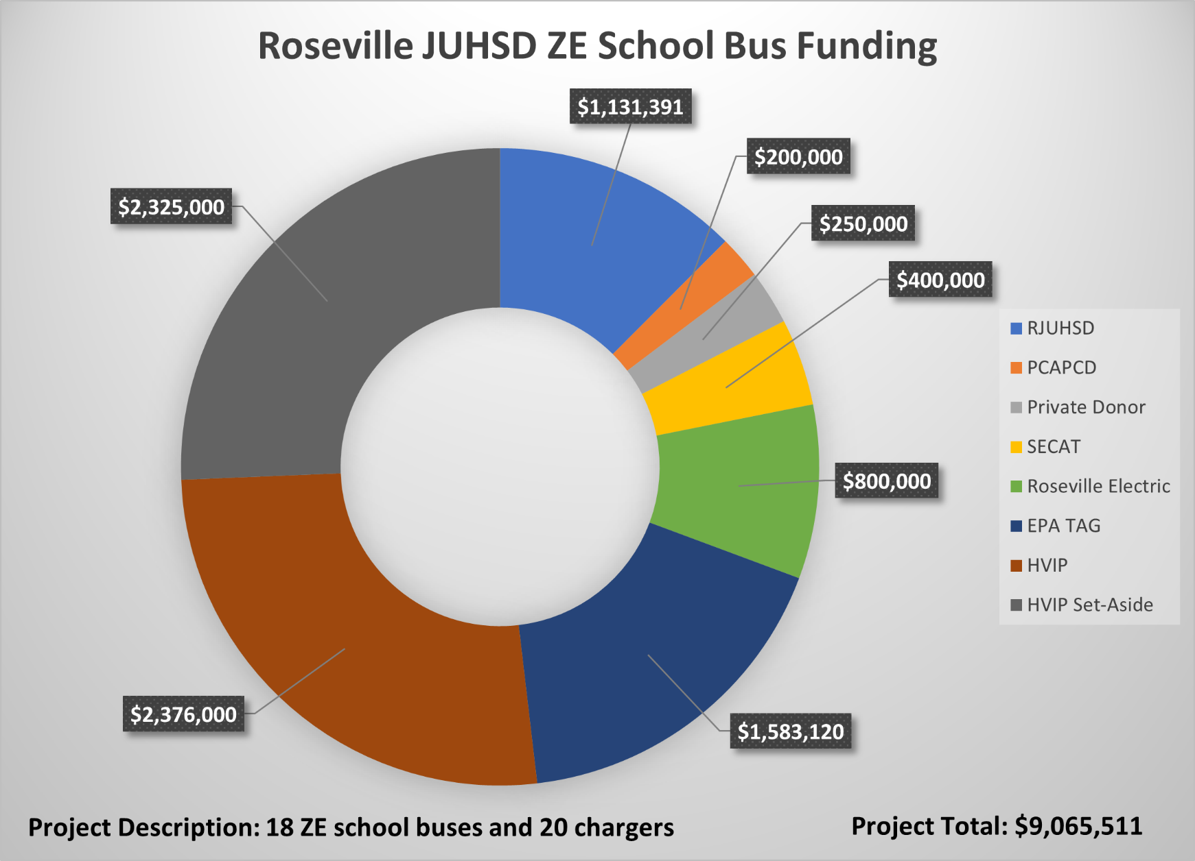
RJUHSD has a fleet of 44 school buses, 41 diesel, two propane, and one gasoline. Approximately two-thirds of the buses in the fleet are model year-2008 or older, with more than half of those buses being model year 2002 or older. The school district has a goal to acquire 22 electric school buses (ESBs) and charging infrastructure.
To obtain its initial fleet of 18 ESBs and 20 chargers, RJUHSD relied principally on external funding sources for the buses and infrastructure. The total cost was almost $9 million dollars with a school district contribution estimated at $1.1 million. External funding sources include HVIP, HVIP School Bus Set-Aside, Environmental Protection Agency Targeted Airshed Grant, Roseville Electric, Sacramento Air Quality Management District SECAT Program, Placer County Air Pollution District Clean Air Grant Program, and a private donor.

