Slide 1
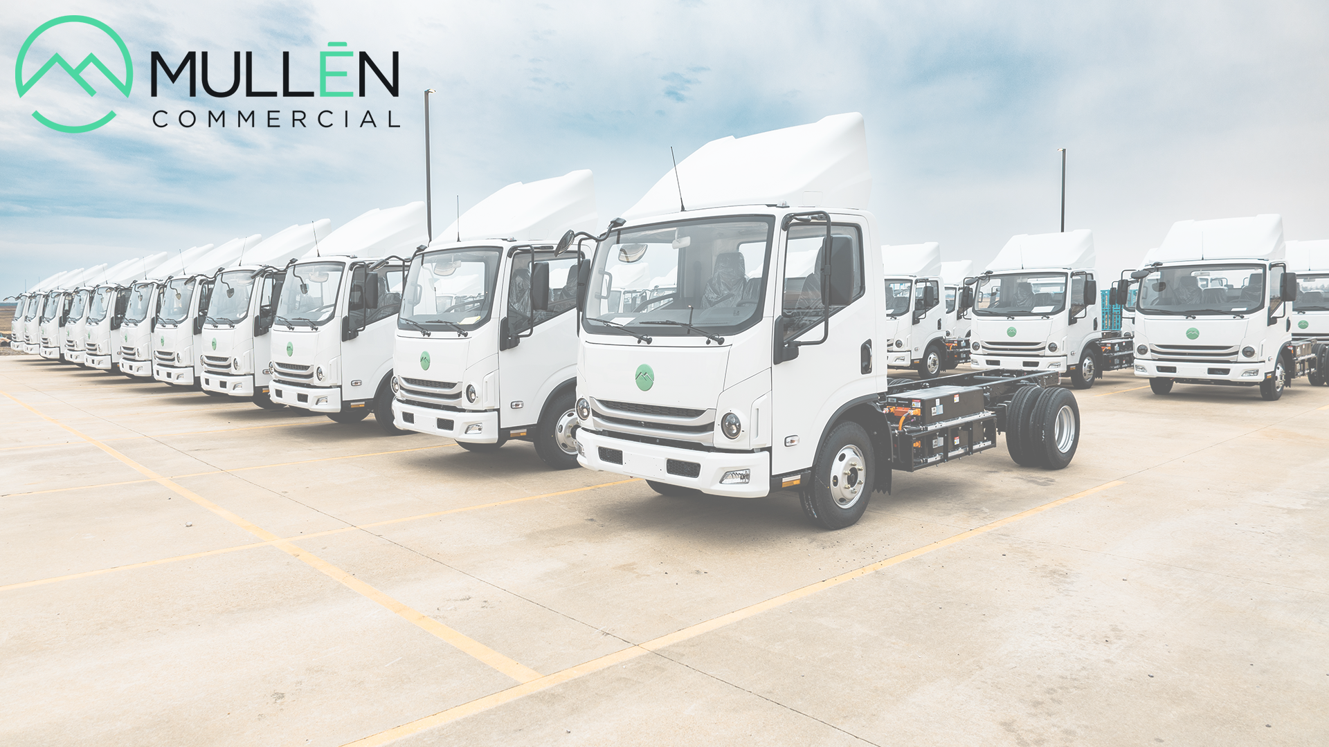

THE ALL ELECTRIC
MULLEN THREE
CLASS 3 LOW CAB FORWARD

Slide 2
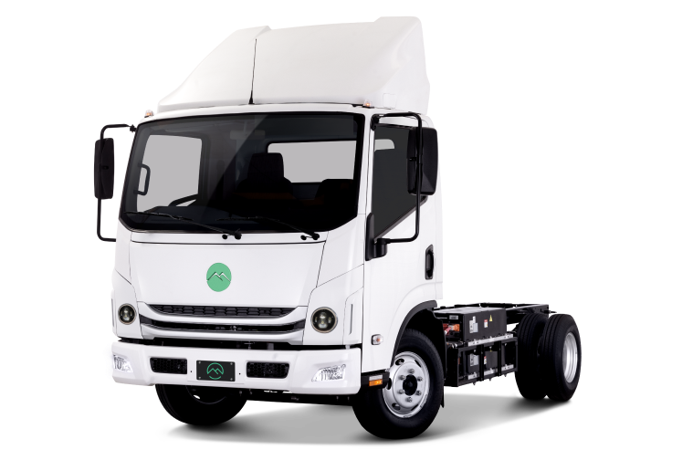
MULLEN THREE – ALL ELECTRIC CHASSIS CAB
    “Big Little Vehicle”
    Low Cab Forward Design Provides Excellent Visibility and Maneuverability
    16% Stronger Frame for Larger Upfits
    Better Manuverability and Turning Circle than the traditional Medium Duty Box Deletes.
Mullen Three
(1) Combined City/Highway usage with 10 percent remaining battery state of charge. Range can vary depending on conditions such as climate, driving behavior, road conditions, etc.
Note: All specifications and dates are reference only and Mullen reserves the right to modify any and all information shown, without notification.

Slide 3
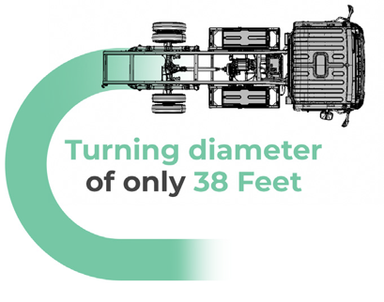
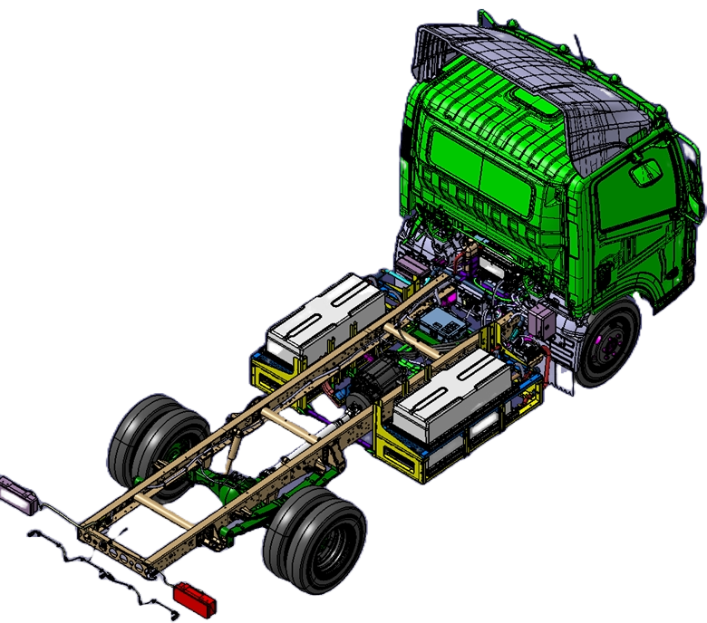
MULLEN THREE – ALL ELECTRIC CHASSIS CAB
  Weight Ratings
  GVWR 11,000 lbs.
  Available Payload 5,316 lbs.
  Dimensions
  130” Wheelbase
  108” Cab/Axle Cab/Rear 164.5” Rear Overhang 56.5”
    Max Upfit Body length 14’
  Plenty of room around batteries and frame for mounting
    Typical industry U-bolt & Shear Strap fastener friendly
  Frame Width 29”
  Turning Diameter 38’
Note: All specifications and dates are reference only and Mullen reserves the right to modify any and all information shown, without notification.

Slide 4
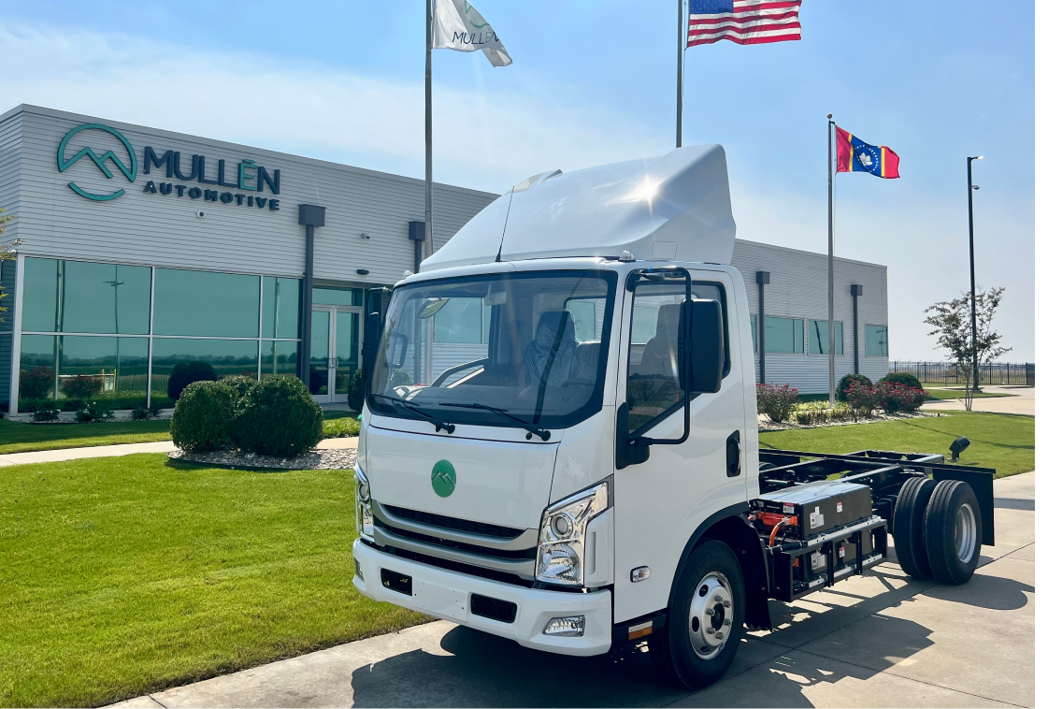
MULLEN THREE – ALL ELECTRIC CHASSIS CAB
  Electric Motor
  120 kW
  Battery Packs: 89 kWh total
  Lithium-Iron Phosphate
  Liquid Cooled/Heated
  3” proud of frame rail / Below Risers
  Performance
  Range >125 miles⁽¹⁾
  Max Speed 65mph
  Regenerative Braking Standard
  Charging
  Level 2 up to 12kW On-board – Approx 7.5 hours Charge Time
  Level 3 up to 78kW On-board – Approx, 1.75 hours Charging Time
(1) Combined City/Highway usage with 10 percent remaining battery state of charge. Range can vary depending on conditions such as climate, driving behavior, road conditions, etc.
Note: All specifications and dates are reference only and Mullen reserves the right to modify any and all information shown, without notification.

Slide 5
Territory Managers:
Ryan Murphy - North of Interstate I-80
916-601-5415 cell
rmurphy@papekenworth.com
Mario Mejia - South of Interstate I-80
916-825-5440 cell
mmejia@papekenworth.com
Additional Support:
Mike Hoheisel – BEV Specialist
mhoheisel@papekenworth.com
Shannon Villareal – Grant Specialist
sphaneuf@papekenworth.com

