Slide 1

GOVERNMENT SURPLUS
AUCTION INSIGHTS

Slide 2



Who is Purple Wave?
25 year old National Surplus Auction Company, based in KS
In past year, grown to nationwide force with 120 Territory Managers, including 13 in California alone, 5 in NorCal.
Straight/Simple/Sold - providing agencies an easy process.
  We handle it all - Data Capture, listings, titles, marketing, etc.
  Very simple to use and low fees.
Copart investment gives agencies access to selling from offsite if needed.
Shipping and appraisal services are available
Awarded by OMNIA as only national Full Service Auction Provider

Slide 3

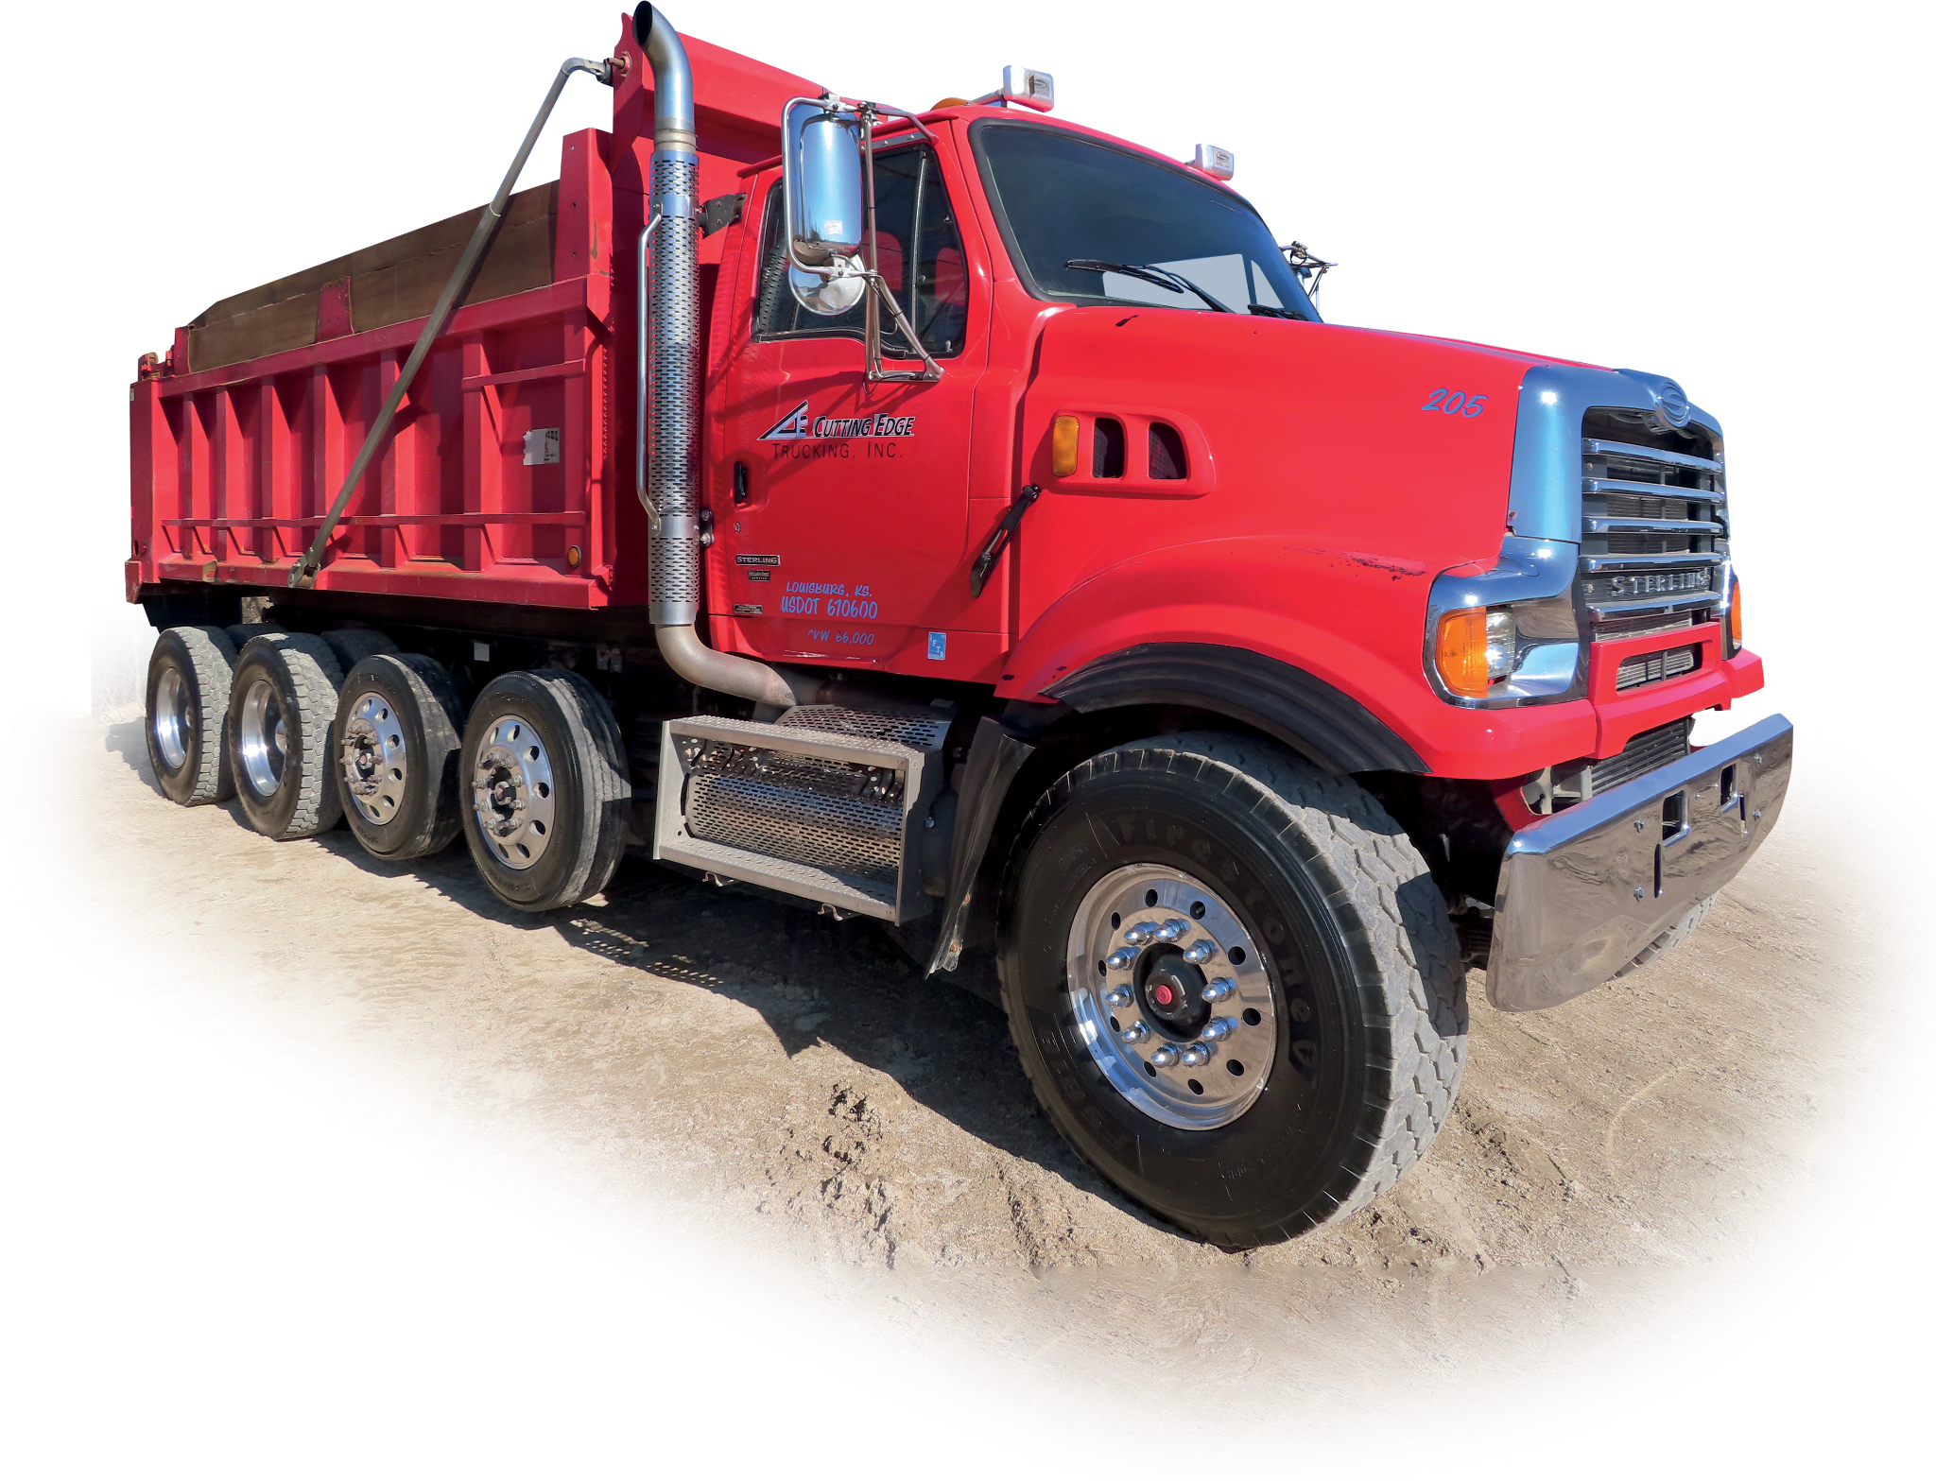

Government Remarketing Trends
What is Important to You?
Ease of Use
Minimal amount of staff time needed
Technology allows for easy updates
Flexibility Important
Aligning our timeline to best fit your timing
Results Are Crucial
Above and beyond asset marketing
Transparency Critical
The auction process must be honest and fair

Slide 4
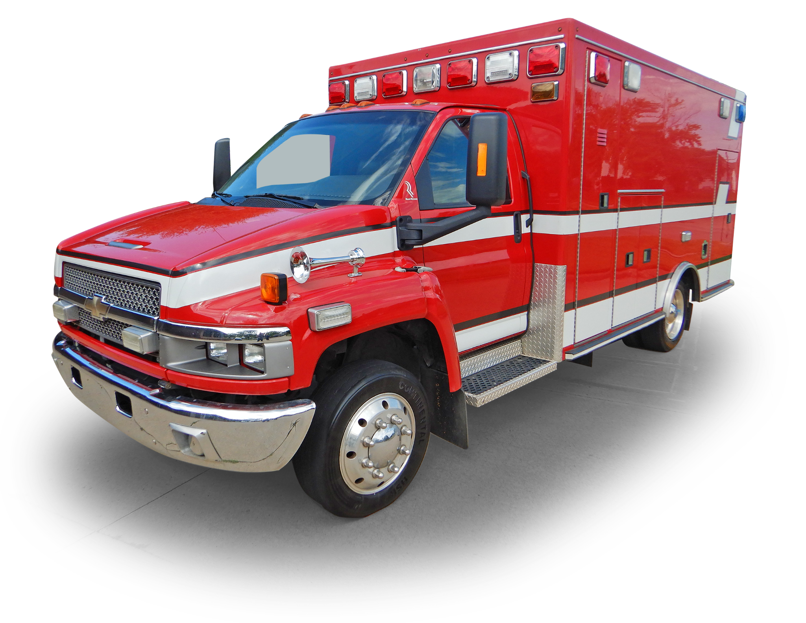
Ease of Use
Let experts handle photos/videos and listings
Let experts handle titles
Let experts market nationwide
Why?
  Your time is valuable
  You can stay focused on what you do best.

Slide 5

You Deserve Best Results
Your auction team will call local bidders on behalf of your assets
Purple Wave will have a good buyer base for what you’re selling
Marketing is important - social media and with and asset promotion team
Your auction company should have understandable fees - nothing should be hidden

Slide 6

Cooperative
Contracts
Contract # R240604
Only Full Service Auction Company Awarded.
Low fee to you - flat 10% Buyers Premium
Purple Wave supports the Fleet community

Slide 7
A Quick Word about Sustainability in Auction Services
We always strive to offer service at your location, if possible
  Cuts down on time (fluid leakage)
  Cuts down on fuel and emissions in transfer process
Due to insurance or space restrictions, often time this isn’t possible, so we make it easy for you either way
  Our transportation services are out quickly
  We sell from our local Copart yard
  We help buyers with transportation, if possible
We ourselves are here - local touch with nationwide reach

Slide 8

Questions?
Local Hustle with National Muscle
John Littler, Govt Strategic Account Manager
john.littler@purplewave.com
360.564.9655
David VanHill, TSM
David.VanHill@purplewave.com
916-336-7794
Alexis Maurtua, TSM
Alexis.Maurtua@purplewave.com
916-469-8752

