Slide 1


Continuously Connected

Slide 2
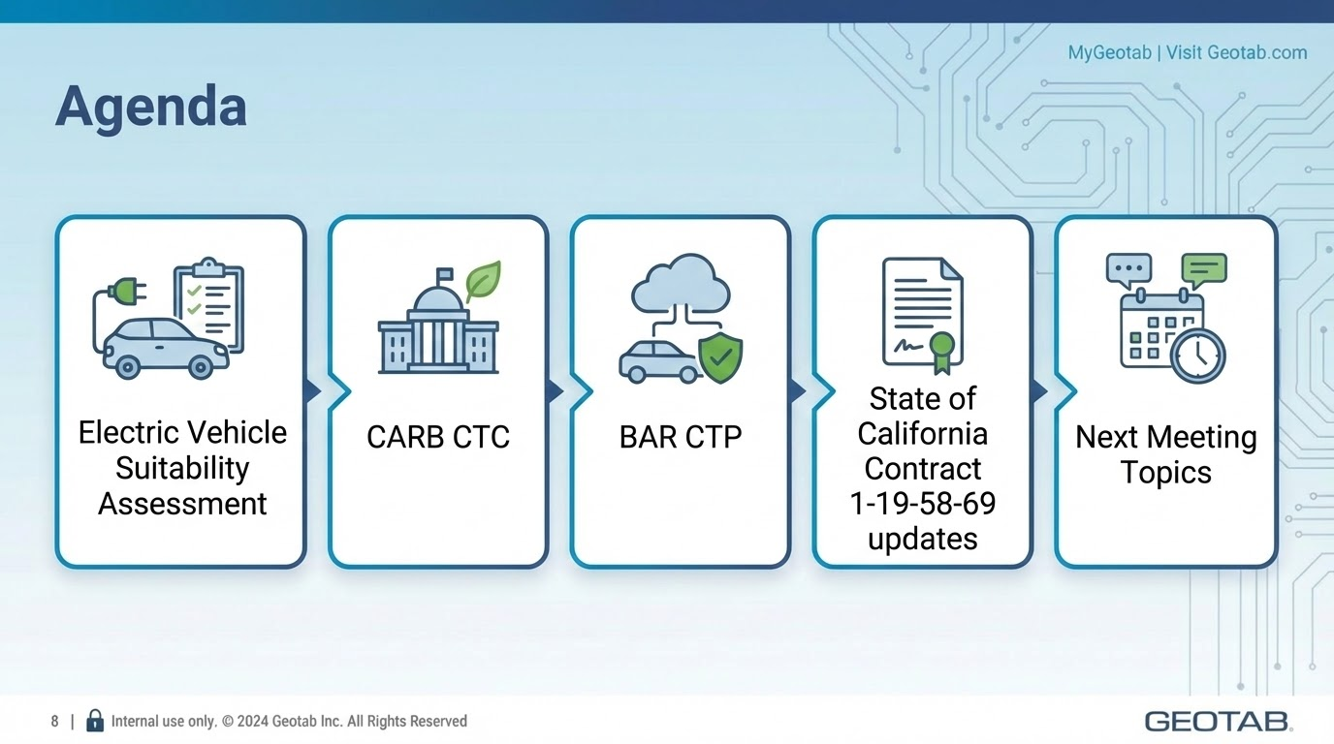

Slide 3





Advancing sustainability goals is challenging
Regulatory complexity
Navigating varying emissions rules,
reporting requirements, and available incentives.
Stakeholder expectations
Addressing customer and investor demands
for verifiable data on carbon emissions.
Disconnected data
Missing a consolidated view from
telematics, fuel and charging data.
Difficulty guiding investments
Lacking clarity to prioritize investments
for maximum impact.

Slide 4




Achieve your sustainability goals with Geotab
Assess
sustainability
Plan EV
transition
Optimize EV performance
Report
emissions
Understand fleet emissions and fuel use at a glance.
Identify opportunities for light-duty fleet electrification.
Strategically evaluate which vehicles to electrify.
Make informed decisions on costs, fleet readiness, and charging infrastructure.
Efficiently manage
EV operations.
Gain confidence in your EV investment and build your case for further adoption.
Streamline GHG reporting
for regulatory and
customer needs.
Report with confidence and meet global standards.
Operate a responsible, future-proof fleet.

Slide 5






Geotab is the best partner to help plan your fleet electrification journey
Robust EV model support
1
Go electric with confidence
2
Optimize electric fleet operations
3
Charging integrations
No EVs
More EVs
Notes:
Why Geotab for fleet electrification?
Leader in telematics with over 20 years of experience
44k+ customers, 3M+ connected vehicles across 130+ countries
280+ fully supported EV models, twice that of other fleet telematics solutions
10+ years of experience working with OEMs to support advanced EV signals
Robust EV model support – Your fleet is supported now and into the future
Unlike fuel vehicles there is no standard for EV data
Geotab fleets benefit from 10+ years of innovation with OEMs
Over 280 EV makes and models are fully supported
Twice that of the nearest competitor
Advanced EV signals including state of charge
Go electric with confidence – pinpoint where an EV can do the job for less
Adding EVs to fleets can be a complicated. Fleets get EV model recommendations based on range, vehicle class, and ROI.
Optimize electric fleet operation – ensure your EVs are used optimally and are paying off
Electric fleets come with new considerations. Geotab ensures a fleets EV investment pays off. Fleets get assurance that EVs are charged, optimally deployed, charging costs tracked and ROI positive.
Charging integration – integrate with partners to begin managing charging and energy demands
EV charging demand at scale needs to be managed. Geotab is working with charging providers to integrate EV data with load management solutions. Fleets will be able to optimize EV charging and costs based on operations.

Slide 6
Key data points to plan for electrification
Financial
Operational
Environmental
Total cost of ownership
and savings
Operational
feasibility and fit
GHG reduction
and compliance
1
Quantify the ROI of electrification
by comparing lifetime TCO of
EVs vs. ICE vehicles, factoring in
fuel, electricity, maintenance,
and procurement costs.
2
Pinpoint best-fit EVs by
analyzing real-world driving
patterns, guaranteeing range assurance across seasonal
changes, and estimating charging requirements to meet those needs.
3
Project the direct impact of electrification by calculating the
total reduction in tailpipe emissions to help achieve sustainability
and disclosure goals.

Slide 7





Electrification
Success Ingredients
Vehicle Replacement Strategy
Charging Infrastructure Plan
Notes:
There are several ingredients that would lead you to success in your deployment plan,
i’m going to focus on two cornerstones on which you’ll build the rest of your plan.

Slide 8
Vehicle Replacement Strategy
How to prioritize which vehicles to replace by EVs?
Range capability / On-route charging tolerance
Procurement and operational expenses
Tailpipe CO₂ reduction
Range Capability Analysis
Weather seasonality
Driving speed
Terrain topology
Payload mass
TCO Analysis
Procurement
Residual value
Maintenance
Fuel / Energy
Incentives & Grants
Multi-year Replacement Plan
Vehicles end-of-life
Annual budget constraints
Notes:
You need to put criteria on what a good fit for EV replacement means to your org.
How do I prioritize………….
This is where Telematics shines in giving you accurate range analysis and EV energy consumption estimates so you can build the TCO with better numbers
Easy for Passenger vehicles and harder for higher weight classes

Slide 9
Charging Infrastructure Plan
Where do I start with creating a charging plan?
How do I prioritize sites?
Should I create a home charging policy?
Vehicle Charging Suitability
Dwell time validation
Dwell location conformity
On-route charging needs
Different charger speeds
Site/Depot Assessment
Vehicle congregation patterns
Number of chargers
Incremental power needs
Electrical upgrades
Load management / lower peak consumption
Multi-year Replacement Plan
EV growth projections
Annual budget constraints
Real estate considerations
Physical site constraints
Power constraints
Notes:
Vehicle charging suitability: Extend range suitability to validate the vehicle dwells enough and and its dwelling location is predictable and doesn’t change a lot.

Slide 10

Home Charging Programs
Currently underutilized by most organizations
PROs
Reduce site power requirements
Reduce overall costs
Increase pool of capable EVs in fleet
Employee perk
CONs
Insurance / Liability
Build program policies:
  Eligibility based on dwelling type
  Employee relocation / departure
Coordinate installations / support
Manage charging cost reimbursement
Notes:
Underutilized because it adds complexity and nuances. Fleets are deferring it till they’ve got a handle on site charging.

Slide 11




Collaboration within the organization
Another important success ingredient
Different roles across the organization need to work together to ensure success
Sustainability Manager
Set emissions targets
Craft decarbonization strategy
Get organizational alignment
Measure & track progress
Fleet Manager
Identify EV opportunities
Manage introduction of EVs to fleet
Ensure smooth EV operation
Facilities Manager
Understand power requirements
Coordinate site upgrades
Charger installation & upkeep
Drivers
Vehicle selection
Range anxiety -> range awareness
Access to charging
New driving & charging habits
Minimal job interruption
Notes:
Buy-in, education, and support
Drivers: data to get them on board

Slide 12
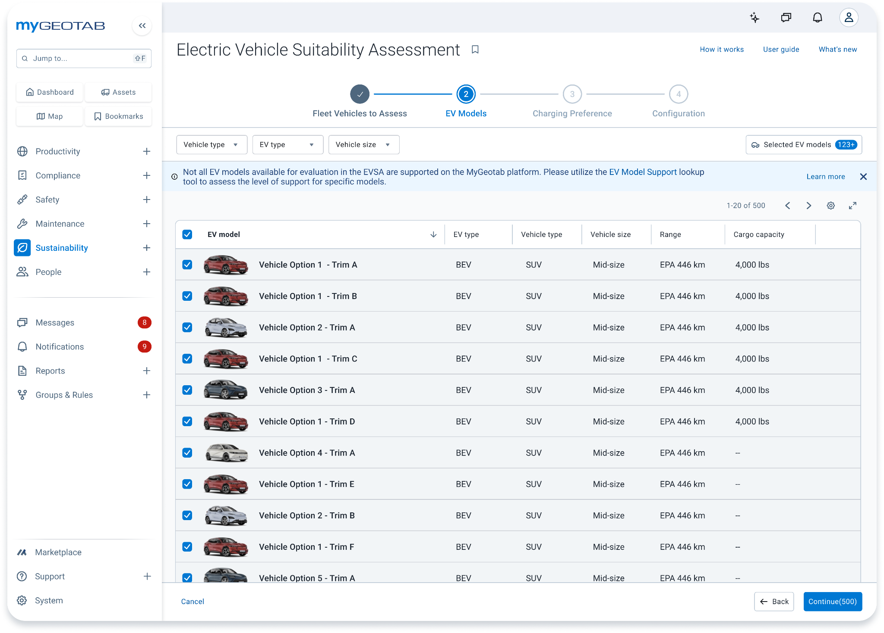




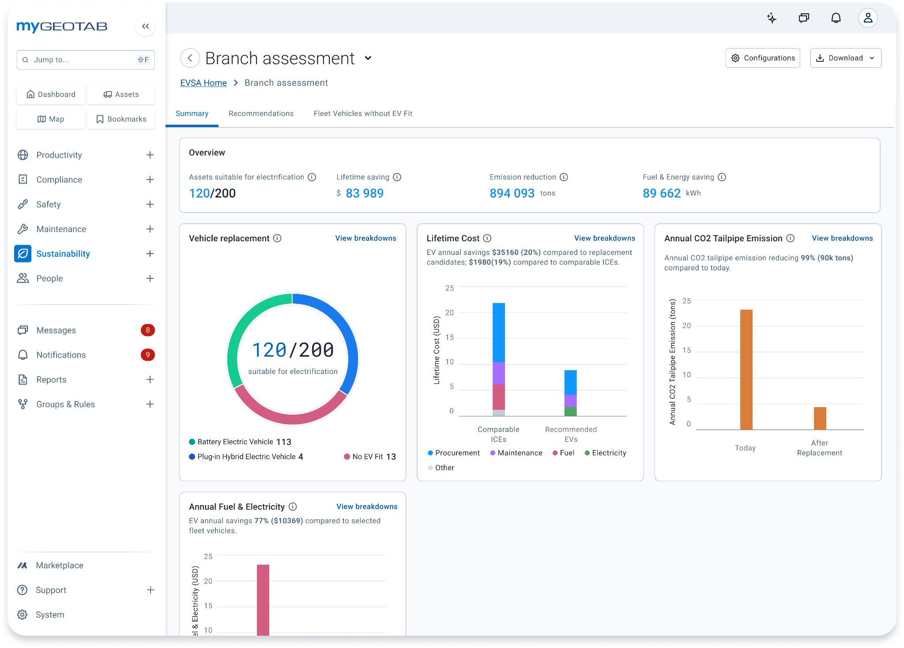

Electric Vehicle
Suitability Assessment (EVSA)
PLAN
Plan your roadmap
Build your case
Identify electrification candidates using real-world data and charging information.
Get reliable financial forecasts and compare lifetime costs
your current vehicles and potential EV replacements.
Save time researching EV replacements with local market best-fit model recommendations.
Estimate your potential fuel savings and CO2 emission reductions by simulating electrification scenarios.
Assess EV viability based
on charging availability
and driver preferences.
Notes:
Our EV Suitability Assessment (EVSA) takes the guesswork out of your transition:
Analyze Fleet Data: Identifies the best-suited electric models for your fleet using your real-world driving data.
Estimate Reductions: Forecasts your potential emissions reductions based on specific EV replacement choices.
Access Financial Insights: Compares lifetime Total Cost of Ownership (TCO) between your current vehicles and potential EV replacements.
Analyze Charging Needs: Determines workplace or home charging requirements to confirm the viability of your transition plan.
One of the biggest hurdles in electrification is knowing where to start. Our EV Suitability Assessment removes that uncertainty. It analyzes your existing fleet's telematics data to identify which vehicles are prime candidates for electrification. It recommends specific models, forecasts your emissions savings, provides a clear financial breakdown including TCO, and even analyzes what you'll need for charging infrastructure.

Slide 13
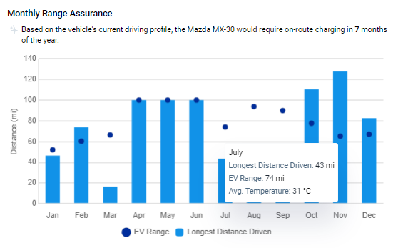
Accurate EV range simulations
Recommendations that work
Using real world EV data to create energy efficiency models for our recommendation and suitability assessment engine.
Benefits
Account for the impact of seasonal outside temperature (and projected climate control usage), trip speed & air resistance, trip distances and durations
Avoid recommendations of electric vehicles that won't meet fleet needs
Increase end user trust and confidence
in the recommendation

Slide 14
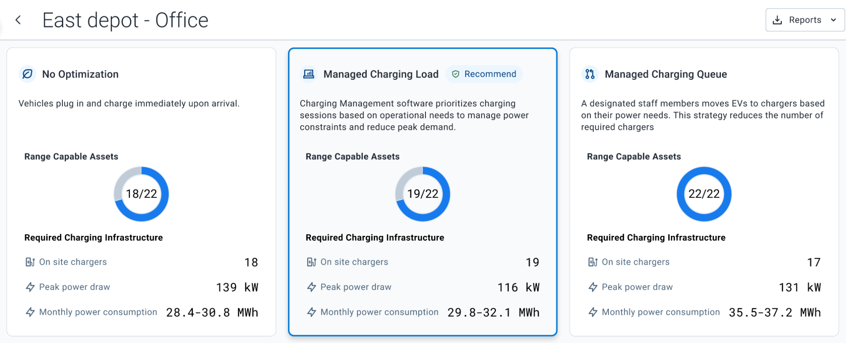
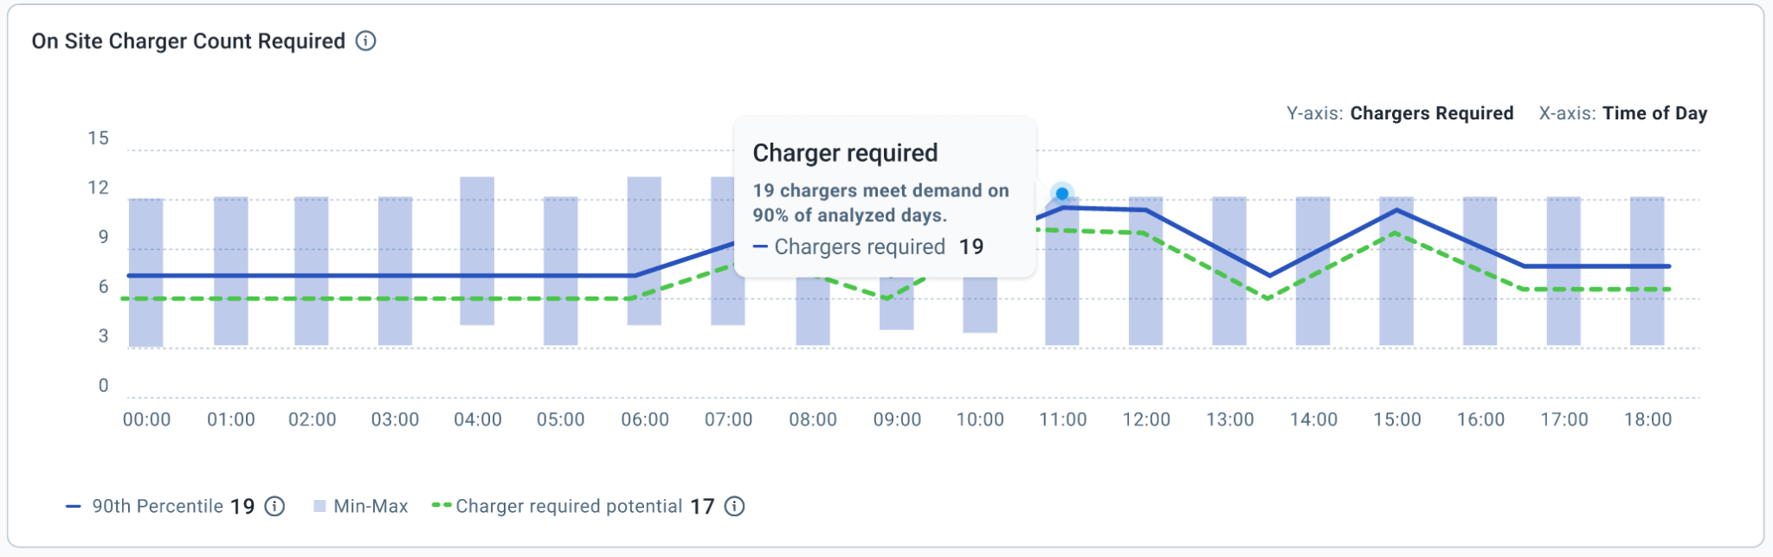
Charging infrastructure planning insights (coming soon)
Optimize capital investment:
Accurately simulate operations to determine the optimal number of chargers based on driving and dwelling patterns
Per-site Charging needs:
Number of chargers
Peak power load
Monthly energy projection
Compare multiple strategies:
Charging management
Queue management
Home charging potential

Slide 15
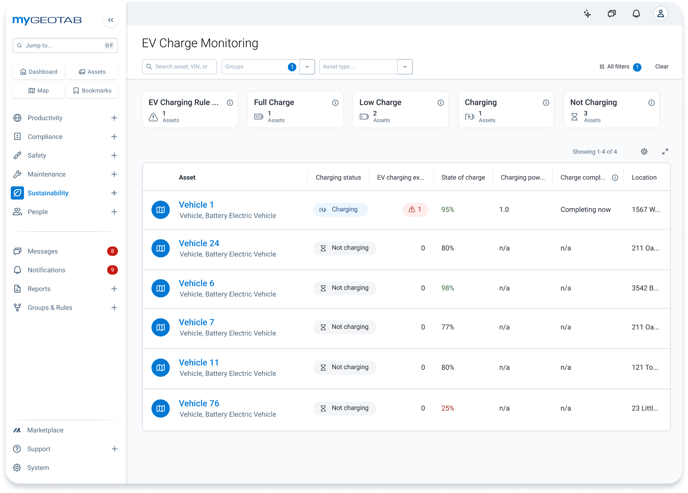


OPTIMIZE
EV Charge Monitoring
See the live charging status and key metrics for all electric vehicles, including:
Battery state of charge (%)
Charging power
Remaining range
Location
Effectively manage a queue of vehicles waiting to charge, and predict vehicle charging completion and range to inform dispatch decisions.
Configure rules to identify and resolve charging exceptions and problems (including those missed by charging station software).

Slide 16


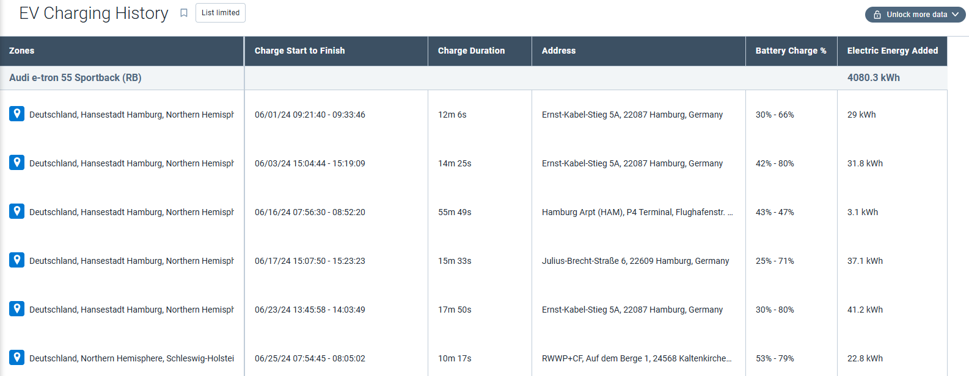




EV Charging History
OPTIMIZE
View and analyze the history of all charging events during a selected date period.
Identify patterns in EV charging history.
See per-session details for every EV:
Charging zone
Charge duration
Charge start to finish
Battery charge %
Location
Odometer reading
Understand where and when assets primarily charge and how much energy is added at each location.
Access the trip history related with the charge session.
Find cost-saving opportunities through charge optimization.

Slide 17
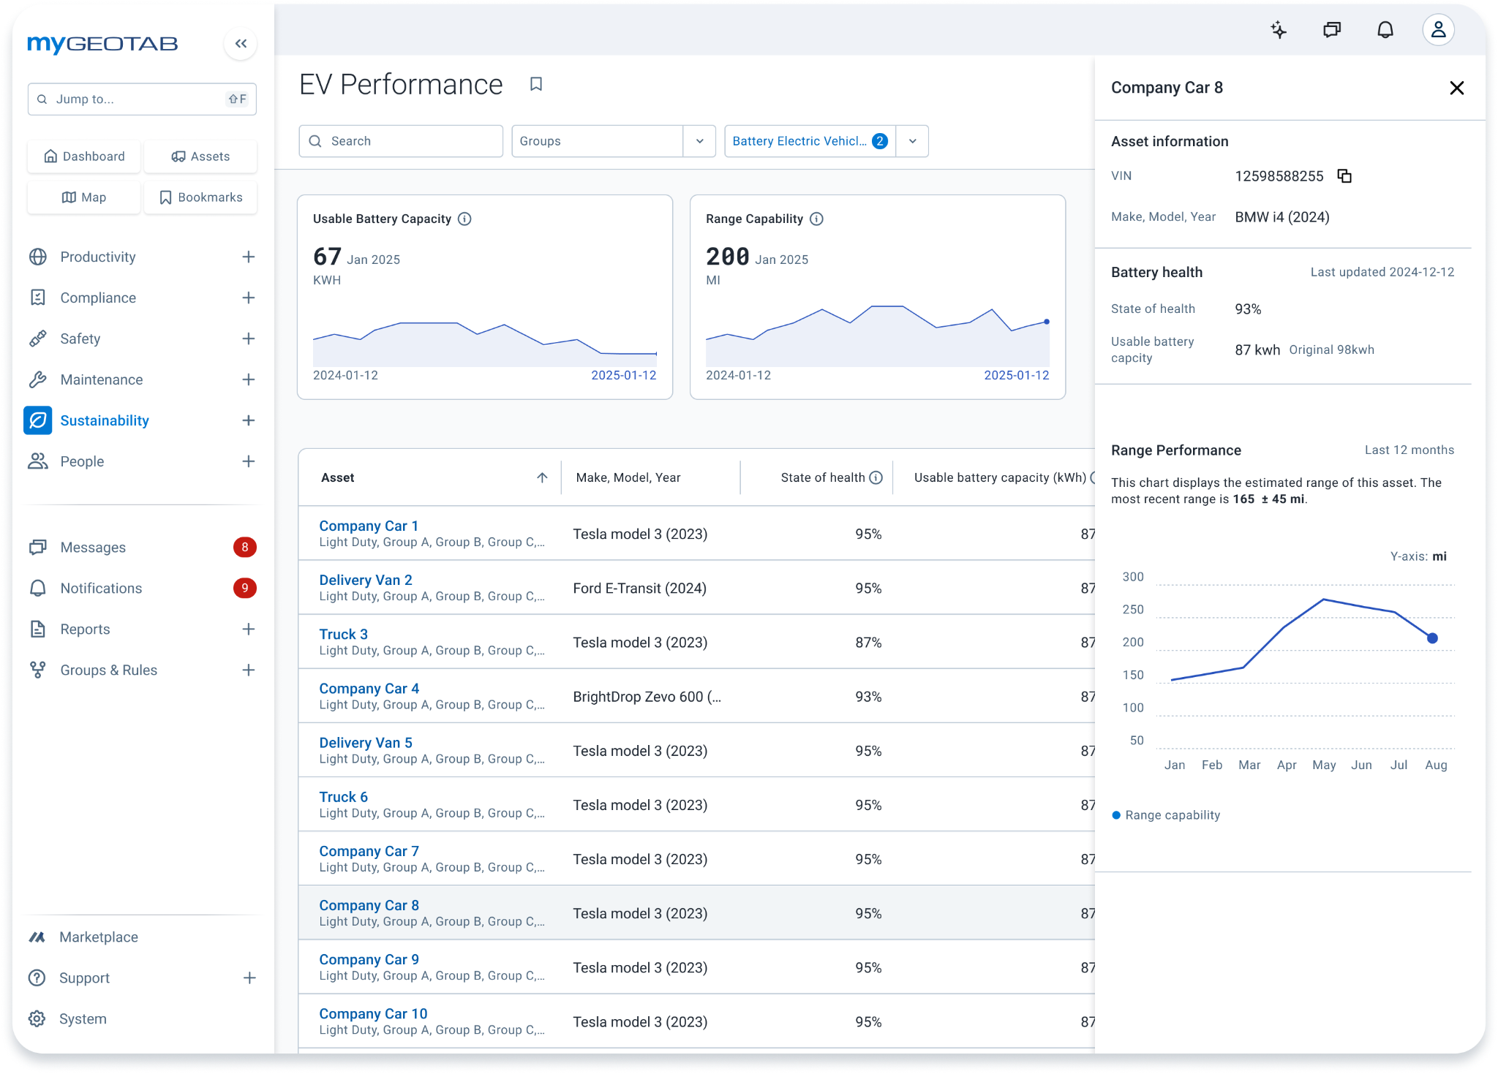



EV Performance
OPTIMIZE
Gain confidence in
your EV investment
Build your case for further adoption
View real-time and
seasonal variation in
range capability across
all makes and models.
Understand battery degradation impact
on service life and total
cost of ownership.
Monitor your useable
battery capacity and
battery state of health to understand degradation.
Identify and confirm EVs that can actually drive your routes.

Slide 18
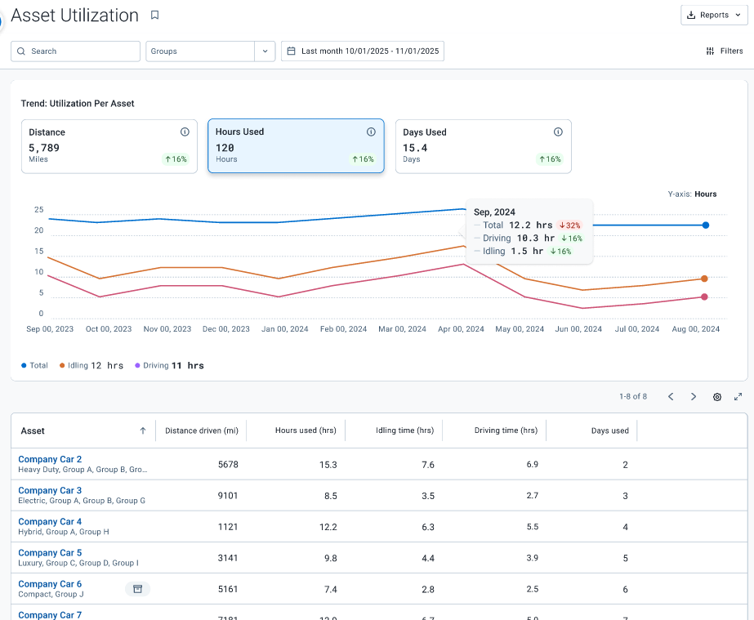
Asset Utilization
(coming soon)
OPTIMIZE
Optimize your entire fleet operation
Right-size your fleet
Identify underutilized assets that can be removed from the fleet without impacting operations.
Get more from your existing assets
Plan to pool assets or move them to other departments where they can get more use.
Rotate assets between high use departments and low use departments to balance wear and tear, extend service life.
Data-backed lifecycle management
Head into annual budget / procurement cycles with a data-backed plan for which vehicles to retire, which vehicles to keep, and which departments truly need additional vehicles to be procured.

Slide 19
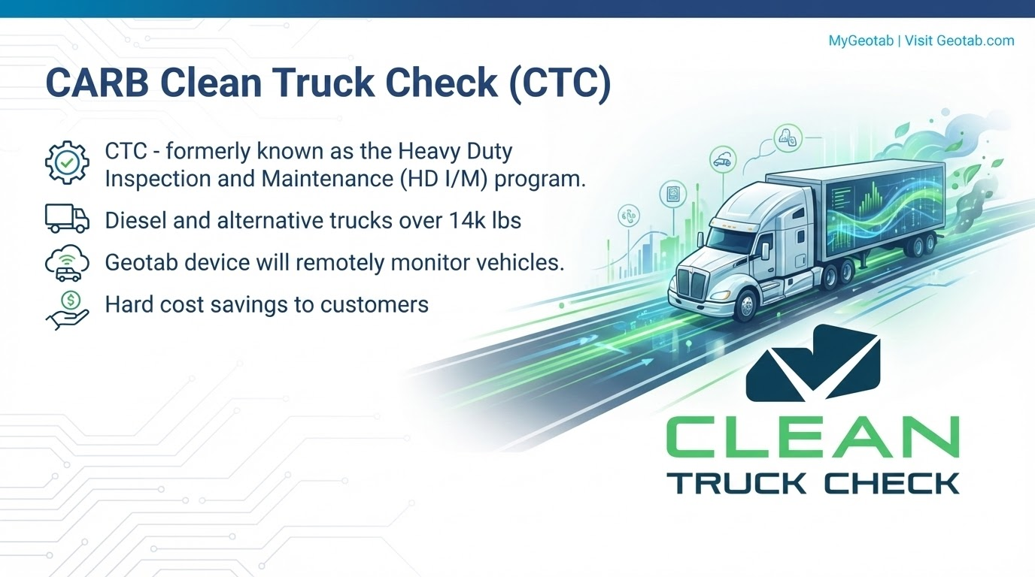

Slide 20
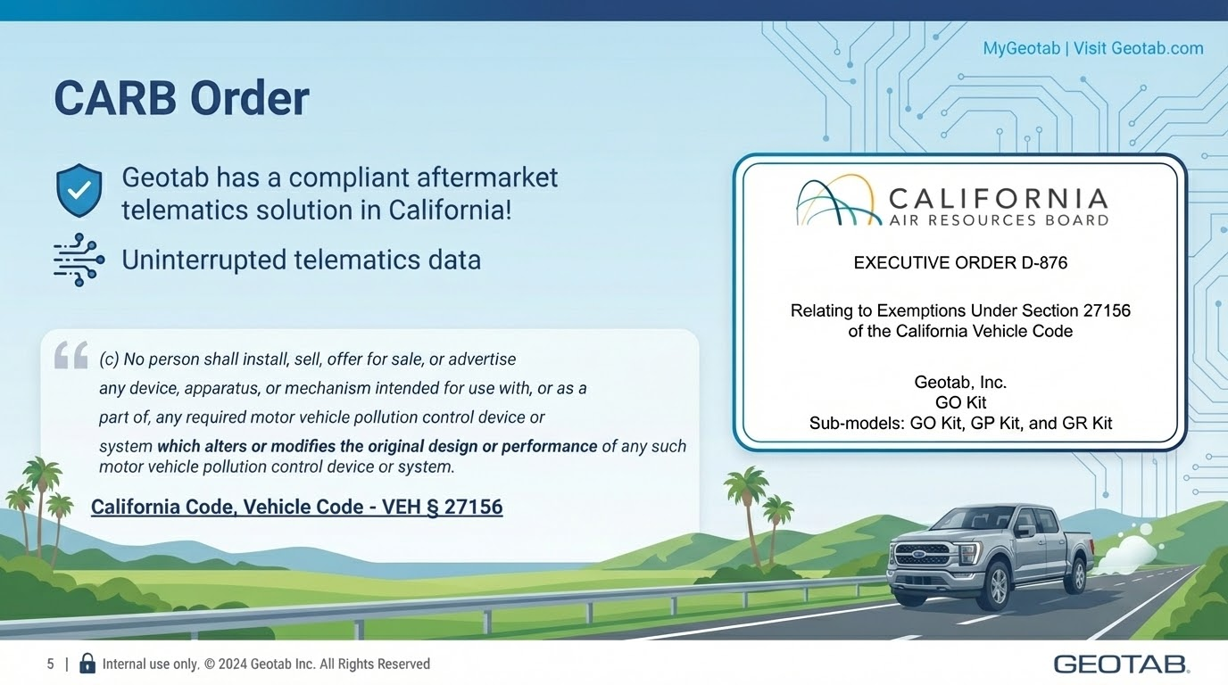

Slide 21
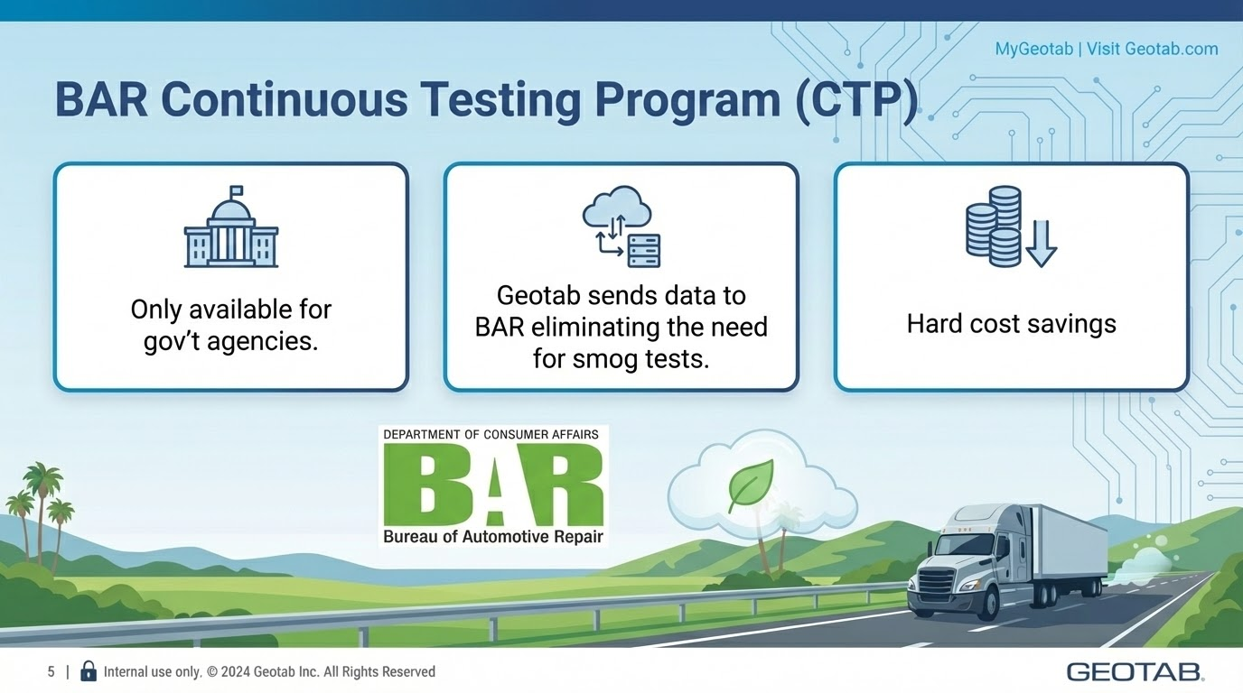

Slide 22
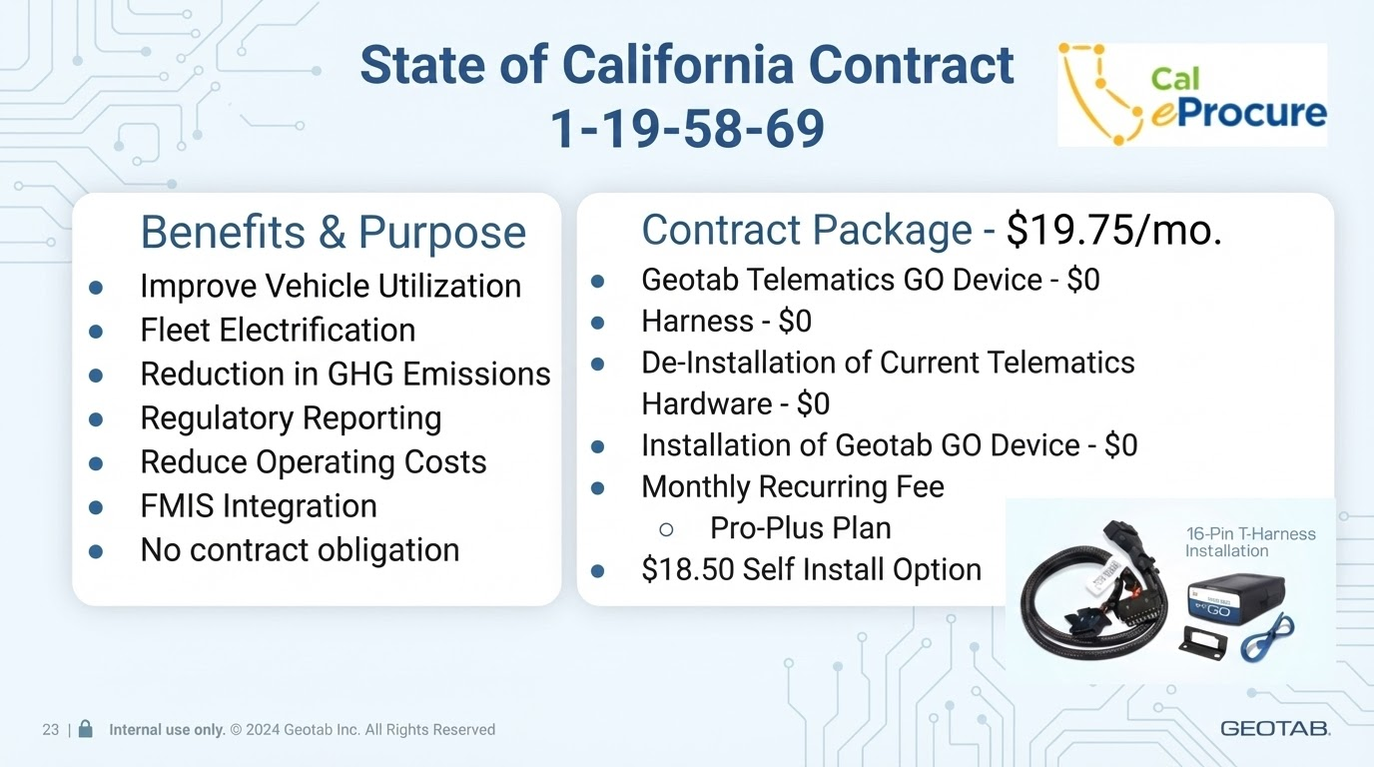

Slide 23
