Slide 1
Data-Driven Decision Making in the California State Fleet
Duane West
Fleet Policy and Reporting Manager
Department of General Services
Office of Fleet and Asset Management
Notes:
Good morning!
My name is Duane West, and I am the State Fleet Policy and Reporting Manager.
My role is to work with state agencies to provide—or validate—data related to their fleet acquisition plans. We ensure those plans align with state policy, including Zero Emission Vehicle (ZEV) transition goals, while minimizing operational disruptions.
Let’s get started. Next slide, please.

Slide 2
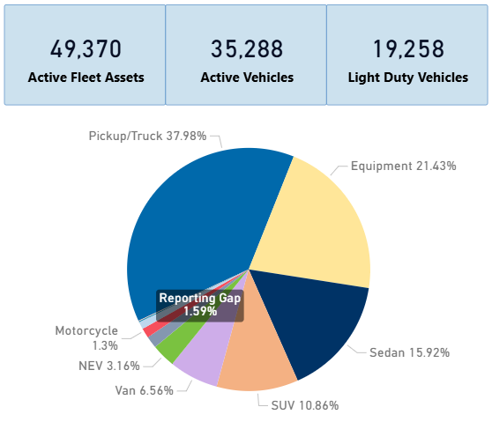
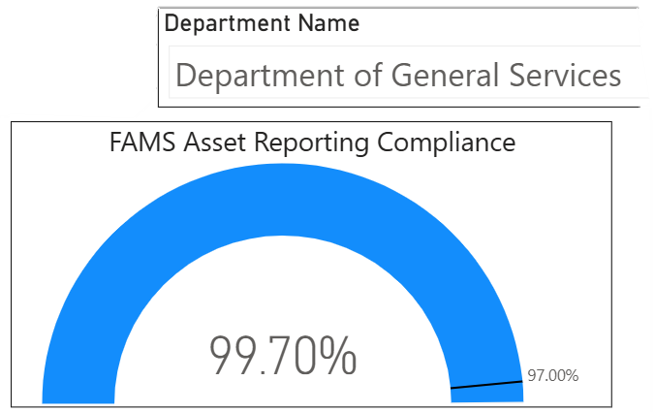
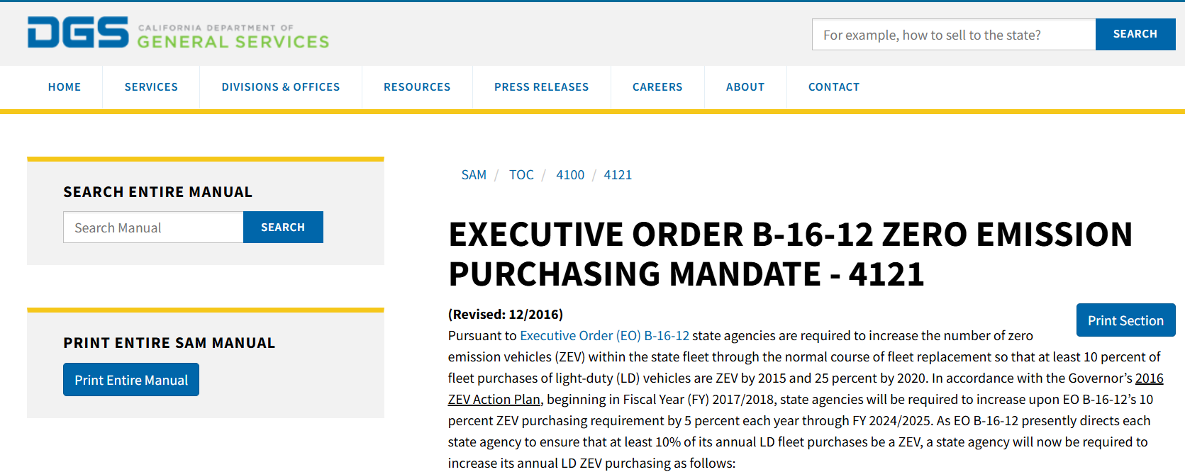
How the State Uses Data to Drive Fleet Decisions
Fleet Composition Reporting
Telematics and reporting analytics
Policy Development and Compliance Review
Notes:
The ZEV transition has created a strong need to become increasingly data-driven.
My team relies on several key sources:
Fleet composition reporting gives us a snapshot of what’s currently in a department’s fleet or the state overall.
Telematics and analytical tools provide real-world usage and historical insights.
Policy development and compliance reviews help ensure the state is meeting mandates, identifying areas for improvement, and using data to justify when ZEVs aren’t operationally feasible.
I’d like to walk you through a couple of examples where data-driven decision-making helped departments determine whether to transition to ZEVs.
Next slide, please.

Slide 3
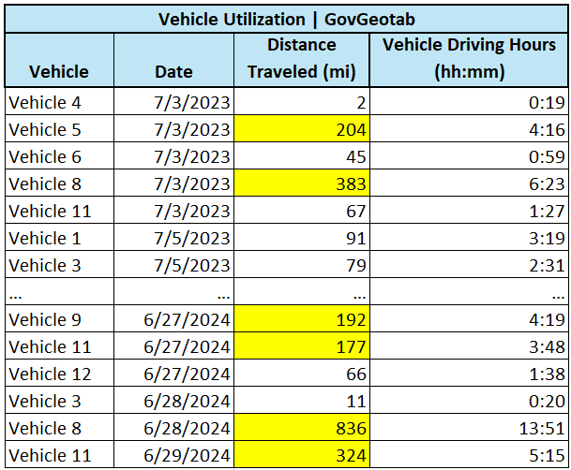
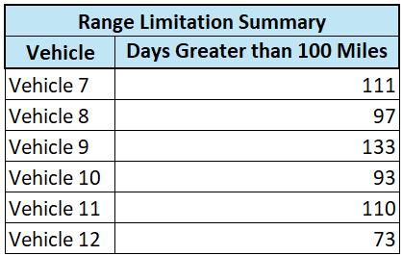
Telematics Data in Action
ZEV Range Limitation Exemption
Telematics Data from Geotab was provided by customer department shows actual usage over the previous fiscal year.
SMART compared this data to the range of a comparable ZEV model.
Six vehicles regularly exceeded the ZEV range, indicating a BEV would not meet operational needs.
Based on this analysis, a ZEV exemption was approved.
Exemption Approved
Notes:
Here’s a real-world example of how telematics data supported a ZEV exemption.
A department provided a year’s worth of telematics data showing that some vehicles frequently exceeded the daily range of a ZEV. These vehicles were often in the field all day, with no opportunity to stop and charge—meaning a “charger break” wasn’t feasible. The data showed that six vehicles clearly exceeded the ZEV range and were approved for exemption. But it also showed that another six could transition to ZEVs without issue.
This level of detail was key. Even though all 12 vehicles had the same job, their daily mileage varied significantly. Instead of treating them as one group, we evaluated them individually—revealing opportunities for ZEV adoption that might have been missed otherwise.
Next slide, please.

Slide 4
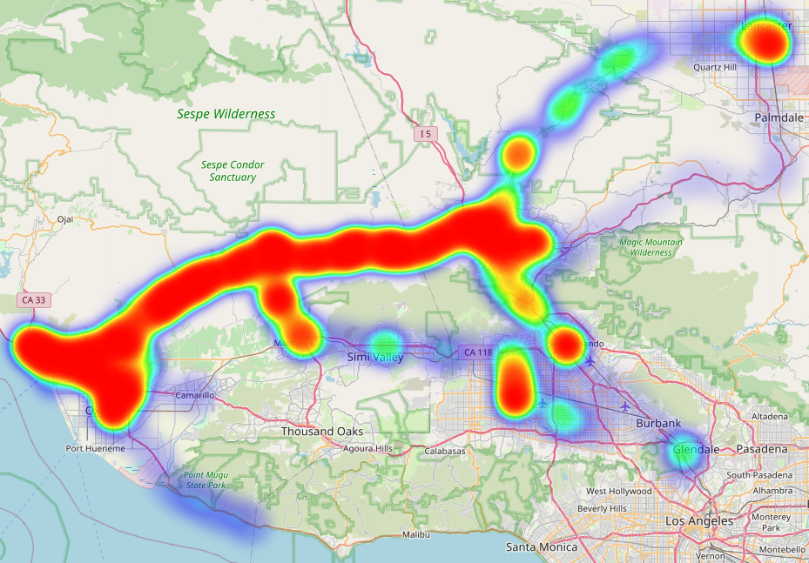
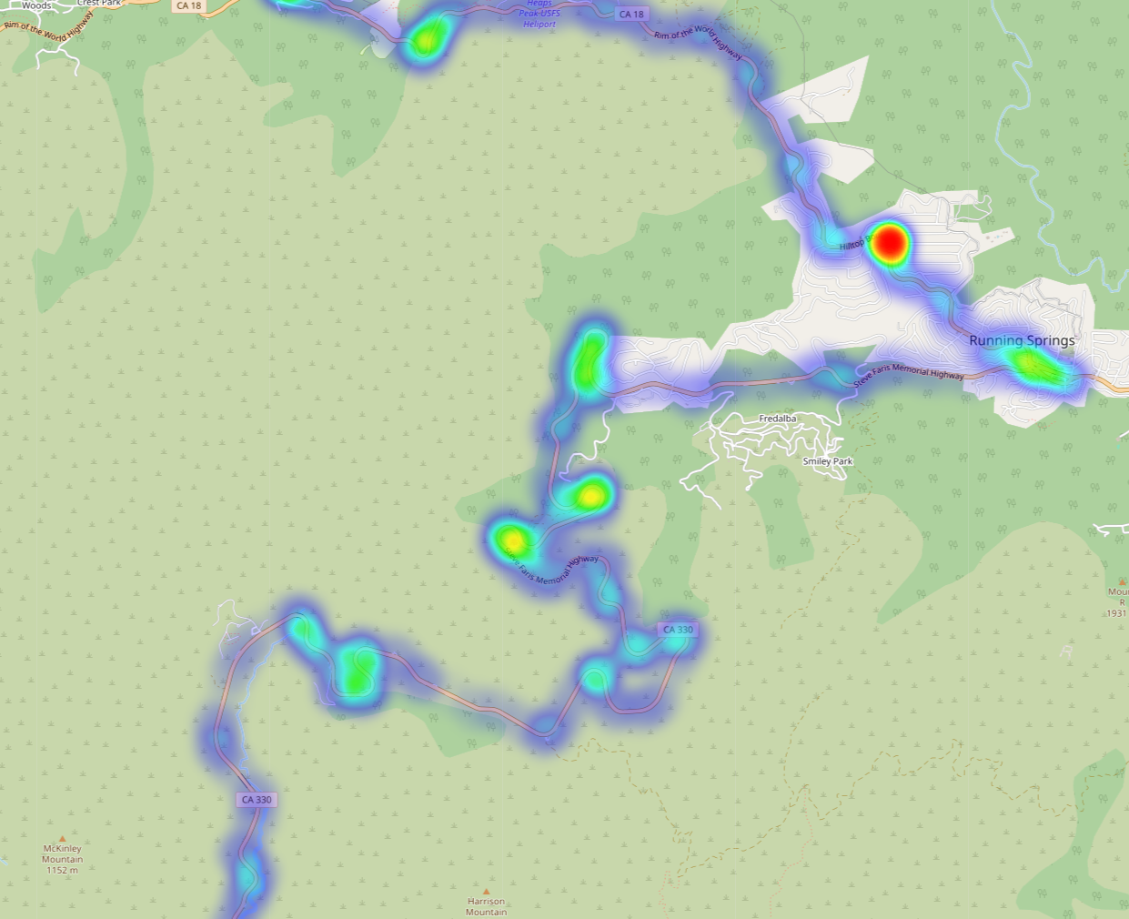
Telematics Data for Operational Needs
Heat Maps for Understanding Usage.
Notes:
Heat maps are another great tool for evaluating vehicle usage and ZEV feasibility.
Here are two examples from 2024:
The image on the left shows a vehicle operating mostly in a central area, with occasional trips to a nearby city.
The image on the right shows a vehicle operating in a much more remote region.
These heat maps are powerful on their own—but they become even more valuable when combined with other data sources.
Let’s take a closer look at the driver on the left. They initially claimed a ZEV couldn’t be used because he needed four-wheel drive for the snow in the winter.
Based on his job function, we knew he wasn’t working a typical office job. So, we dug deeper into the data.
Next slide, please.

Slide 5
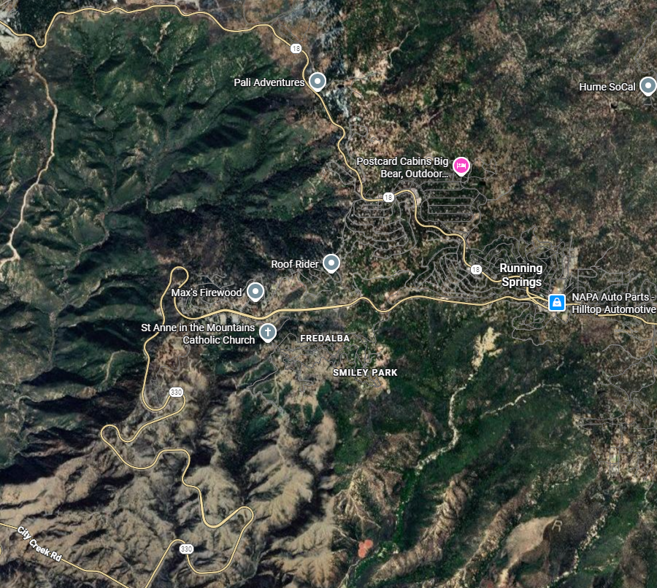
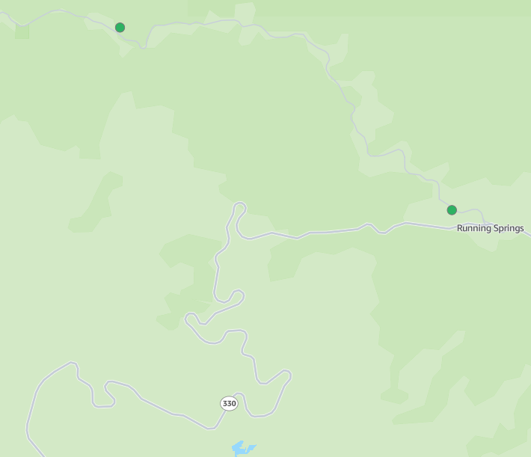
Telematics Data for Operational Needs
Heat Maps for ZEV Understanding Usage
4X4 Capability Needed
Limited EVSE Infrastructure
Google Satellite View
US Dept of Energy Charger Map
Notes:
A Google satellite view of the area confirmed that this driver operates in mountainous terrain. The data supported his claim—he genuinely needs a 4x4 vehicle to perform his duties, especially during the winter months when snow becomes a factor.
Another major consideration is charger infrastructure. A search using the U.S. Department of Energy’s public charger map showed there are only two charging sites in the area.
When you combine that limited infrastructure with the need for 4x4 capability and the reduced range ZEVs experience in cold weather—due to battery temperature, climate control, and terrain—it becomes clear that this driver is not a good candidate for ZEV transition… yet.
This is a great example of how combining telematics, mapping tools, and job function data can validate operational needs and support informed, data-backed decisions.
Next slide, please.

Slide 6
ZEV Transitions and Policy Compliance
Driving Change with Purpose
Look at fleet wholistically.
  Leverage redirections and swaps to open opportunities for ZEVs
Support when data proves limitations.
  When legitimate needs are taken seriously, it helps with buy-in.
Balance compliance with operational needs.
  Prioritize realistic transitions; let data justify exemptions
Notes:
Here are a few takeaways I’d offer to any fleet manager as they navigate ZEV transitions.
- First, look at the fleet wholistically. Instead of “Bob’s truck” or “Debbie’s Van”, try to keep vehicles flexible and open to being moved where they are needed most.
Second, support drivers when the data proves limitations. When you take the time to validate legitimate needs, it builds trust. It won’t stop all the exaggerated claims--like “I have to carry a jersey barrier in my truck everywhere.”—but it may help reduce them.
Finally, balance compliance with operational needs. Getting to compliance while maintaining operations AND making your drivers happy may not be possible. But using data--like the example of range limitation, or the driver in the mountains--allows you to approach with a scalpel, not a chain saw.

Slide 7
Questions?

