Slide 1

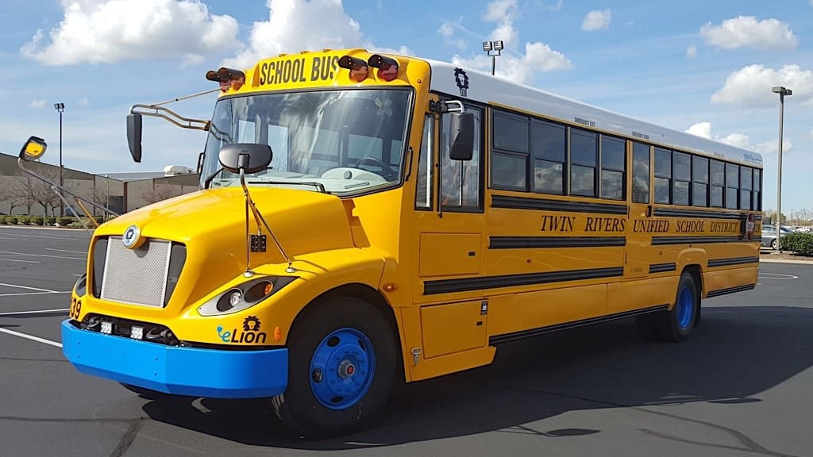
Specializing in service and PMs on orphaned and underserved Commercial BEVs
Providing hard to find parts and common parts for Commercial EV’s
Nation Wide Coverage
Technician, driver, and support personnel training, designed with safety in mind
EVSE PM and Repair Services
www.fleeteforce.com
303-970-4613
support@fleeteforce.com
4041 Bruin Blvd Suite 3 Longmont CO 80504
Ben Schroder President and COO

Slide 2
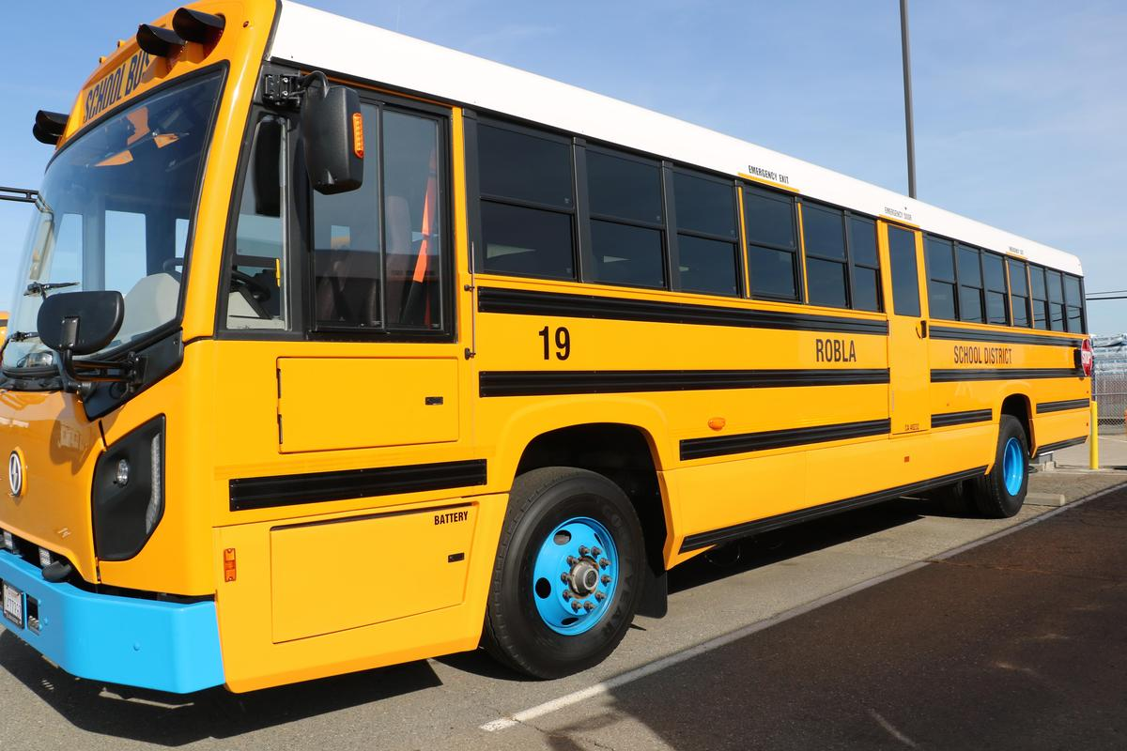
Diligently prepared to support Lion School bus
Starting in 2024 Fleet Eforce pursued Lion to become a support partner
Early 2025 we sent three employees to Lion technician training in Sacramento
Fleet EForce has hired 4 technicians who were previously employed with Lion. Including Davann Tim who was a senior support specialist for internal Lion technicians and customers.
Fleet EForce has recently purchased a large parts inventory of for all models of Lion, including a minimum of one vehicle of each Type C Generation, a type D bus, and a Lion Class 6 vehicle.
Fleet Eforce has begun rebuilding and securing supply chain to provide on-going parts support for Lion Buses
Fleet Eforce is actively pursuing real estate in Sacramento to open a parts distribution and service center in Northern California.

