Slide 1
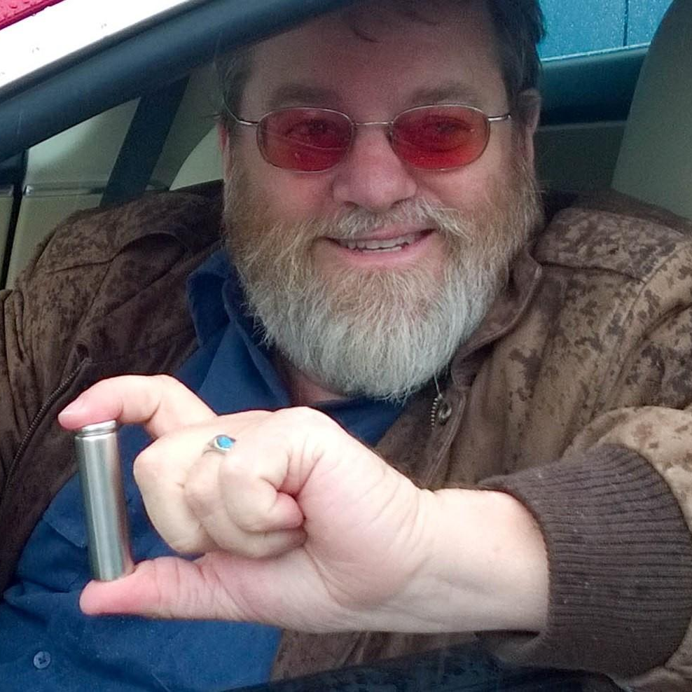

2025 Review and A Look Forward
Craig Stevenson

Slide 2
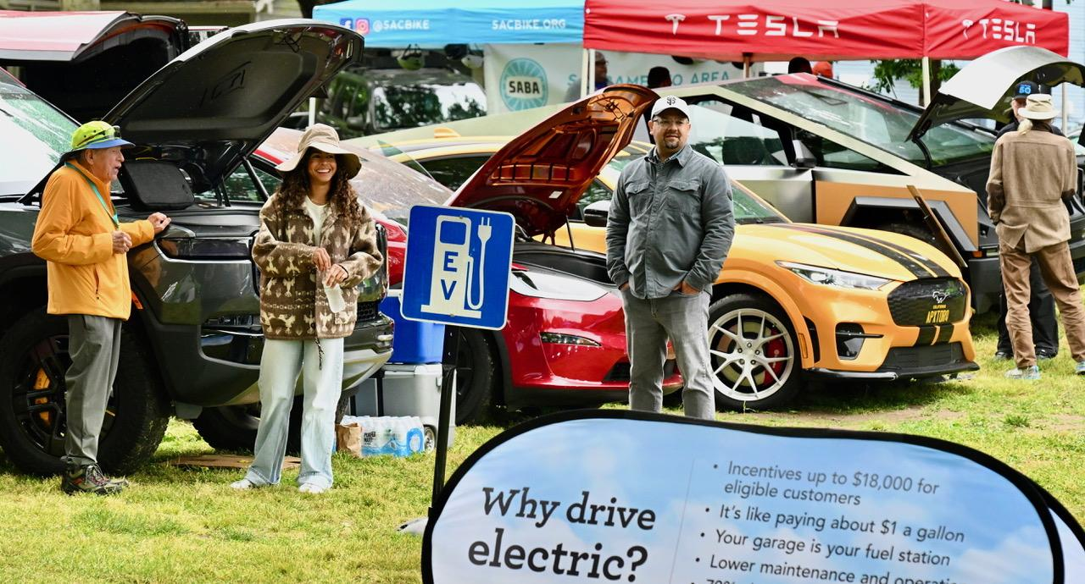
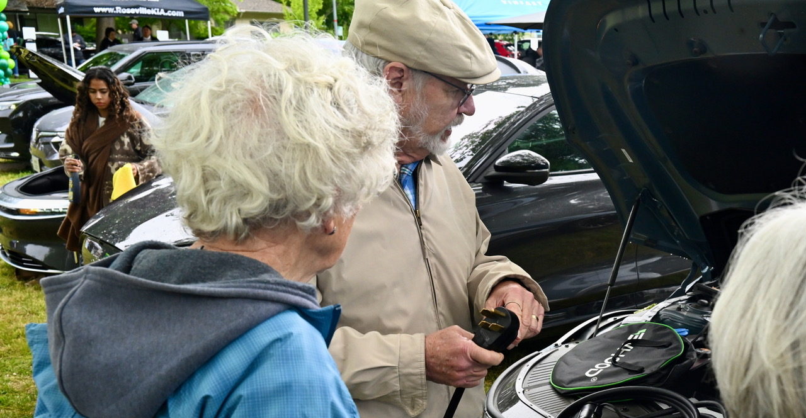
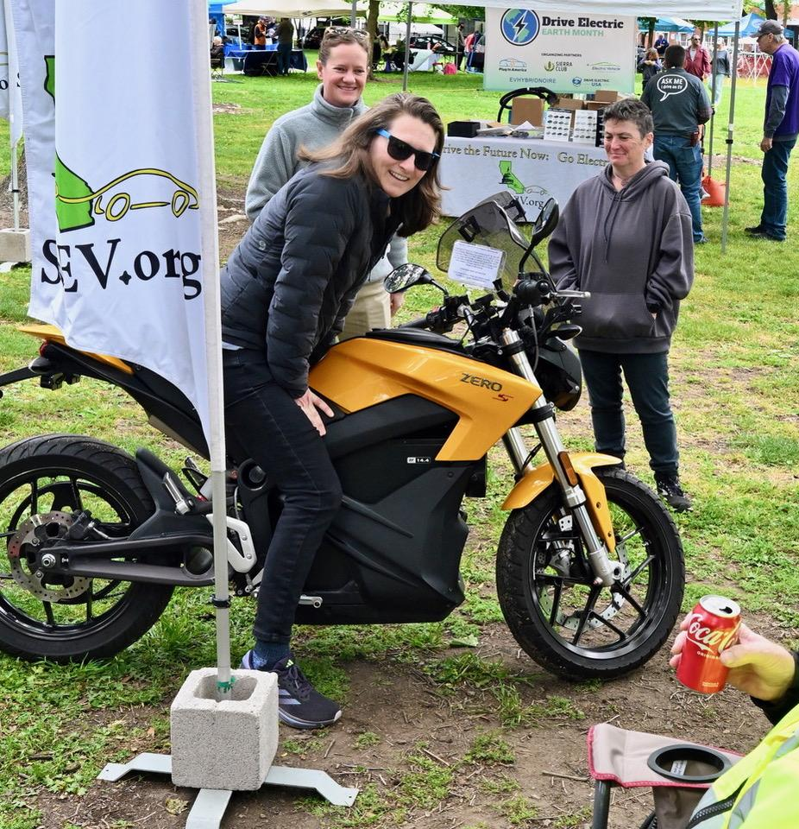
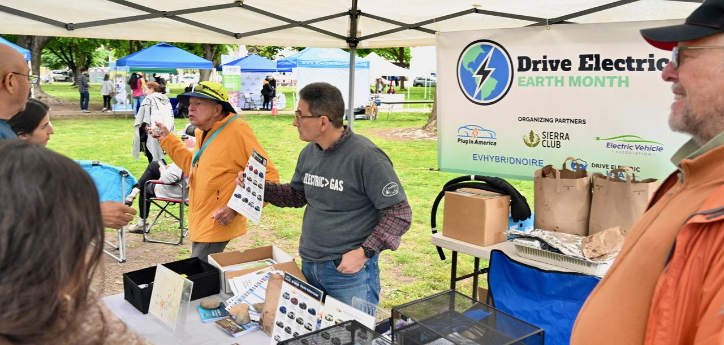
2025 Results
2025
Notes:
Events: NorCal Science Fair, SacEV General Meeting, California Capital Air Show, Stockton STEAM, Rosemont High School
CRC Earth Day, Arden fair mall Earth Day, ECOS Earth Day, May Day III (Del Paso Heights), Arden Fair Ride and Drive
Sunrise Farmers Market, Lake Tahoe Electric Transportation Forum, Sparkz, OG Lowrider x Wired Down Sacramento Festival and Car Show, EVs at Climate Justice, EVs @ Pavillon, Black Film Festival, Electricity Fair, School of Engineering
Number of conversations: 11- 899 per event

Slide 3

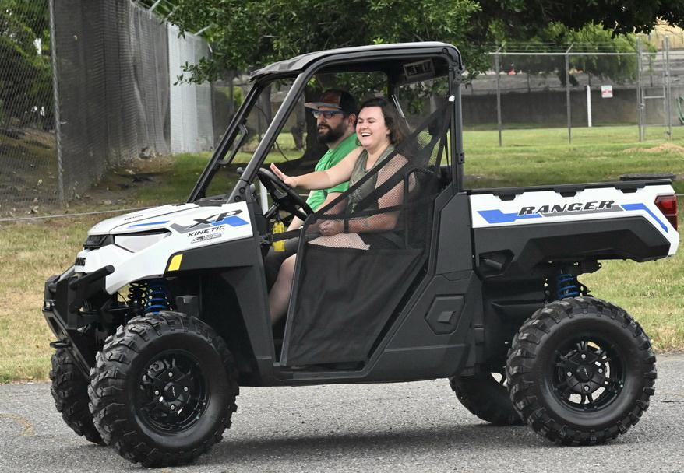
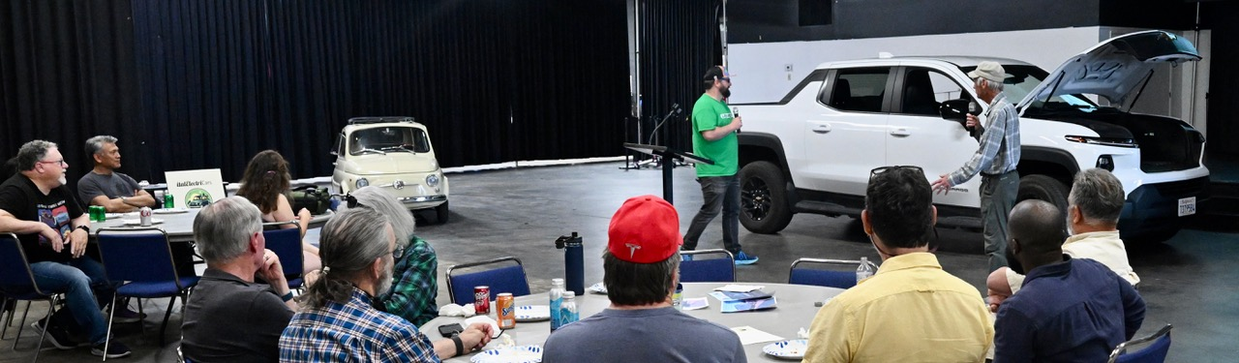
2025 Results
EVents: 24
Conversations: 3300
Volunteer hours: 773
EVs in Sacramento Region
ZEVs sold since 2010 - 146,893
ZEVs sold in 2025 26,114 (23%)
Mkt share Units .
Q4 2024 25%, 2025 7,276
Q4 2025 19%, 2025 5,075
Notes:
The ending of the $7,500 (new EV) and $2,500 (used EV) incentives ending in the 3rd qtr, pulled EV sales up from the 4th qtr into the 3rd. The real
Conversations: We don’t track number of people, we track conversations. A potential EV buyer will need more than one conversation to understand EVs. The more conversations, from more people, the better.
Events: NorCal Science Fair, SacEV General Meeting, California Capital Air Show, Stockton STEAM, Rosemont High School
CRC Earth Day, Arden fair mall Earth Day, ECOS Earth Day, May Day III (Del Paso Heights), Arden Fair Ride and Drive
Sunrise Farmers Market, Lake Tahoe Electric Transportation Forum, Sparkz, OG Lowrider x Wired Down Sacramento Festival and Car Show, EVs at Climate Justice, EVs @ Pavillon, Black Film Festival, Electricity Fair, School of Engineering
Number of conversations: 11- 899 per event
Sac Region EV sales:
2024 Q4 7,276.17, 2025 Q4 5,075
Q4 2024 7,276, 2025 5,075
Q4 2024 25.5%, 2025 19% of light duty vehicle sales
New EV ATP: The average transaction price (ATP) for new EVs in January was $55,715, down 0.6% year over year and 3.1% lower month over month. The EV premium over ICE+ narrowed to $7,098, the slimmest gap since July 2025.
Looking Forward: As the year progresses, the EV market is likely to remain uneven, with elevated new‑vehicle inventory and cautious consumer demand continuing to pressure volumes and pricing.
https://www.coxautoinc.com/insights/ev-market-monitor-january-2026/

Slide 4
J.D. Power: EV Interest Surging
Returning EV Lessees Double-Down on New EVs
  94% say “definitely will” or “probably will”
EV Consideration Surges in October
  expect to consider an EV in next 12 mos at
  24.2% in Oct, up from 21.6% in Sept.
Lower Cost of Ownership is Top EV Purchase Driver
Notes:
JD Power: Mass market BEV quality continues to outperform premium BEVs

Slide 5

Used EV Market Thriving
Recurrent: Used EV Market Thriving
December sales up 10.2% year over year
2025 used EV sales increased 35% from 2024
“More than 300,000 EVs are expected to come off lease in 2026 alone, and they are about to flood the used car market” Simran Rastogi, Autoblog
Notes:
Here’s another change as we go into 2026. We’re not just talking about new car sales. The used EV market is picking up.
Hundreds of Thousands of Lightly Used Electric Cars About to Hit US Market https://cleantechnica.com/2026/03/13/hundreds-of-thousands-of-lightly-used-electric-cars-about-to-hit-us-market/
Recurrent: Used EV Market Thriving with 35% Growth
Most forecasts correctly projected a loss of momentum in new EV sales in Q4 2025 after 6 years of steady growth. However, surprising news came from the used EV sector:
December sales were up 10.2% year over year
December sales rose 9.7% from November
Total 2025 used EV sales increased 35% from 2024
https://www.recurrentauto.com/research/used-electric-vehicle-buying-report
https://www.coxautoinc.com/insights/ev-market-monitor-january-2026/
Bloomberg: The 2026 U.S.-Israel war with Iran is boosting EV interest by surging gasoline prices, leading to immediate spikes in buyer interest and potential sales. While rising oil prices strengthen the case for electric vehicles, the conflict also threatens to disrupt automotive supply chains, potentially increasing production costs and interest rates.
$4 gas prices are the tipping point for drivers to make the switch
https://www.bloomberg.com/news/articles/2026-03-14/iran-war-reignites-ev-interest-in-us-markets

Slide 6
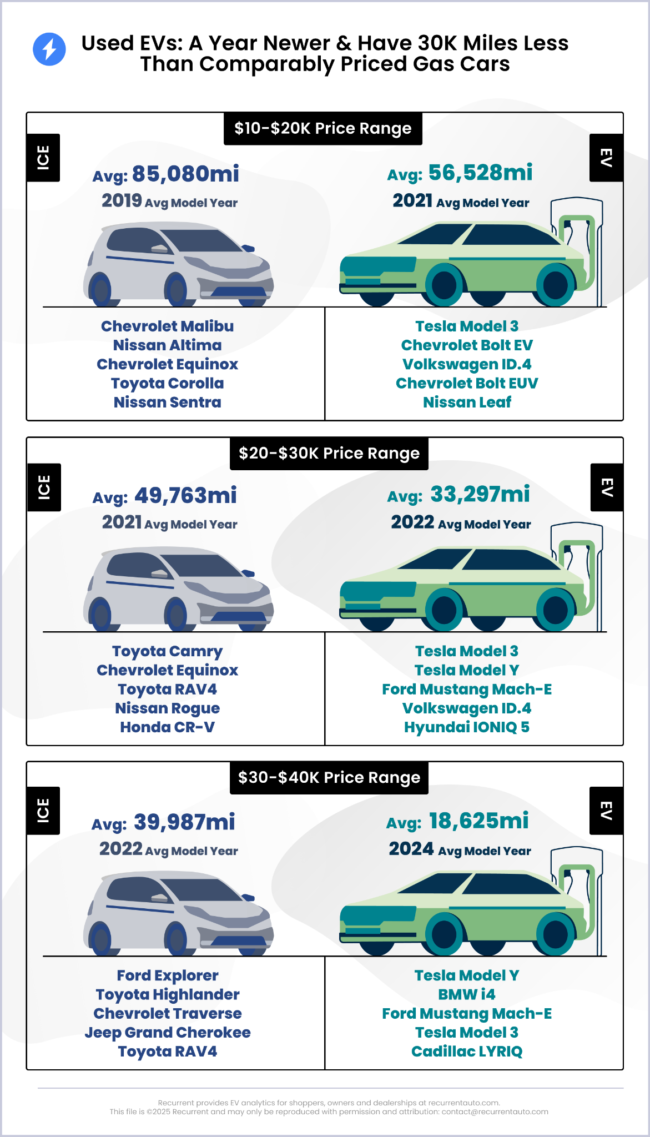
Used EVs are 1 year newer with 30K miles less
Notes:
Used EV Value Advantage Is Growing
Used EV inventory offerings remain well poised to compete with gas cars, offering newer models and low mileage on lease returns:
55% is 2023 or newer; 68% 2022 or newer; 82% is 2020 or newer
39% of models selling for under $25,000
https://www.recurrentauto.com/research/used-electric-vehicle-buying-report

Slide 7
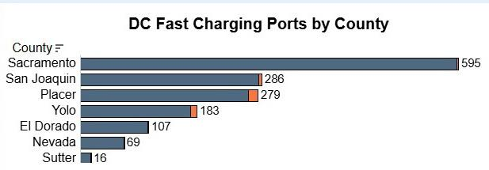
DCFast Chargers 2025
1555 DCFast Chargering Ports in Sacramento Region
Notes:
The US added 4,200 new DC fast charging ports - https://electrek.co/2025/07/28/the-us-added-4200-new-dc-fast-charging-ports-and-thats-just-q2/
Up from 743 DCFCs in 2022,

Slide 8
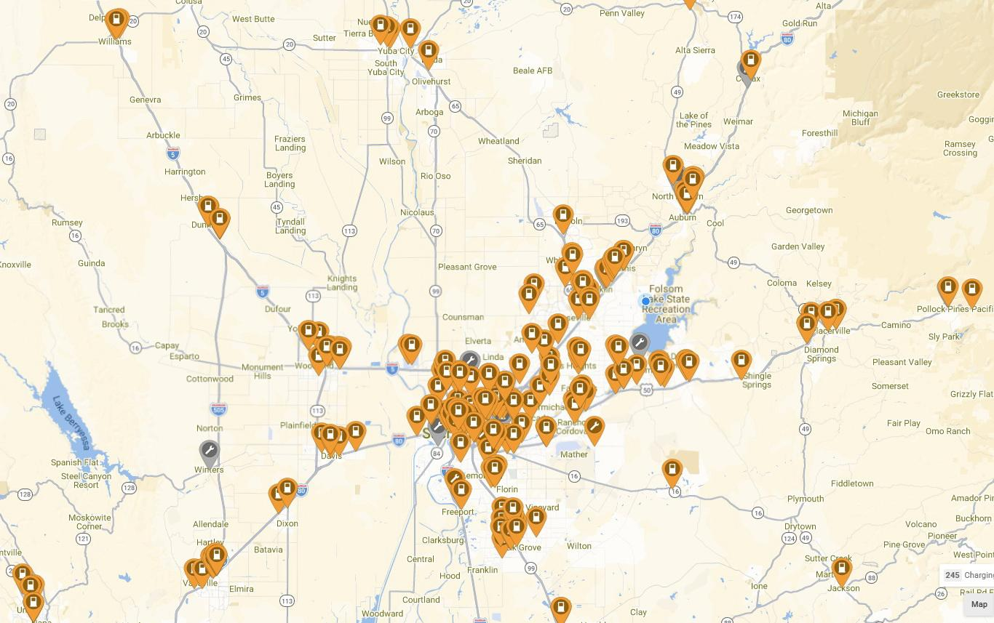
DCFast Chargers 2025!
1555 DCFast Chargering Ports in Sacramento Region
The US added 4,200 new DCFast Charging ports in Q2
245 Stations
Notes:
The US added 4,200 new DC fast charging ports - https://electrek.co/2025/07/28/the-us-added-4200-new-dc-fast-charging-ports-and-thats-just-q2/

Slide 9
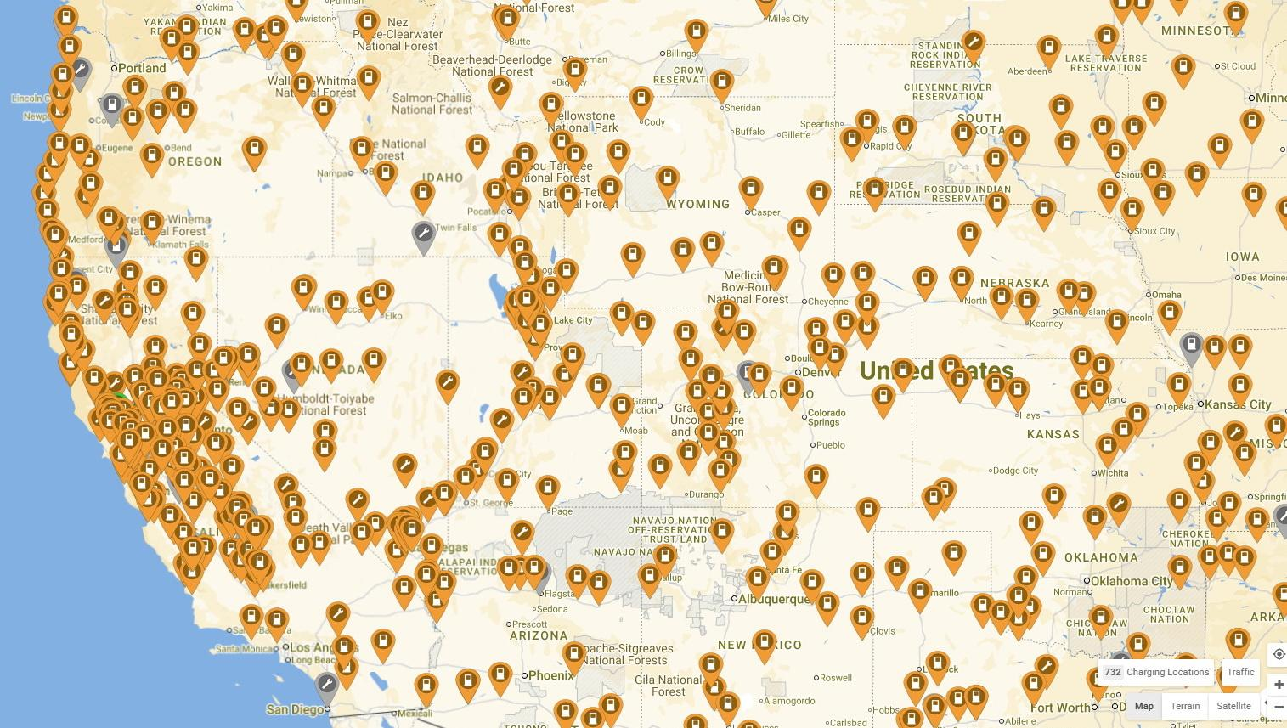
DCFast Chargers 2025!
Q2: US added 4,200 DCFC ports
732 Stations
Notes:
The US added 4,200 new DC fast charging ports - https://electrek.co/2025/07/28/the-us-added-4200-new-dc-fast-charging-ports-and-thats-just-q2/

Slide 10
Earth Month 2026!
Sac City College, | Tue. Apr 11th
Fairytale Town | Sat. Apr 18th
Cosumnes River College | Wed. Apr 21st
ECOS Earth Day | Sun, Apr 26th
Details in SacEV newsletters or info@SacEV.org

Slide 11
Post Earth Month 2026!
Event | Date
Rancho Cordova iFest* | Saturday, May 9, 5 - 8
Arden Fair Mall** | Saturday, July 11
North Natomas Farmers Market** | Saturday, September 19
Celebrate North Highlands** | Sunday, September 27*
CA Capital Airshow** | Sat - Sun, October 10-11
Details in SacEV newsletters or info@SacEV.org
*w/ChargeAcrossTown **w/SMUD

Slide 12
New Veloz Survey Reveals Which Messages Break Through
Most motivating EV messages:
EVs require less maintenance – you will never have to change your oil or get a tune-up
Charge your EV at home while you sleep using a standard home outlet without extra equipment
Today’s EVs have 300+ miles of range, as much as an average gas car
Skipping the gas station saves drivers up to $2,000 per year and up to $10,000 over the life of the car
EVs cost on average $15.26 to fully charge at home compared to $43 to fill a gas tank
EVs can easily handle weekend trips and longer drives with today’s expanded public charging network
EVs come in a wide range of models: sedan, SUV, truck, crossover, all-wheel drives, and more
Notes:
The survey, released by the national nonpartisan nonprofit Veloz and conducted by BSP Research, finds that practical convenience benefits, including charging while you sleep, fewer maintenance needs, and up to 300+ miles of real-world driving range, increased interest in EVs. Even respondents who began the survey more hesitant of EVs, were moved to consider making the switch to electric. The finding highlights how everyday convenience and time savings are proving more persuasive than horsepower, rebates, or sustainability when consumers weigh EVs against gas-powered cars.
“Interestingly, what changes minds most about EVs isn’t just the technology, it’s the ease of driving electric,” said Josh D. Boone, Executive Director of Veloz. “When people understand they can charge while they sleep, avoid dreaded oil changes, and drive hundreds of miles on a single charge, interest in EVs rose. This survey shows EV interest isn’t ideological, it’s informational.”
Savings-related messages also appear to have a sizable impact among respondents. Results showed increased willingness to purchase EVs by a meaningful margin, through core messages about how much drivers can save by driving a vehicle with less maintenance and lower operating costs.
149 Light-Duty Models Available in California
https://www.veloz.org/whats-changing-consumers-minds-about-evs-new-survey-reveals-which-messages-break-through/

Slide 13

Mar 2026
Connect with SacEVA at info@SacEV.org
Get the free newsletter about region EV news and event: https://www.SacEVA/
General questions or request/join an EVent: Info@SacEV.org
Craig Stevenson Craig.Stevenson@SacEV.org
Guy Hall Guy.Hall@SacEV.org

Slide 14
Mar 2026

Slide 15
Hundreds of Thousands of Lightly Used EVs About to Hit US Market
More than 300,000 EVs are expected to come off lease in 2026 alone, and they are about to flood the used car market”
Simran Rastogi, Autoblog
Notes:
Here’s another change as we go into 2026. We’re not just talking about new car sales. The used EV market is picking up.
Hundreds of Thousands of Lightly Used Electric Cars About to Hit US Market https://cleantechnica.com/2026/03/13/hundreds-of-thousands-of-lightly-used-electric-cars-about-to-hit-us-market/
Recurrent: Used EV Market Thriving with 35% Growth
Most forecasts correctly projected a loss of momentum in new EV sales in Q4 2025 after 6 years of steady growth. However, surprising news came from the used EV sector:
December sales were up 10.2% year over year
December sales rose 9.7% from November
Total 2025 used EV sales increased 35% from 2024

