Slide 1
Sacramento Region Hydrogen Efforts
Presenter: Victoria Peña
Associate Air Quality Specialist

Slide 2
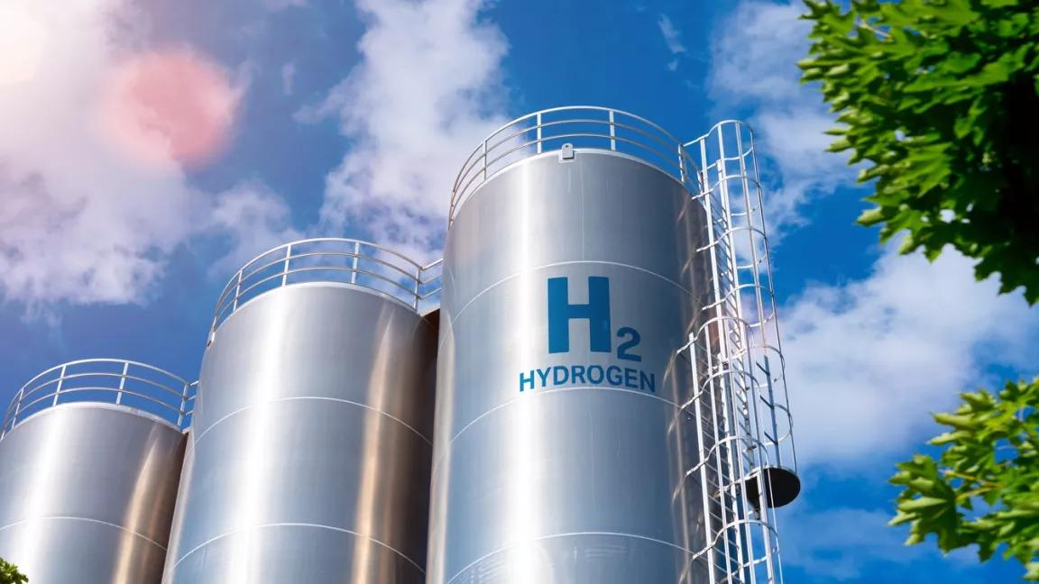
Transportation and Climate Change Division
Hydrogen Efforts:
Projects in Progress
Challenges of Hydrogen Projects
Continuing Advocacy for Hydrogen

Slide 3
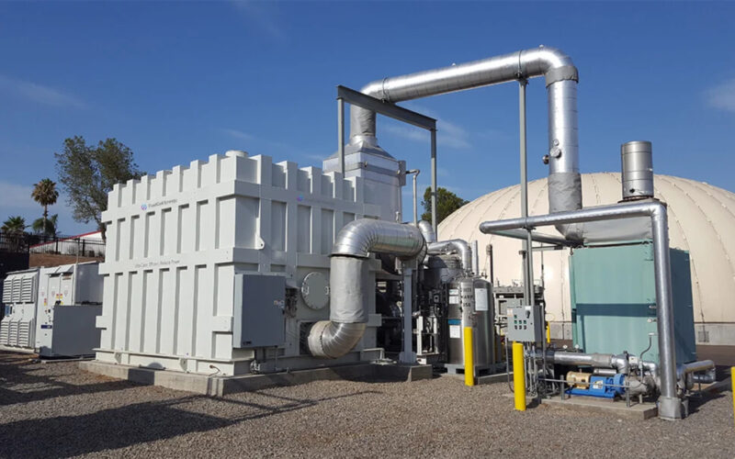
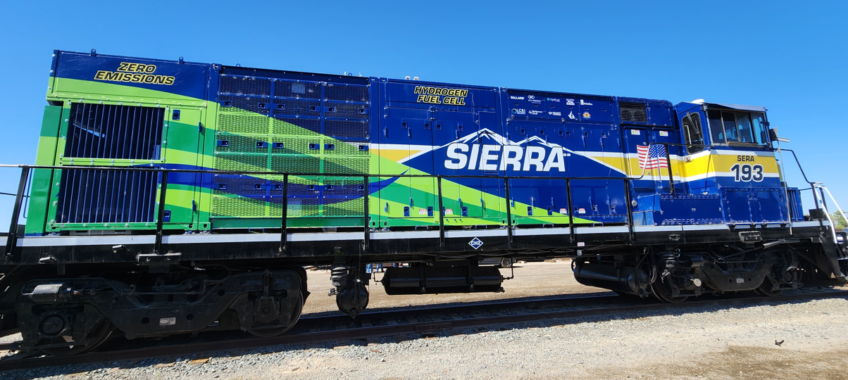
Projects in Progress
Sierra Northern Railway, Port of West Sacramento
First Hydrogen Fuel Cell Locomotive Switcher
1 of 4 switcher conversions is complete
100 kW fuel cell
Project stakeholders: CEC, SMAQMD, GTI Energy
Sacramento Sewer District using biogas to
generate energy, using electrolyzer technology
Integrated 13.4 MW cogeneration plant
Potential to produce hydrogen
Estimated to be fully operational by Q4 2026

Slide 4
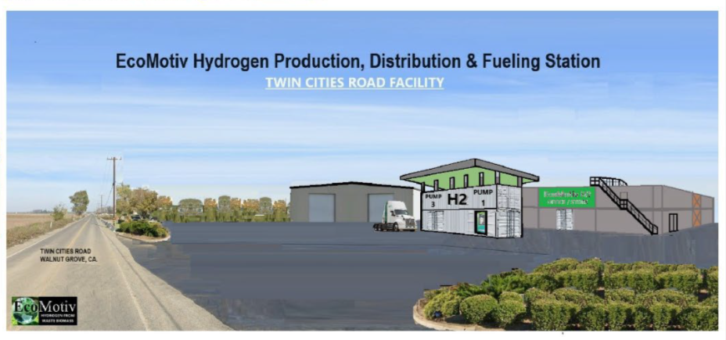
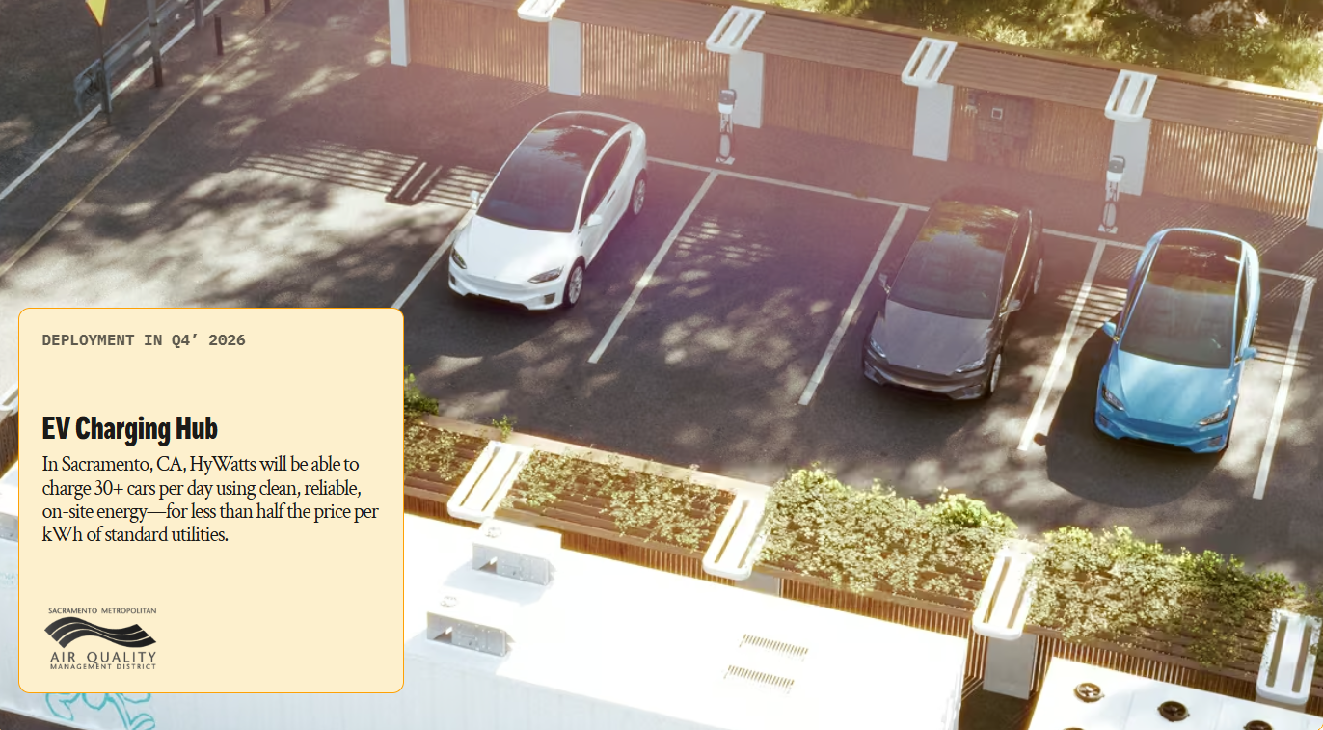
Projects in Progress
EcoMotiv LLC: Twin Cities Road & I - 5
Biomass to Hydrogen Conversion Facility
H2 Production & Fueling
500 kg/day up to 5000 kg/day of gaseous hydrogen
HyWatts project: hydrogen - assisted solar EV fast charging infrastructure
Using solar & hydrogen to reduce grid impact and improve resiliency
Workforce development with SAVA
Notes:
-Facility provides a cleaner alternative to ag burning in our County, as well as local hydrogen production for transportation fuel, including the Sierra Northern Railway locomotive switchers
- Biomass to Hydrogen Conversion Facility: using agricultural and forest biomass
They are in the early stages of the County permitting process
Because this is a new type of facility in the County. EcoMotive is facing challenges with the County as it goes through the land entitlement or zoning process
We are doing our best to help them navigate this process
HyWatts

Slide 5


Challenges of Hydrogen
Navigating the Regulatory Complexities:
Multiple jurisdictions are involved in permitting: State and Local
Lack of familiarity with hydrogen infrastructure at the local level
Meeting the liquidation timelines of grant funding

Slide 6
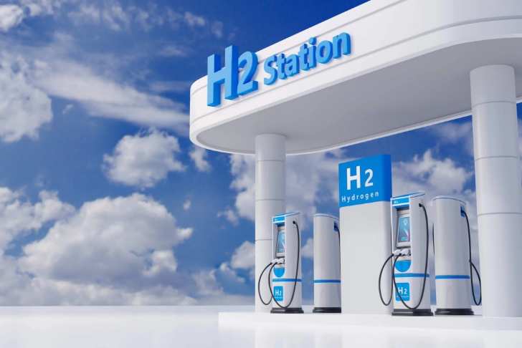

Meeting Project Challenges
CEQA & Permitting
Consult Early & Often:
- Air District,
- Planning Department,
- Fire Department,
- CUPA
A clear understanding of the project
Building public and private relationships

Slide 7
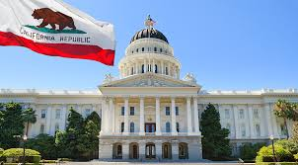
Continuing Advocacy for Hydrogen
Hydrogen Fuel Cell Partnership:
Access to key stakeholders, both public & private
Creating a collaborative forefront to bring hydrogen projects to Sacramento and California
Addressing the challenges of hydrogen projects (education & permitting process)
Lobby Day in Sacramento:
California Hydrogen Coalition
Focus on how hydrogen plays a role in reducing emissions in our transportation sector and provides energy resilience
Sharing the challenges of hydrogen projects

Slide 8
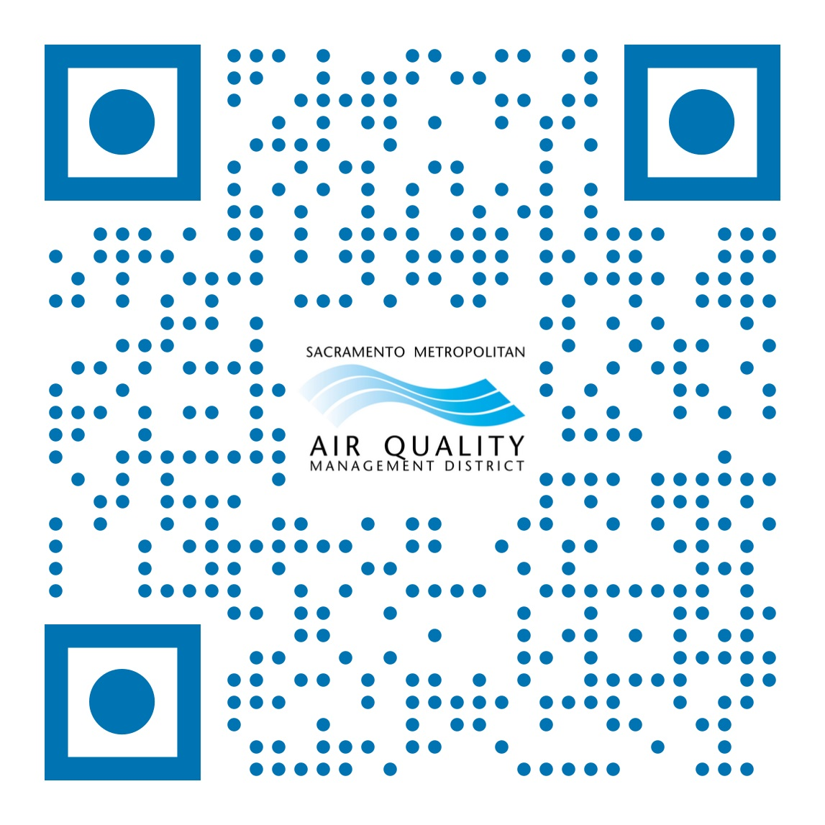
Thank You
Questions? vpena@airquality.org

